Slide 1
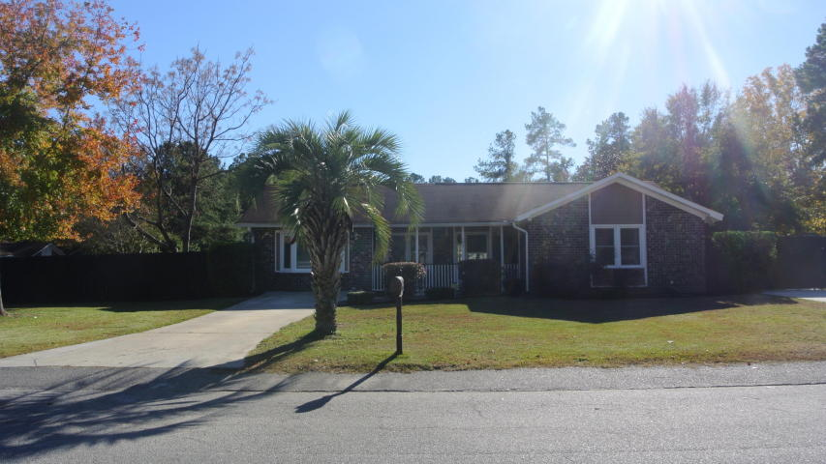
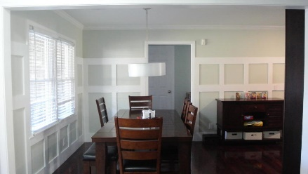
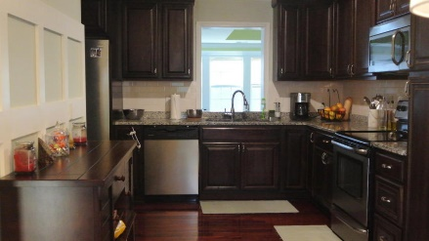
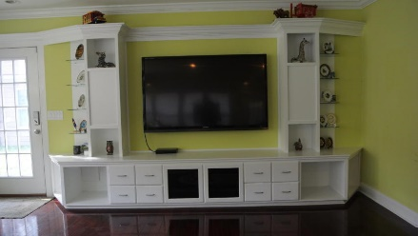
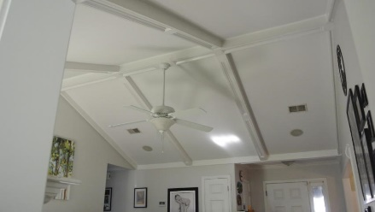
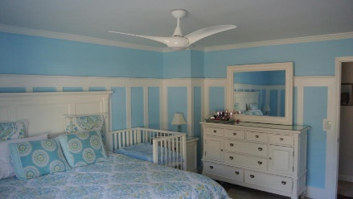
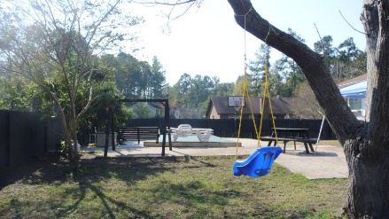
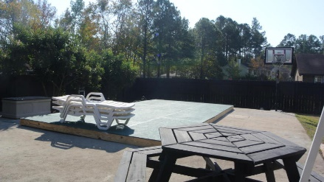
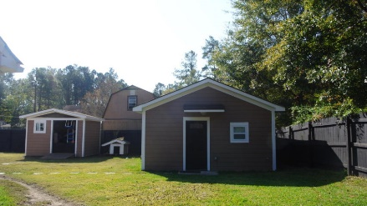

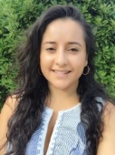
Bring your Buyers!
101 Wadmalaw Circle
Palmetto Park ~ Summerville ~ MLS# 16029817 ~ $192,000
Beautiful 4 bedroom 2 full bath brick home PLUS Mother-in-law suite (separate building) with kitchenette and full bathroom in the back of property. Minutes from Downtown Summerville, Dorchester II school district. Home has been upgraded with hardwood floors throughout, crown molding, media built-ins, huge sunroom with built in bar, underground vinyl pool. Come check it out!
Ana Marcela Ruiz
Mobile - (843) 900-4363
charlestonmrealtor@gmail.com
ERA Wilder Realty, 125-F Wappoo Creek Dr, Charleston, SC 29412

