Slide 1
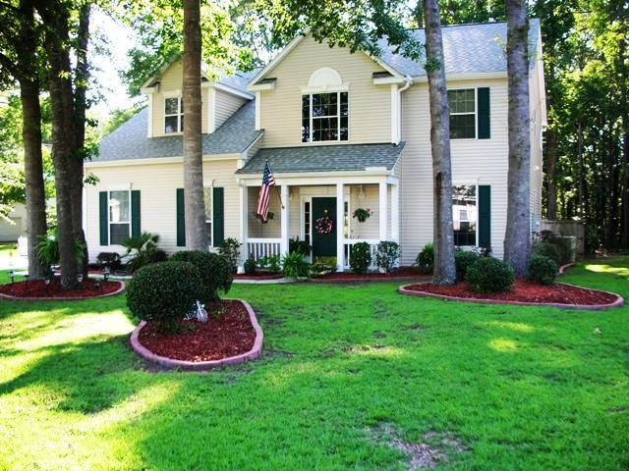
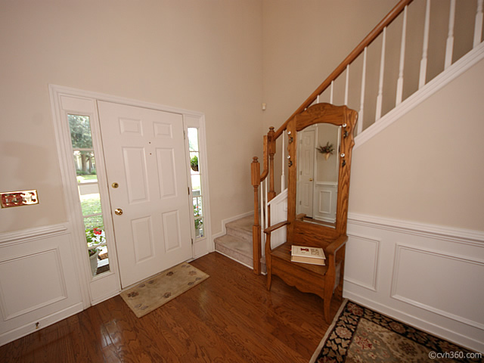
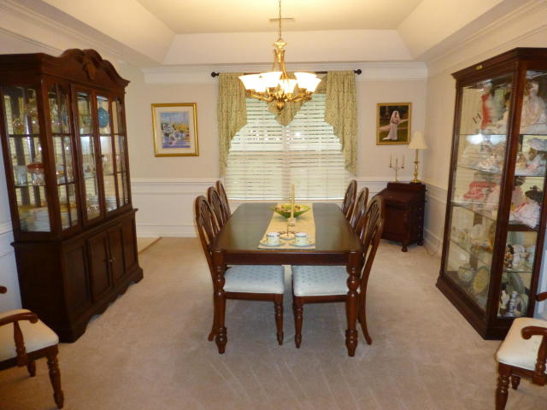
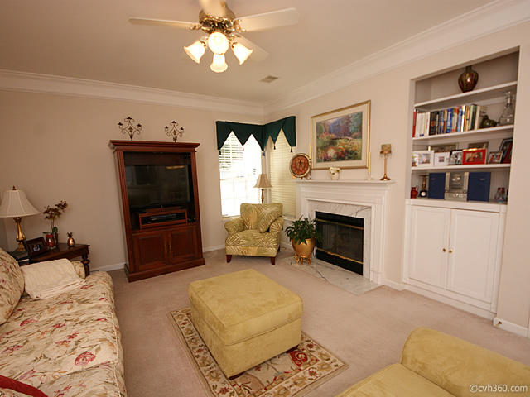
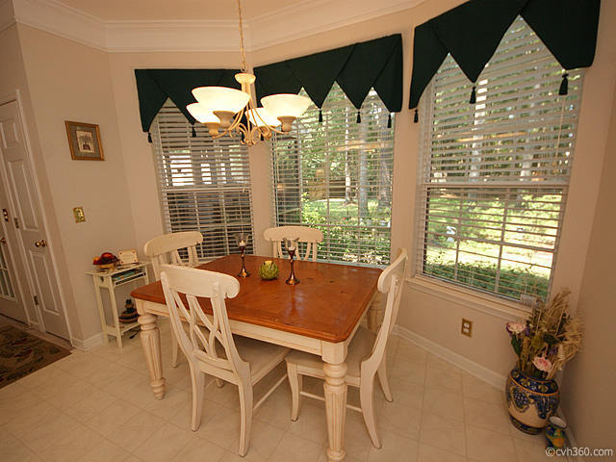
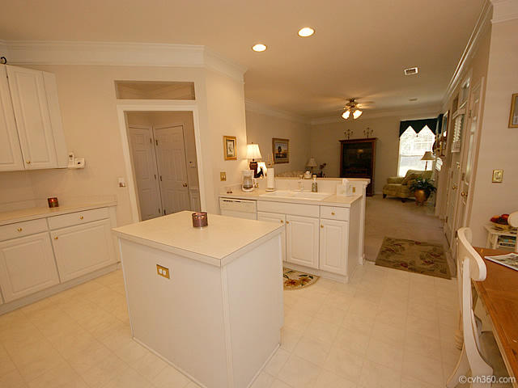
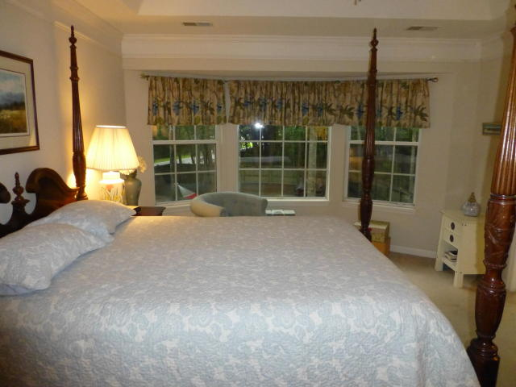
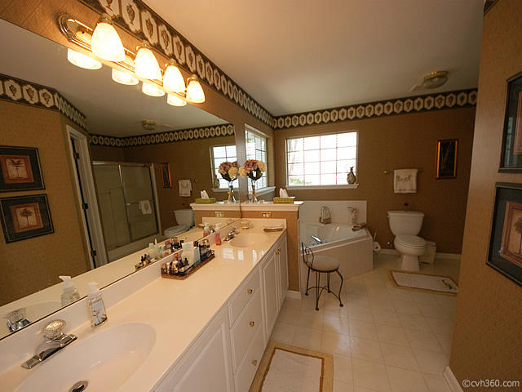
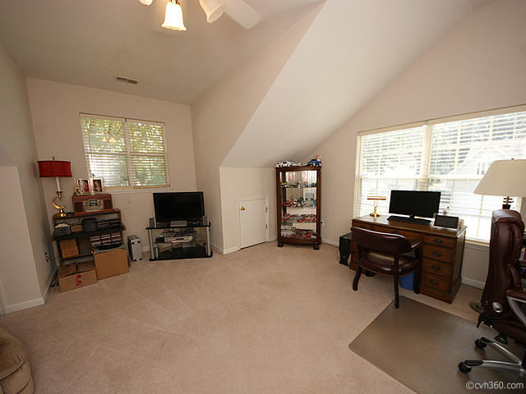
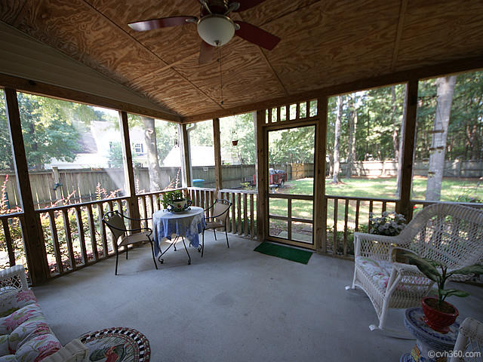
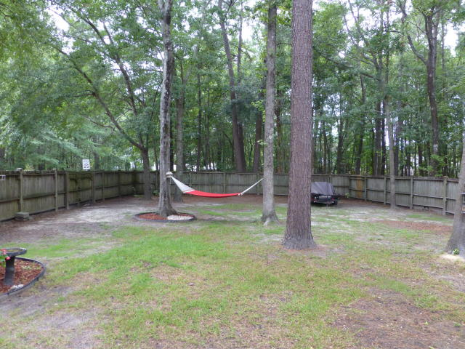
OPEN HOUSE – SUNDAY AUGUST 13TH – 1 to 4 PM
GAHAGAN EAST – SUMMERVILLE – 101 YORK COURT COME PREVIEW THIS WONDERFUL HOME!!! MLS# 17020484 - $275,000
GREAT Location! Close to everything!! Custom floorplan, one of the largest lots in Gahagan East and wooded in back. 2-story foyer, hardwood floors, large Family Room with gas logs fireplace and formal Dining Room is oversized with crown molding, tray ceiling and wainscoting. The Kitchen has ceramic floors, tile backsplash, island and a large bay window, and includes lots of cabinets and pull-out drawers. Master bedroom includes tray ceiling, bay window and 2-door entry, and Master bath has garden tub, shower and dual vanities. Lots of closets. Private backyard - fully fenced!! Large screened porch! New Roof in 2015, new HVAC in 2013. This is a LOVELY well cared for Home!!!
Randy Espeseth
843-743-1025 | Randy@RandyEHomes.com | Carolina Elite Real Estate

