Slide 1
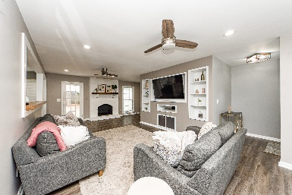
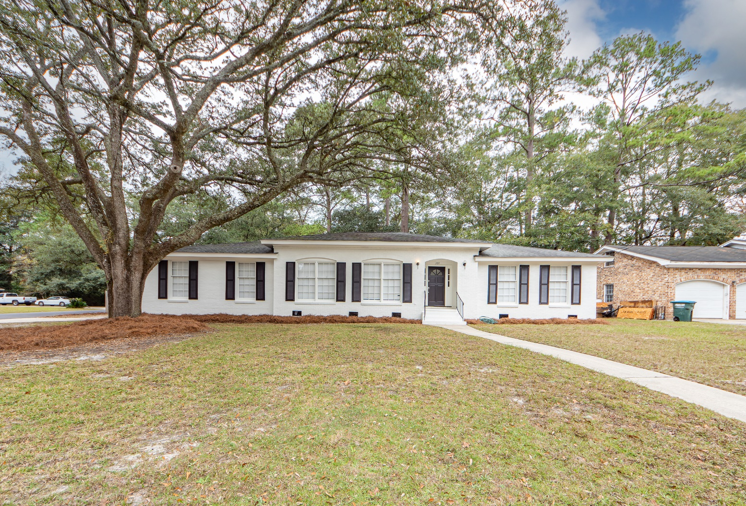
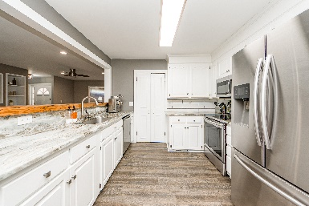
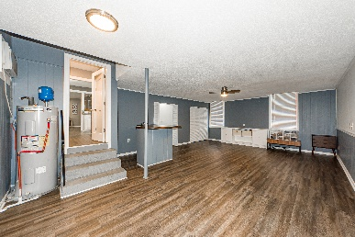
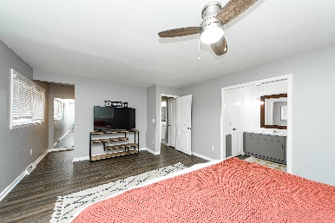
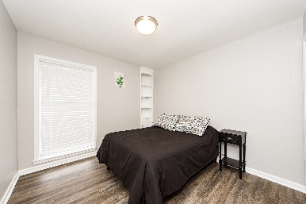
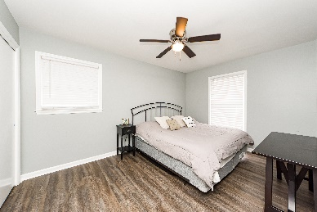
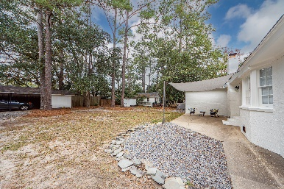
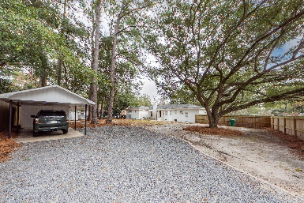


101 Chucker Drive
Summerville, SC 29485 | MLS# 22029418 | $395,000
NEWLY LISTED in Quail Arbor
$1,000 Buyer's Agent Bonus
For Ratified Contract That Can Close By 9/27/2019
This 3 BR/2 BA beauty is nestled in the heart of Summerville, in the Quail Arbor community between Trolley Road and Bacon's Bridge Rd. Fully and beautifully updated, and ready for its new owners, this home boasts 3 large oak trees, is situated on a corner lot w/ .39 acres, & sports a huge backyard. There is also a large swinging gate to accommodate backyard parking for a vehicle/boat/RV. The home has tons of natural light, an open floor plan, and LVP flooring throughout. The living area has a beautiful fireplace & built-ins, recessed lighting, and has plenty of space for entertaining family & guests. The kitchen sports gorgeous granite countertops, an eat-in dining area, a large walk-in pantry, and stainless steel appliances. The large owners suite features TWO large walk-in closets. There are two secondary bedrooms, also nicely sized. The two car garage was converted by the previous homeowners and was used as a large gaming room. That is also where the laundry room is located. A carport in the backyard has a workshop w/ electricity, perfect for those projects that need a separate space to keep dust & noise out of the living area. :) Oh, I almost forgot to mention that there is a room over the garage that can be finished - for a playroom, a crafting room, or a man-cave. The sellers put a lot of love, sweat, & tears into making this home theirs. The beams they took down from the ceilings were reclaimed & used for the bench, the bar counter, and the fireplace mantle. So many sweet touches in this home. It's a MUST-SEE! The cherry on top is that this home is located in the much sought after, highly acclaimed, and award winning DDII School District. Don't miss out. Schedule your showing today!
Take a Virtual Tour:
https://www.charlestonvirtualhomes.com/2220440/
Tammy Thompson
843-412-1856
tammylthompson@live.com
https://www.coldwellbankerhomes.com/
Coldwell Banker Realty | 4969 Centre Pointe Dr. Ste 103 | Charleston, SC 29418

