Slide 1
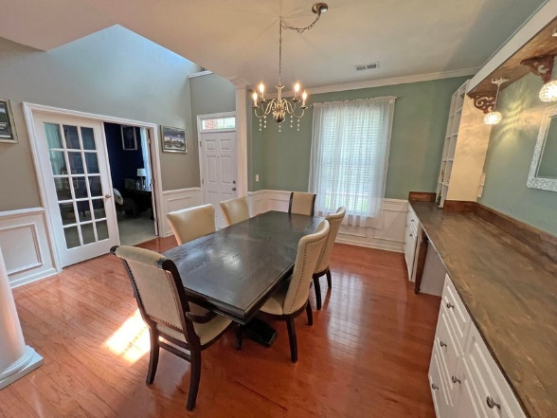
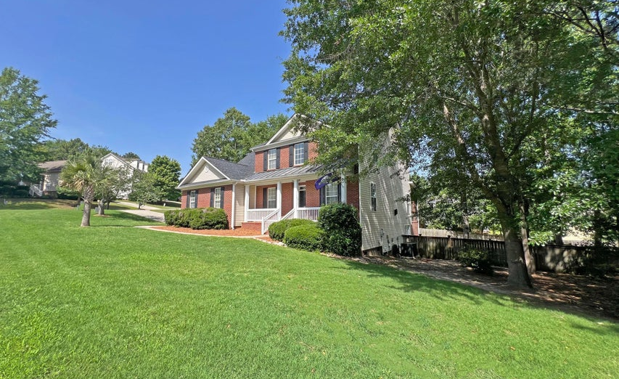
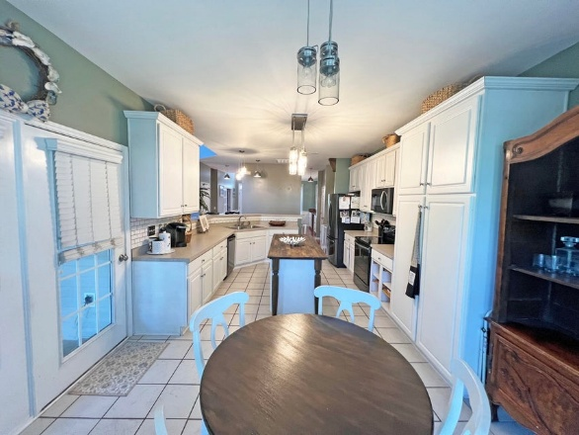
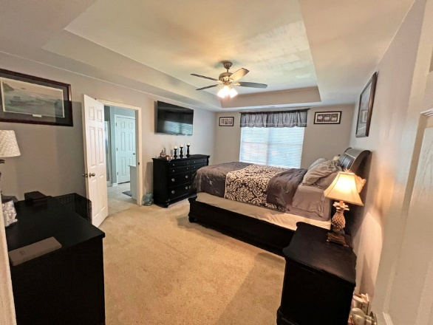
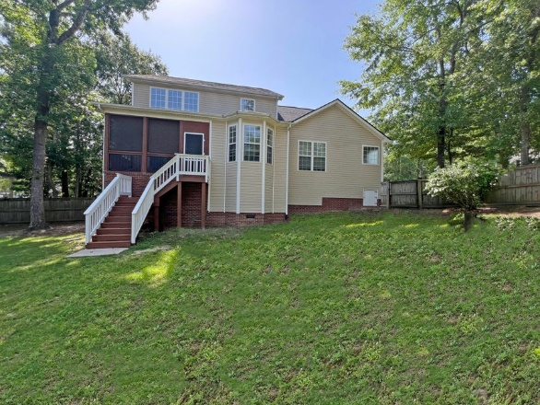


Price Improved!
101 Cobblers Glen Court
Lexington, SC 29072
MLS# 25012016
$384,900
Spacious 4 bedroom and 2 full bath (and 2 half baths) home with master suite on the ground floor. The home has new roof (2025) as well as fresh paint on back stairs and railing as well a front porch. Frog is used as 5th bedroom with half bath.
Close to I-20 (5 minutes) as well as Lexington. Home is located in Lexington District One school system. This community has a pool and clubhouse. There are also planned community events for children and adults throughout the year. Home has a two-car garage with additional parking for three automobiles. Buyer and Buyers agent please verify all information of importance.
Carla Davis
843-437-4873
gaweber@tds.net
Adler Realty
518 Parrot Point Dr
Charleston, SC 29412
www.adlerrealtychs.com

