Slide 1
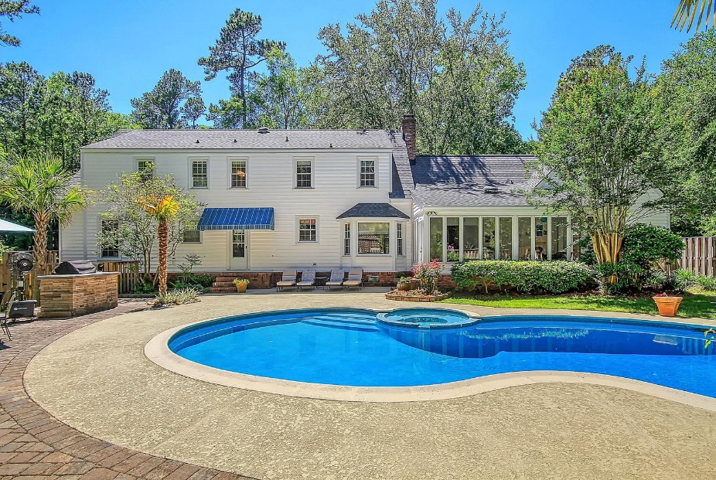
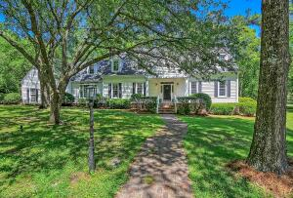
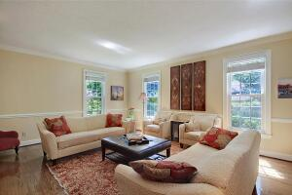
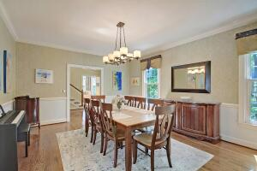
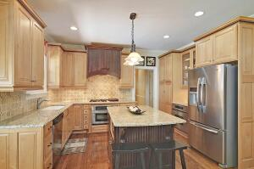
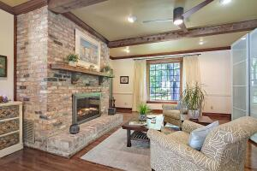
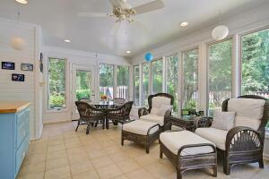


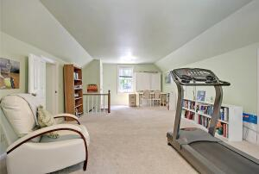
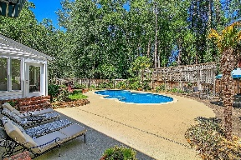
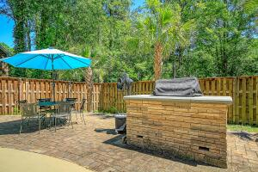
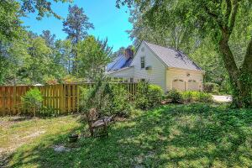
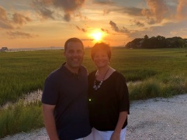

Summerville Beauty in Tea Farm ~ In-Ground Pool!!
101 Coralie Drive
Tea Farm
Summerville, SC 29483
MLS# 22012188
$699,900
5 Bedrooms | 3½ Baths | 3,900 sf
Welcome to 101 Coralie Drive located in the beautiful neighborhood of Tea Farm. This home is just what you've been waiting for! Move in just in time for summer and enjoy the backyard oasis! This home has so much to offer. As you walk in to the home, you'll immediately notice the large dining room and living room, which offers built in maple cabinetry and shelving. The kitchen is a chef's delight with a gas cooktop, two ovens, eat in kitchen area with built in buffet and a lovely decorative brick fireplace. Through the kitchen is the great room that has a beamed ceiling, a fireplace, wet bar and access to the sunroom. Back through the kitchen to the opposite side of the home is a laundry room with cabinetry, a laundry chute, sink and access to the backyard. The first floor also offers a bedroom that has a gorgeous recently renovated full bath just outside in the hall. There are two staircases in this home. The staircase off the great room leads in to the large FROG that has storage as well as a half bath. This room can be used as your 5th bedroom, media room, playroom...you name it! Off the FROG is a private home office.There are two more large bedrooms upstairs as well as another recently renovated bathroom. Down the hall you'll come to the master suite. This oversized master has wood floors, a recently renovated bathroom with a large shower and good size walk in closet. Head back downstairs and outside to your dream backyard! The pool area has recently gone through a renovation as well with new gunite and tile, a gas fire pit as well as an outdoor kitchen area. This backyard is perfect for entertaining! Tea Farm is located in downtown Summerville, walk to the Sawmill branch, Harris Teeter, there's a golf course down the street...this location is fantastic! Come see this house today!
Larry & Kathy Mazalatis
Larry Cell 843-693-0529
Kathy Cell 843-693-0159
Office 843-871-9133
AGENTOWNED PREMIERE GROUP | 1800 TROLLEY RD | SUMMERVILLE, SC 29485

