Slide 1
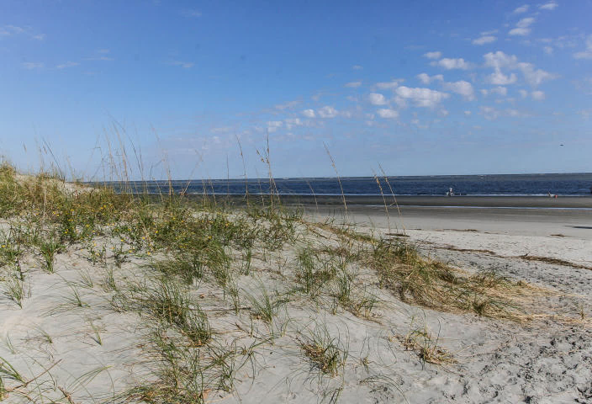
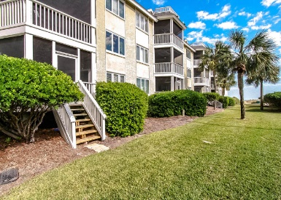
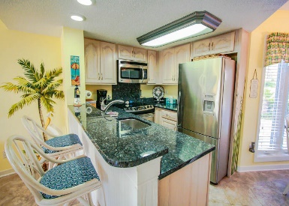
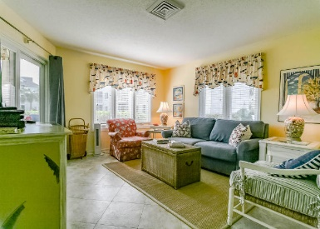
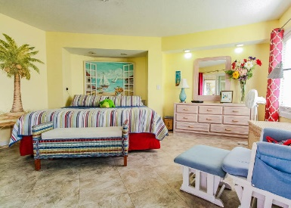
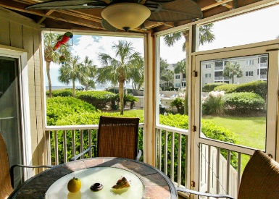
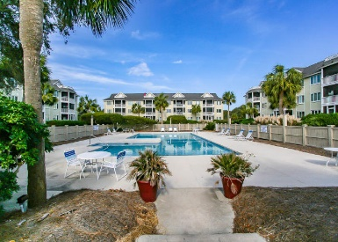
101 Port O Call Drive E101 Wild Dunes · Isle of Palms, SC 29451 · MLS# 16028312 · $425,000 Perfect 1st Floor/Walk-Out/End Unit Condo- just steps to the beach and pool! Decorated with bright and coastal colors, this open and airy unit boasts tile floors/granite countertops and stainless steel appliances. Enjoy time relaxing on the enclosed screen porch with direct outside access, perfect for those last minute walks on the beach, dips in the pool or cooking out on the nearby community grill. Opportunities for recreation, dining and entertainment, With Charleston being named one of the Top Destinations in the World for Travel, why choose anywhere else to buy a vacation beach property! Currently on a rental program, with owners grossing over 50K/year in rental income. Great Investment!
It's Another Beautiful Day at the Beach!
Neil Schneider · 843-200-8902 · neil@charleston.info

