Slide 1
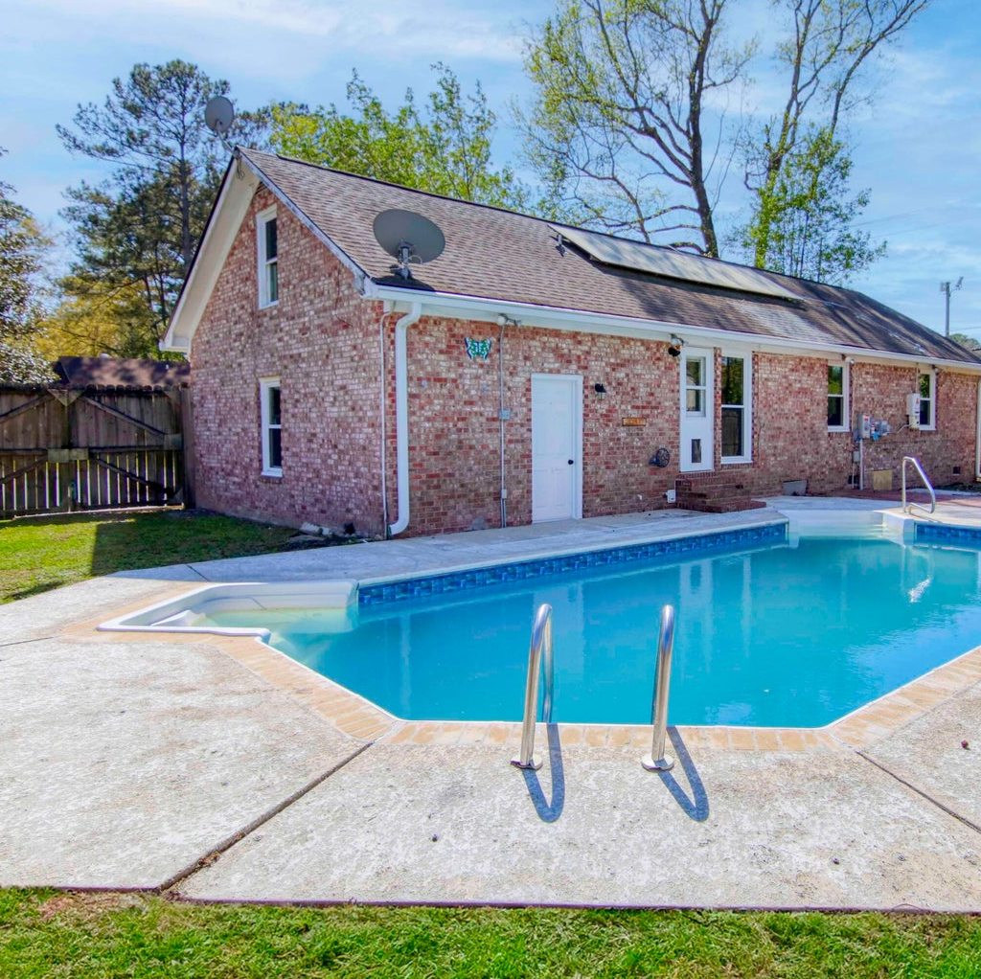
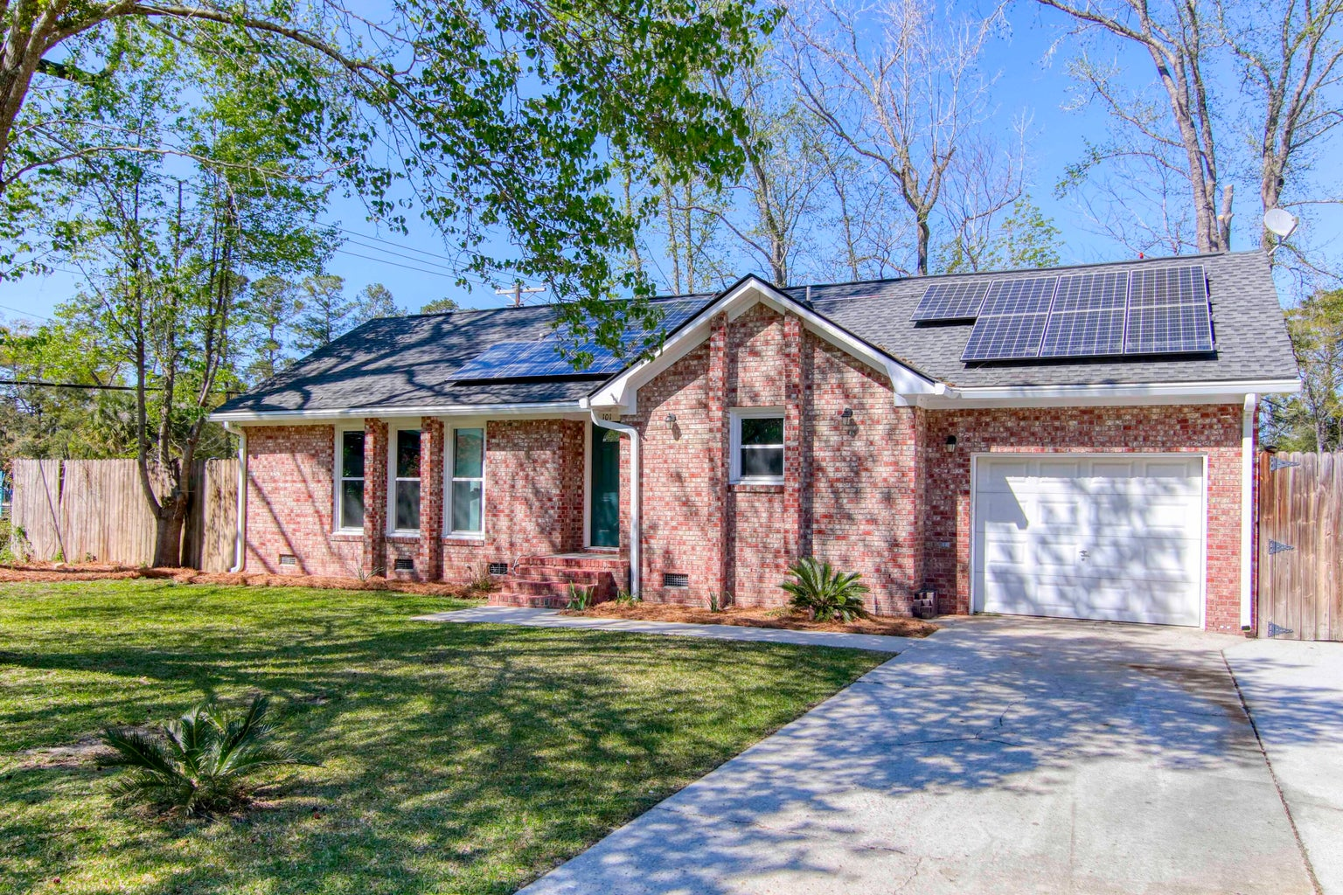
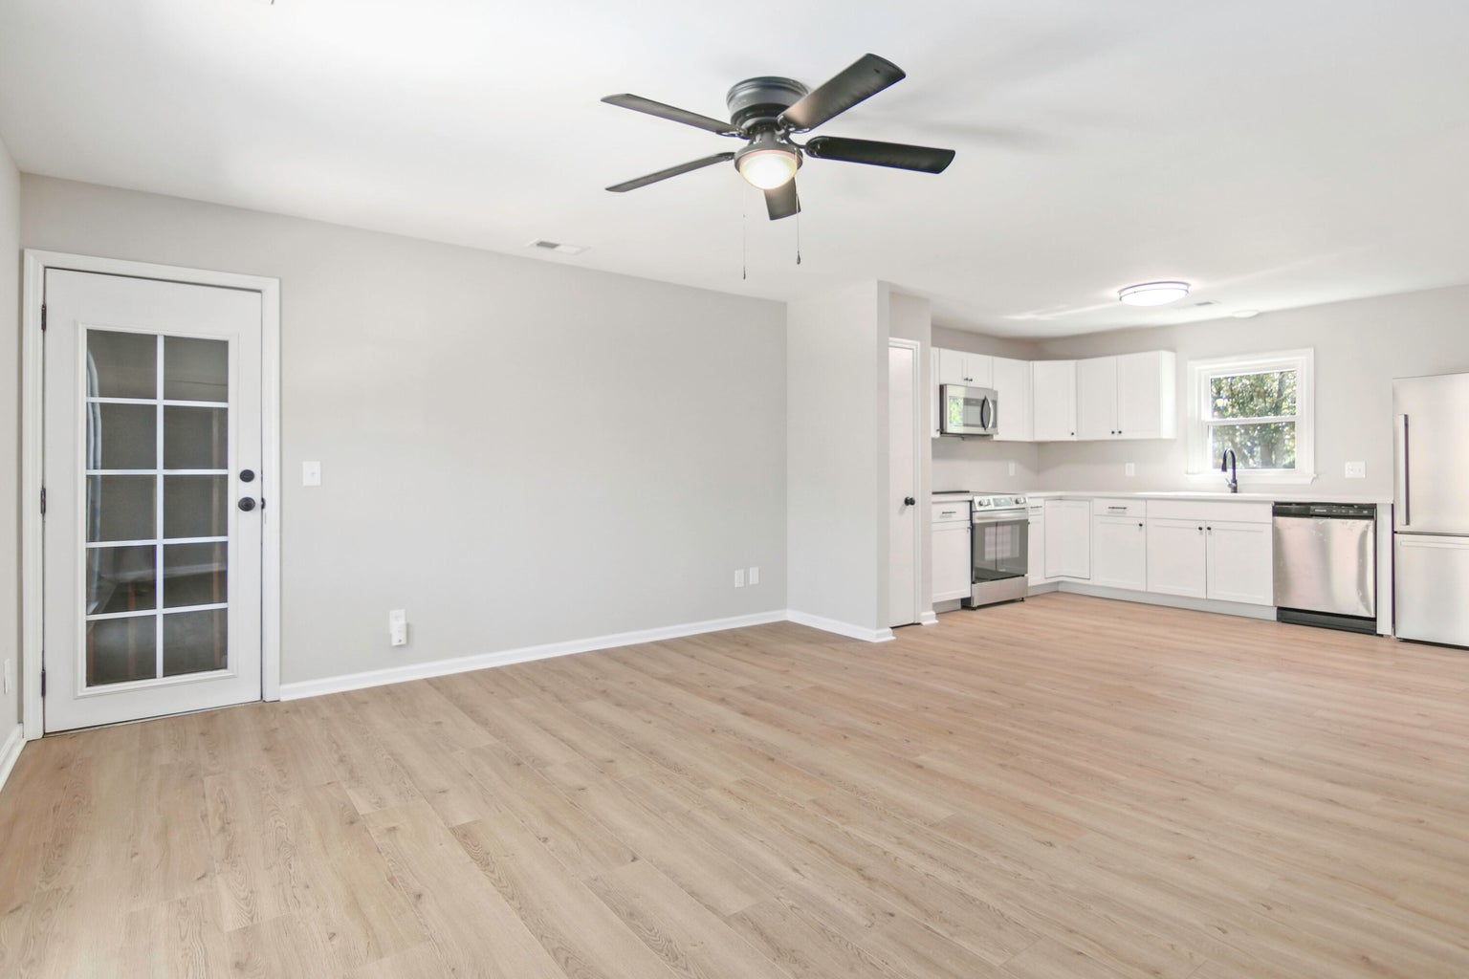
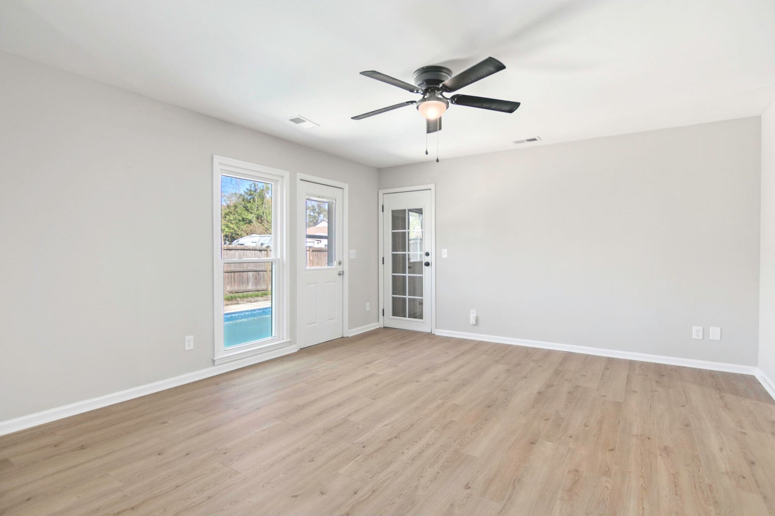




GET YOUR POOL IN TIME FOR SUMMER!
101 Judy Street
Warington | Summerville, SC 29483
MLS# 24007135 | $325,000
This 3 Bedroom, 2 Full Bath Brick ranch has close proximity to historic downtown Summerville shops, restaurants, schools and parks. The property includes ''paid off'' solar panels which significantly add energy and value to the home. In addition, the home features a brand new kitchen with quartz countertops and state-of-the-art appliances, along with updated bathrooms, HVAC system, flooring, carpeting, paint, lighting fixtures and frog area making the home move-in ready and appealing to potential buyers. The private backyard and pool are ideal for enjoying the warm weather and entertaining guests. This is a great find that will exceed your expectations!
Susan Stanley
843-323-5573
susancstanley@gmail.com
1,330 SF
3 BEDS
2 BATH

