Slide 1
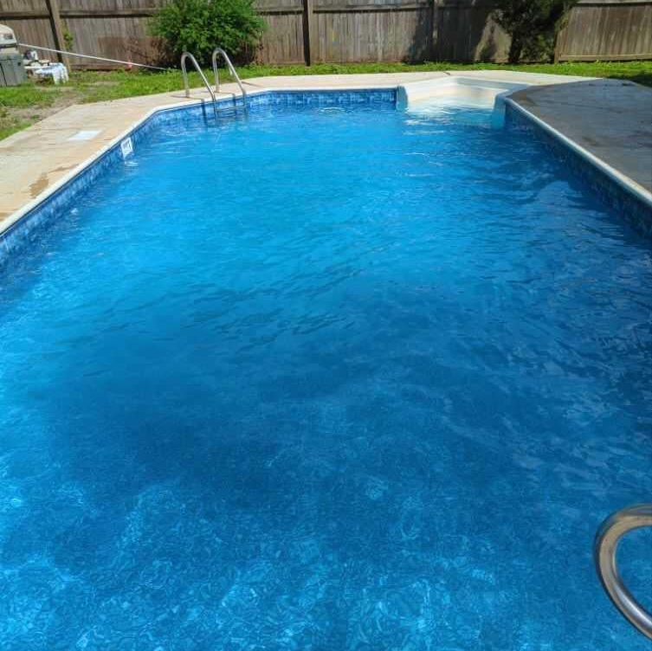
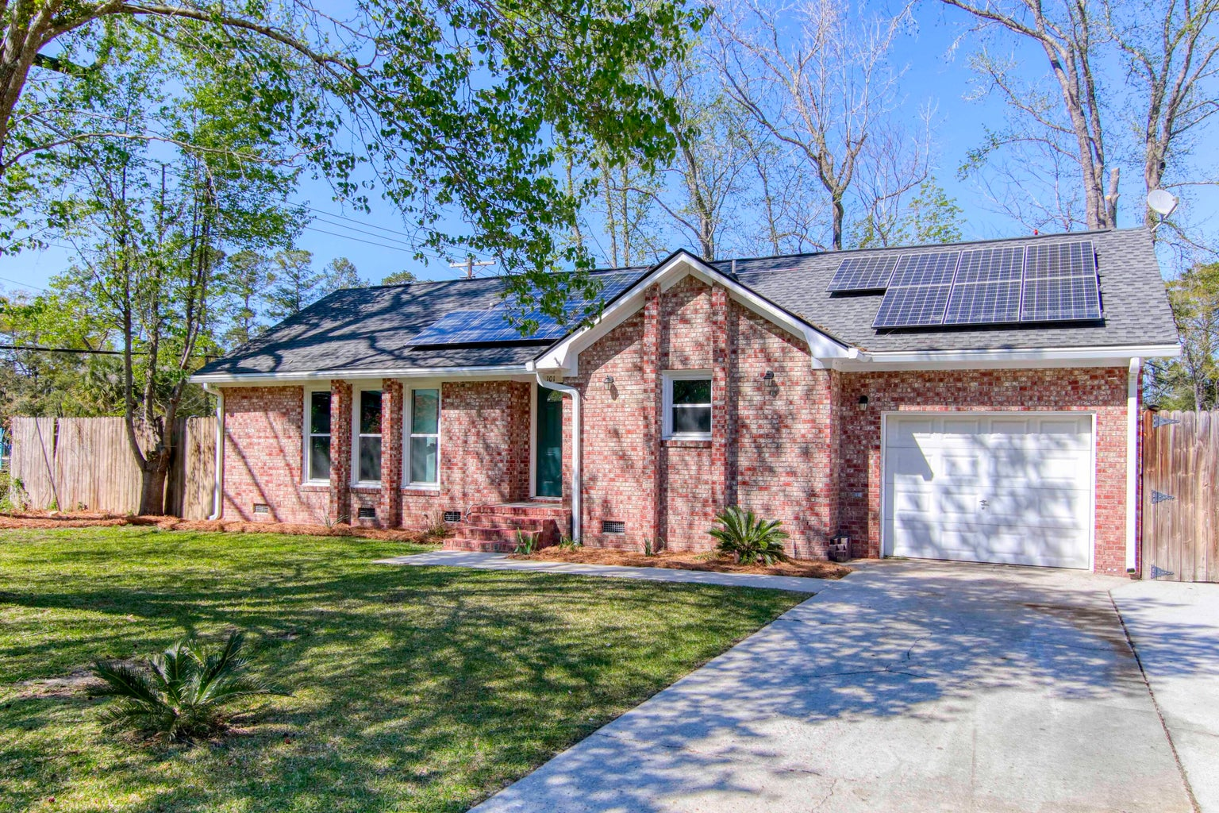
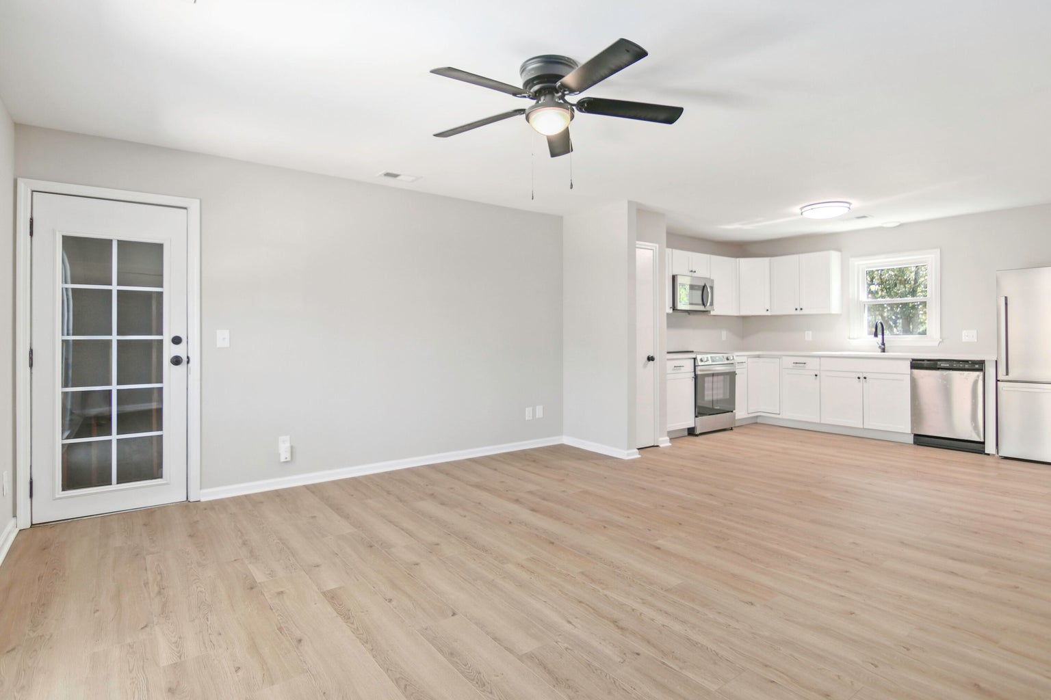
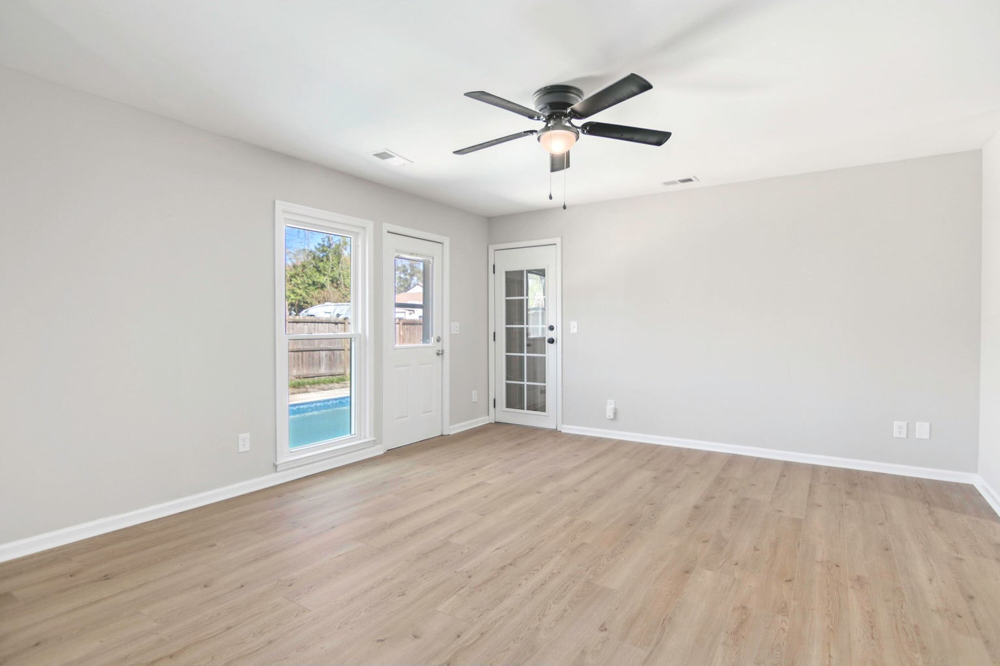




GET YOUR POOL IN TIME FOR SUMMER!
101 Judy Street
Warington | Summerville, SC 29483
MLS# 24007135 | $320,000
Quick Close & Move-In Ready! Relax in the comfort of your Newly Renovated 3 Bedroom, 2 Full Bath Brick ranch and ''Bonus'' POOL with close proximity to historic downtown Summerville. Owner provides a CLEAR CL100 & CLEAR Home Inspection! This property includes ''PAID OFF'' solar panels with docs, which significantly add energy and value to the home. In addition, the home features a brand new kitchen with QUARTZ countertops and state-of-the-art appliances, along with updated bathrooms, HVAC system, flooring, carpeting, paint, lighting fixtures and frog area making the home move-in ready and appealing to potential buyers. The private backyard and pool are ideal for enjoying the warm weather and entertaining guests. This is a great find that will exceed your expectations.
Susan Stanley
843-323-5573
susancstanley@gmail.com
1,330 SF
3 BEDS
2 BATH

