Slide 1
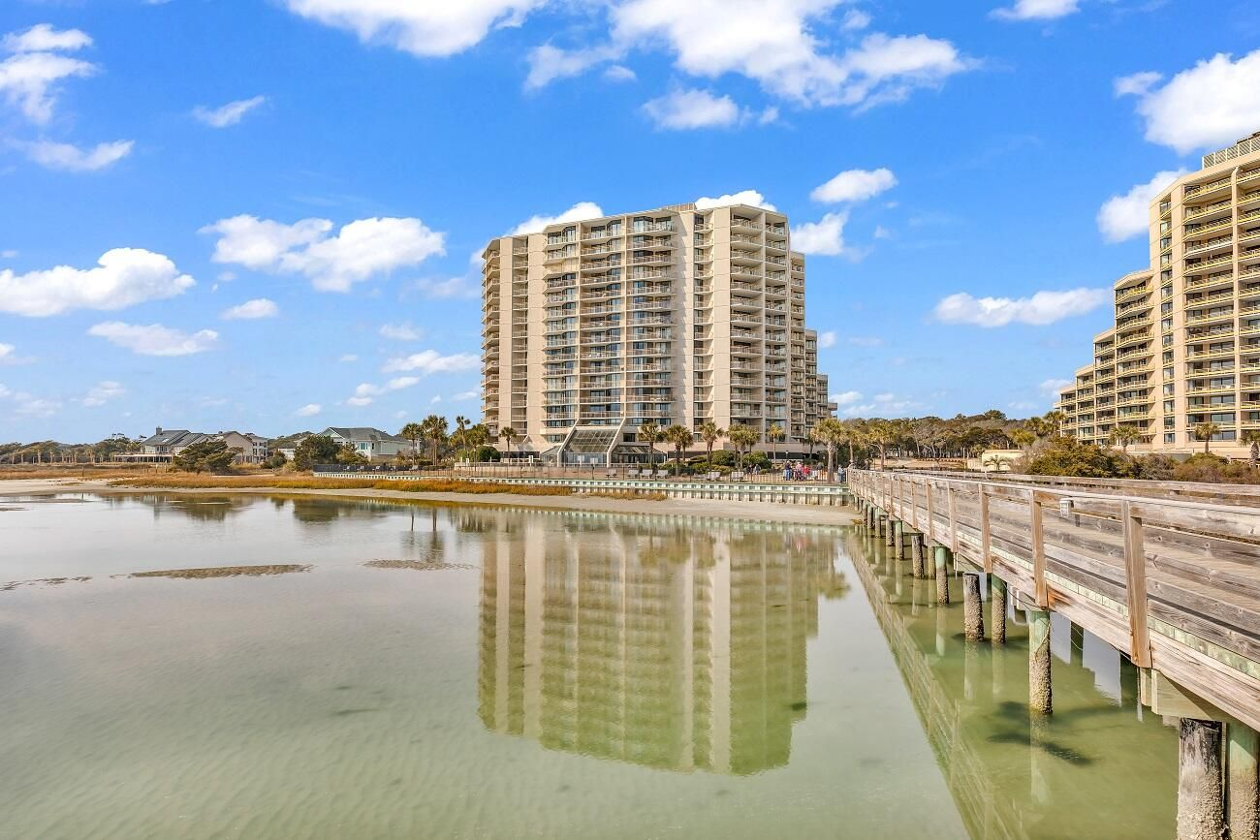
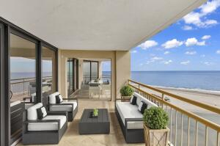
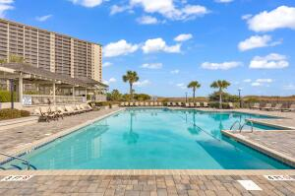
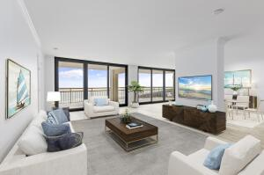
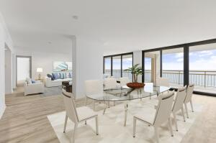
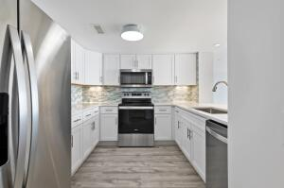
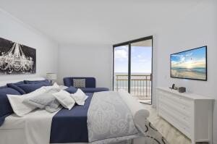


UNIQUE DOUBLE UNIT
101 Ocean Creek Drive
Units KK-14/LL-14
Myrtle Beach, SC 29572
MLS# 22003621
$1,400,000
CHARLESTON SINGLE STYLE HOME
4 BEDS/2.5 BATHS/LOFT
MASTER BEDROOM DOWN
YARD W/PRIVACY FENCE
HARDIPLANK SIDING
HOME ONLY 2 YEARS OLD
QUARTZ COUNTERTOPS
STAINLESS APPLIANCES
REFRIGERATOR INCLUDED
COVERED PORCH
PERFECT JOHNS ISLAND LOCATION
1 MILE FROM SEVERAL RESTAURANTS/SHOPS
BLINDS AND WASHER/DRYER INCLUDED
LESS THAN 10 MILES TO DOWNTOWN CHARLESTON
12 MILES TO KIAWAH OR FOLLY BEACH
Unobstructed Ocean View - Located on the 14th floor of Tower South! A unit like this does not come on the market very often. This is why we are very excited to present to you Unit KK-14/LL-14! The sellers have just completed beautiful renovations to offer to their buyers. This home has newly installed new impact balcony doors in the living and dining area, Silestone Quartz Countertops in kitchen, bathrooms and bars. The kitchen and bars feature Elysium Tile backsplash and new White wood shaker cabinets with soft close cabinet hardware. New stainless-steel appliances, including refrigerator, dishwasher, microwave and oven/stove combo are included as well. Both owners' baths have Tile showers with rain head features. Too much to list...please call for more information.
Pam Bosart
843-452-0757
pam@awsellshomes.com
Adler Wayman Real Estate
1247 Nexton PKWY Ste 201
Summerville, SC 29483
www.adlerrealtychs.com

