Slide 1
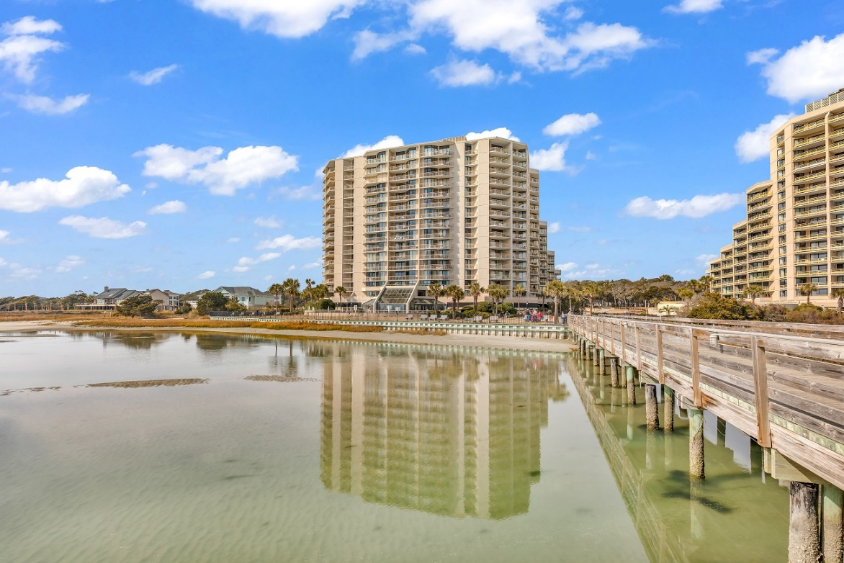
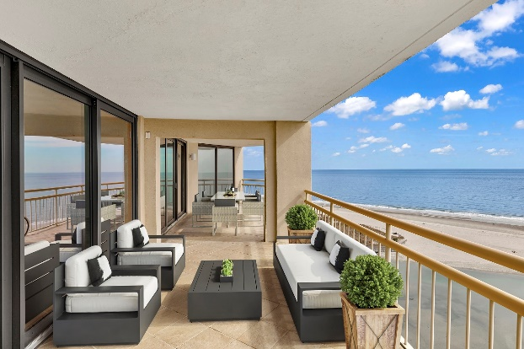
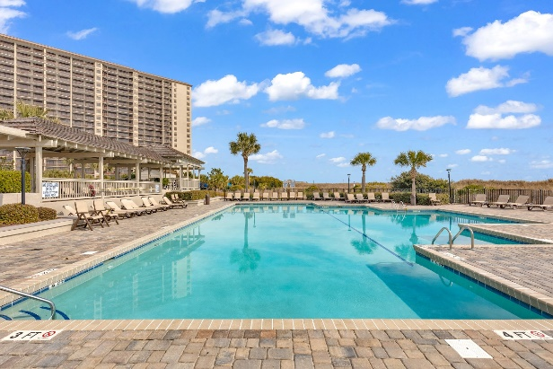
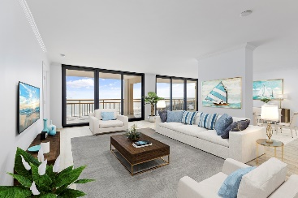
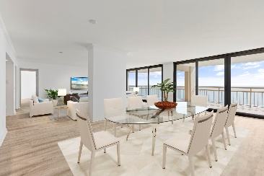
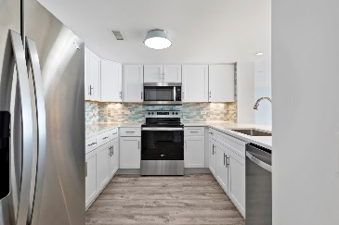
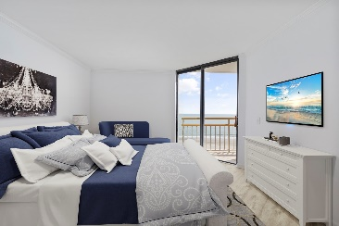


OCEANFRONT UNOBSTRUCTED VIEWS!!
101 Ocean Creek Drive
Units KK-14/LL-14
Myrtle Beach, SC 29572
MLS# 2203027
$1,275,000
CHARLESTON SINGLE STYLE HOME
4 BEDS/2.5 BATHS/LOFT
MASTER BEDROOM DOWN
YARD W/PRIVACY FENCE
HARDIPLANK SIDING
HOME ONLY 2 YEARS OLD
QUARTZ COUNTERTOPS
STAINLESS APPLIANCES
REFRIGERATOR INCLUDED
COVERED PORCH
PERFECT JOHNS ISLAND LOCATION
1 MILE FROM SEVERAL RESTAURANTS/SHOPS
BLINDS AND WASHER/DRYER INCLUDED
LESS THAN 10 MILES TO DOWNTOWN CHARLESTON
12 MILES TO KIAWAH OR FOLLY BEACH
This is a Unique Double Unit - Located on the 14th floor of Tower South! A unit like this does not come on the market very often. The sellers have just completed beautiful renovations to offer to their buyers. This home has newly installed impact balcony doors in the living and dining area, Silestone Quartz Countertops in kitchen, bathrooms and bars. (there are 2 bars - see floor plan in the documents) The kitchen and bars feature Elysium Tile backsplash and new White wood shaker cabinets with soft close cabinet and new hardware. Brand new stainless steel appliances, including refrigerator, dishwasher, microwave and oven/stove combo. Both owners baths have Tile showers with rain head features. Also included is White front load Washer and Dryer on pedestal for your buyer's convenience. New lighting fixtures throughout ( inside and at front door) and Luxury Lifeproof Chiffon Lace Oak vinyl plank Flooring give the home a true coastal feel. Top it all off with a fresh coat of paint to make this a true jaw dropping experience! The photos are lovely but walking into this is a dream come true and experiencing the view in person will make your heart jump! The approx. 420 sq ft Patio is an extension of the living space with more than enough room for a full dining table and a sofa and chairs. Imagine the delicious meals you and your family will share here! Each bedroom has access to a balcony and Ocean front views. You will experience the firework displays on a new level. The calming ocean waves and the breeze will sing you to sleep every night. This unit is Unique not only due to it being double in size, but also because of its a Full ocean facing location. Nothing in your way or can be built to obstruct your view. It is private and offers those views that you would expect would come with a much higher price. If you have been looking for your dream ocean front condo, it has arrived. I have included a list of all the new additions in the documents section. I just cannot say it enough, the is a must see - If you can pull yourself away from this wonderful condo you will enjoy stepping right on the beach and the 60 acre Oceanfront resort. After enjoying your walk along the beach you can return and take a dip in the Tower South private pool or hot tub, indoor pool or one of Ocean Creek Resorts' many other pool choices. Maybe dinner at the 4 Seasons Restaurant onsite. The Beach club bar and grill offers a quick meal or snack - or perhaps a cocktail to enjoy the sunset...take your pick! Just across the street from the entrance is Barefoot landing. Here you can enjoy a day of shopping or grab a bite to eat at one of several choices or even enjoy the House of Blues and take in a great concert! It is all at your fingertips.. ~ there is a short video of the view in the documents for you to share with your buyers ~
Pam Bosart
843-452-0757
pam@awsellshomes.com
Adler Wayman Real Estate
1247 Nexton PKWY Ste 201
Summerville, SC 29483
www.adlerrealtychs.com

