Slide 1
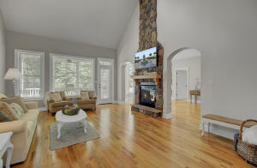
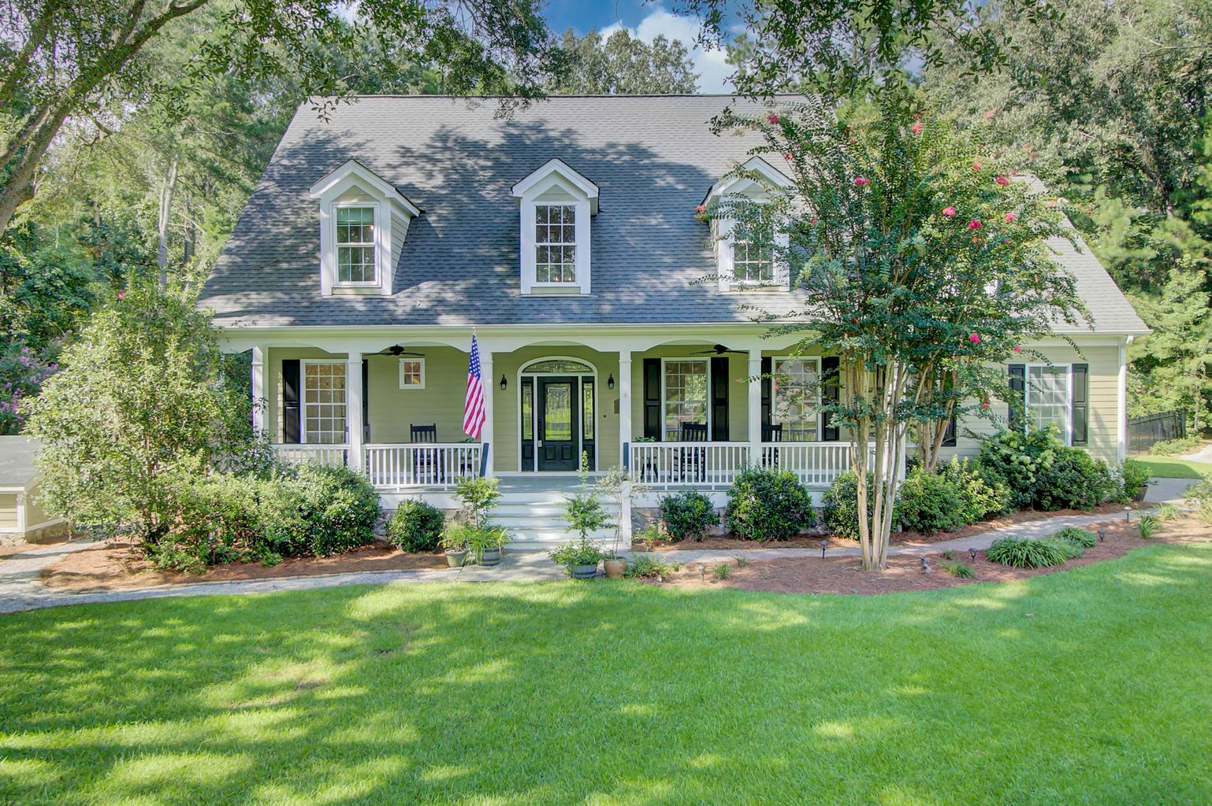
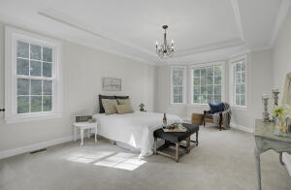
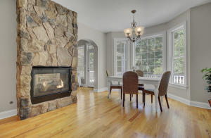
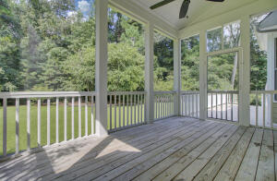
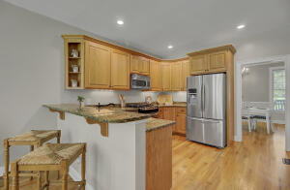
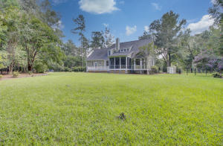


NEW LISTING Stunning Home on 2.86 Acres in Gated Community!
101 Rhetts Way
Boyle Plantation
Summerville, SC 29485
MLS# 21022829 | $699,000
101 Rhetts Way in Summerville, SC is a rare find
This gorgeous 5 bedroom home has a master on the main level plus a dedicated office space that could be converted to an additional bedroom if desired. It is nearly 3500 sf with three renovated full baths and two half baths. As a one owner home, this house has been lovingly maintained and updated and is ready for new owners! The massive yard is fully enclosed and could easily accommodate a large pool, outdoor kitchen- it is the perfect setting for a back yard oasis! Peace and solitude abound in this magnificent home! Open houses are scheduled Saturday 9:30-12:00 and Sunday 2:00-4:00! Private tours available through Showing Time!
Check out the video tour here: https://video214.com/play/oMpkXFZUpywZeKPT8kkFpw/s/dark
Ellen O'Neil
Broker/Owner, ABR, e-PRO, CNE
Charleston Realtor of Distinction
(843) 300-8530
www.EllenONeilProperties.com

