Slide 1
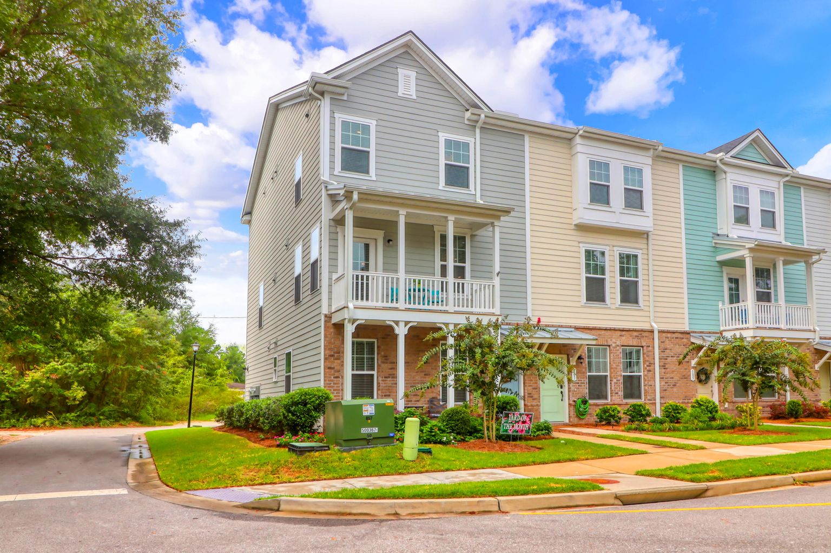
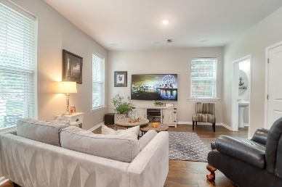
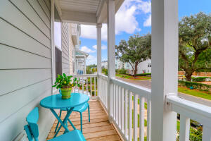
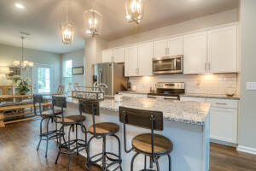
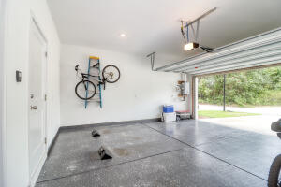


101 Rowans Creek Drive The Marshes at Cooper River | Charleston, SC 29492 | MLS# 21025612 | $399,000
3 Bed/3 Bath Townhome + 2 Car Garage Screen Porch & Tons of Upgrades
Exceptional opportunity to purchase this lovely three bedroom, 3 bath end unit townhouse in the charming neighborhood of The Marshes at Cooper River with a community garden. This home shows like a designer home, like new!! Lots of upgrades, including a Rinnai hot water heater. Complete with custom surround sound on the bottom floor main living area. We have recessed lighting in the master bedroom. Under cabinet lighting. Wooden steps. Hunter ceiling fans in living room, master bedroom and secondary bedroom. Gas furnace. Sherwin Williams paint. Enjoy your back screen porch with a fan and TV. Upgraded closet system in master bedroom closet. The garage has an epoxy floor. This home also qualifies for Dominion Energy Rate 6 Reduced billing.
Virtual Tour: https://www.seetheproperty.com/395535
Darlene Smith Office - (843) 886-8110
Mobile - (843) 696-7824
darlenesmith@carolinaone.com
DarleneSmithTeam.com
Carolina One Real Estate
1503 Palm Blvd Ste
Isle of Palms, SC 29451

