Slide 1
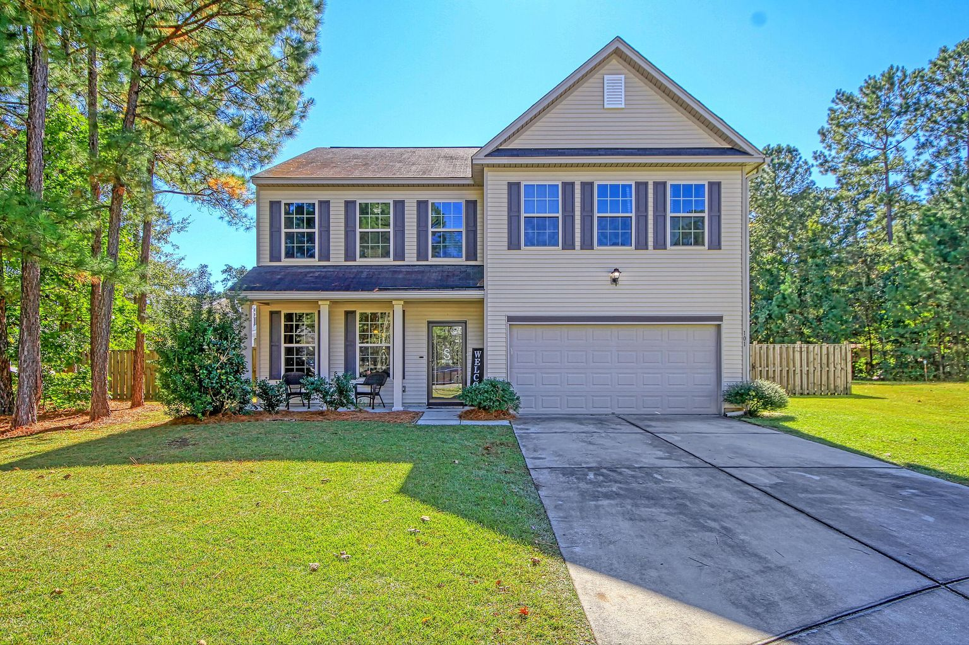
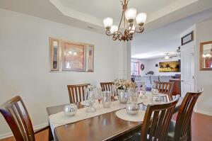
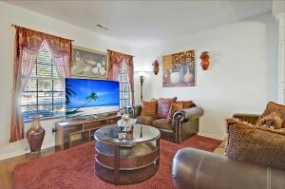
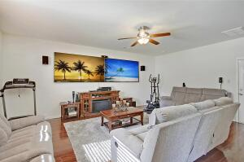
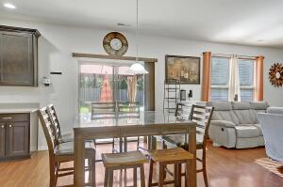
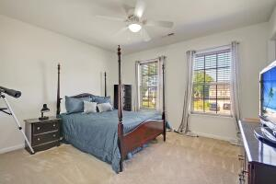
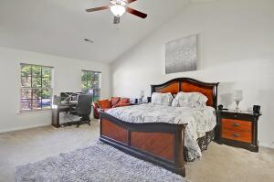
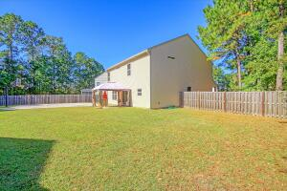
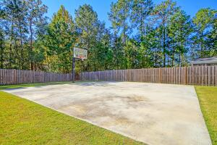

101 Tristen Court Buckshire · Summerville, SC 29485 MLS# 21029959 · $360,000
Half Court Basketball Court YES
Beautiful 4 bedroom, 2.5 bath home with stunning curb appeal and awesome HUGE fenced backyard with a 1/2 court basketball court! Upon entering the home you are greeted with handsome wood floors, an abundance of natural light and an open floor plan. To the left is the spacious living room and gorgeous dining room with stately columns and trey ceiling. Continuing in is the oversized family room that can easily fit a sectional sofa and is open to the eat-in kitchen with stainless steel appliances, 42'' cabinets, tons of counter top space, and pantry-any chef would love to cook and entertain here! Upstairs is the large master bedroom with soaring ceiling, and spa-like ensuite master bath featuring dual sink vanity, shower, and walk-in closet. There is a large loft upstairs that would be a perfect office, or media room! Three additional nicely sized bedrooms that share a full bath and laundry room finish off the second floor. The fantastic fenced backyard features a patio, and hard surface area with a basketball goal that could be used for so many different entertaining purposes: tables with lights for parties, cornhole tournaments, bbq cook-offs......Buckshire in Summerville is a wonderfully landscaped community with a neighborhood pool. The neighborhood is close to local shopping and grocery stores and is a short drive to downtown Charleston with 5-star restaurants, world class shopping and iconic history as well as a short drive to the beaches, the airport, and Boeing This house has it all-ask for a showing today, because it will not last!
Take a video tour: https://vimeo.com/644198374
Stan Huff
843-670-2835 stan.huff@agentowned.com
Jill Marcacci
843-297-5590 jill@agentowned.com
www.agentownedrealty.com
AgentOwned Realty Co. Preferred Group, Inc. | 824 Johnnie Dodds Blvd | Mt Pleasant, SC 29464

