Slide 1
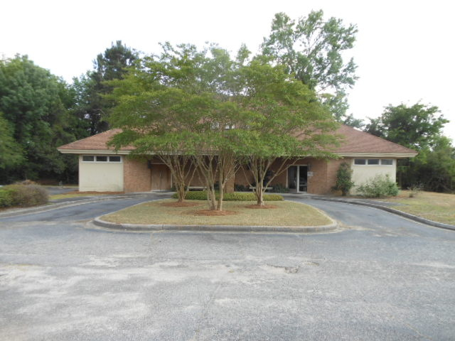
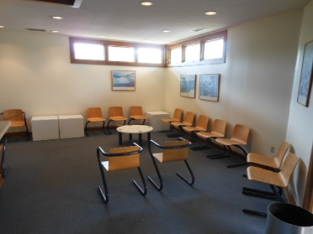
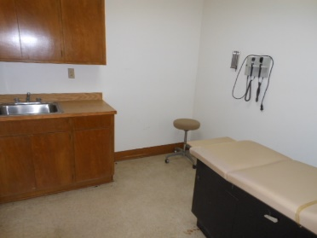
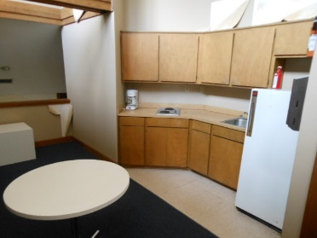
Medical Office Building
3,349 sq ft · $285,000
$40,000
Price Reduction!
Owner Financing
(No Bank Needed)
First class all the way!!!
Truly a 10 on a 10 point scale
1020 Old U.S. 52
Moncks Corner, SC 29461
MLS# 29972635
Medical Office building situated on .5 Acres in Moncks Corner. An additional 1.4 Acres are available. Property can be used for other business rather than medical. Located just 100 yards from Sears, Big Lots and Family Dollar within sight of intersection at Hwy 52 and Old Hwy 52. Owner will sell or do a lease/purchase. The property is in excellent condition and is zoned C-1 within the city limits of Moncks Corner
You better hurry…this home may very well have multiple offers the first weekend it's offered for sale.
Rick Willis
843-327-3017 · Rick@RickWillis.com · The Group, LLC

