Slide 1
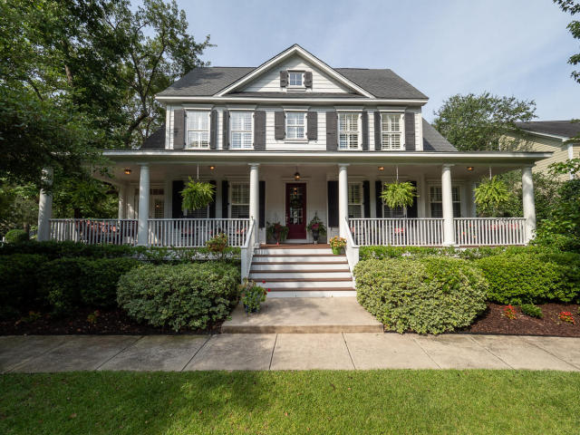
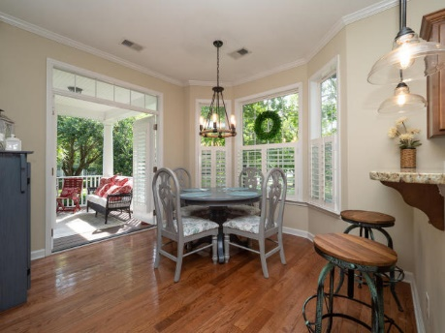
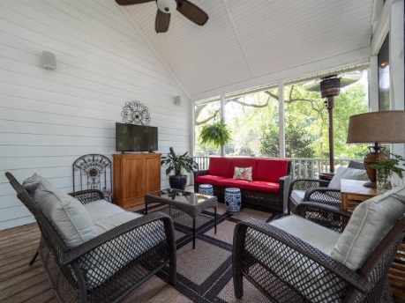


716 Lawton Harbor Drive
1021 Barfield Street
Daniel Island
MLS# 18020055
Just Reduced to $709,000
Open House
Sat & Sun
12-3
5 Bedrooms
4.5 Baths
MBR Downstairs
Detached FROG
Full Front Porch
Screened Porch
Corner Lot in Center Park
Donna Landry (225) 921-2111
donna.landry@cbcarolinas.com

