Slide 1
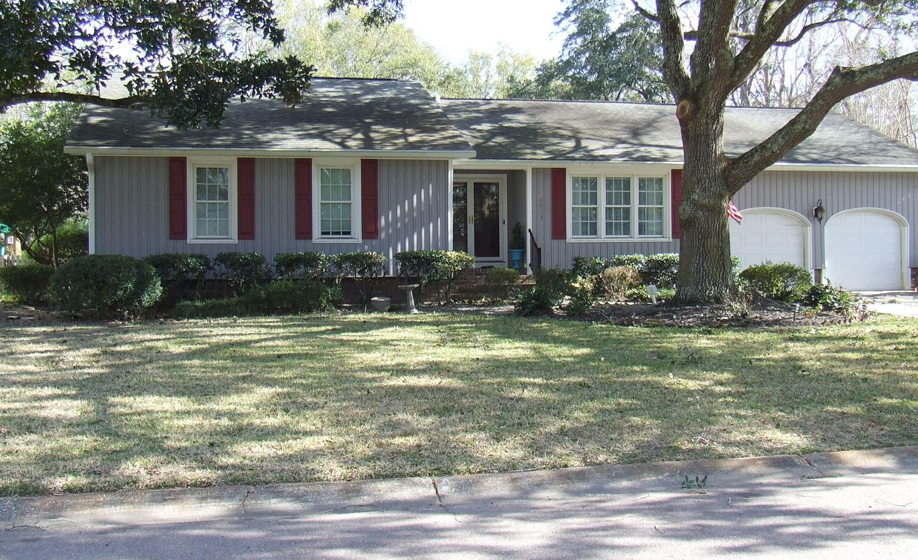
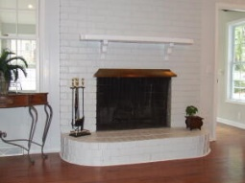
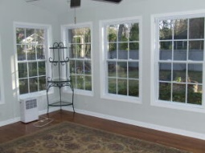
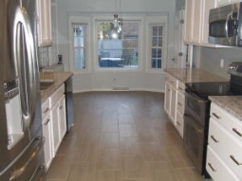
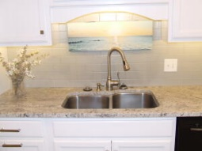
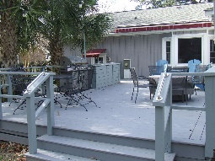
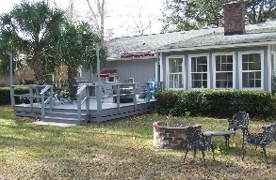


Move-in Ready… This one will not last!
1021 Planters Curve
Snee Farm ~ Mount Pleasant, SC 29464
MLS# 22000136 ~ $749,000
This is a wonderfully updated home in much sought after Snee Farm subdivision.
The home has an open kitchen with stainless steel appliances, granite countertops, and an abundance of natural light. The large family room is adjacent with vaulted ceilings and a wood burning fireplace. There is a large master suite with a walk-in closet and sliding glass doors that lead to the backyard area. The master bath has a very nice walk-in shower as well as a newly installed walk-in tub.
The ceilings have been smoothed throughout the home and the crawlspace is encapsulated. The room over the garage currently has a half bath but there is an option to add a shower and/or tub. The large deck in backyard area has a built-in sink as well as a motorized retractable awning.
Timothy Scalise
843-408-3017
timothyscalise@gmail.com | www.theblvdcompany.com
The Boulevard Company, LLC | 806 Johnnie Dodds Blvd Ste 100 | Mt Pleasant, SC 29464

