Slide 1
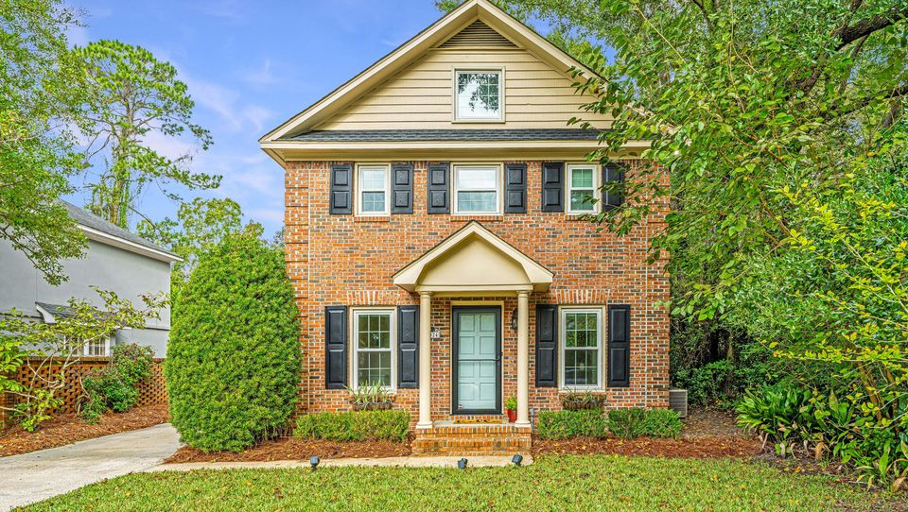
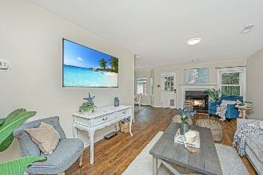
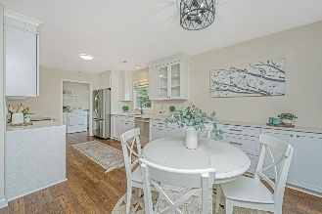
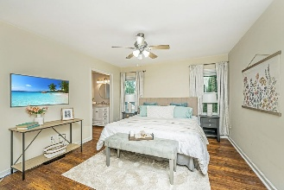
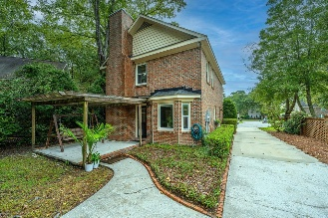
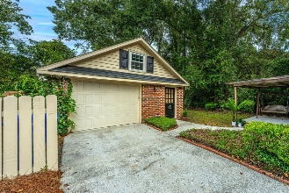

New Charlestowne with Detached Garage
MODERN UPGRADES + CLASSIC LOWCOUNTRY CHARM
1024 Plantation Court
Snee Farm | Mount Pleasant, SC 29464 | MLS# 25027965 | $895,000
Located in the desirable New Charlestowne section of Snee Farm, this meticulously updated all-brick home offers the perfect blend of timeless charm and modern efficiency in one of Mount Pleasant's most established Country Club communities. Just minutes from the beach, historic downtown Charleston, and top-rated schools, this home is not in a flood zone — offering peace of mind along with prime location. Inside, you'll find a thoughtfully designed floor plan featuring luxury vinyl plank (LVT) flooring throughout, smoothed ceilings, and up/down shades on all windows — with blackout shades in the primary suite.
A cozy wood-burning fireplace (with new chimney cap in 2020) adds warmth and character to the main living area. The kitchen was completely updated in 2020, featuring semi-custom soft-close cabinetry with spice racks, deep drawers, built-in trash bin, and an added butler's pantry with extra storage and counter space. All appliances were updated, including a Bosch dishwasher (2024). A charming pocket door adds extra functionality. Both full bathrooms have been stylishly updated, and major systems have been upgraded for peace of mind: HVAC (2021 - both units) | New hot water heater | New electrical panel | Whole-house surge protector | Easy-access water shut-off valve
The home also includes new impact-rated windows throughout, a new energy-efficient attic door, motion-sensing exterior lighting, and multiple WiFi options for seamless connectivity. Enjoy the convenience of an EV charger, invisible pet fence, and new front, side, and storm doors. Outside, a detached one-car garage with a workshop and newer garage door provides ample space for hobbies or storage. Snee Farm amenities (membership optional) include golf, tennis, pool, and a vibrant social scene.
This is truly a move-in-ready gem offering style, security, and comfort in one of Mount Pleasant's most sought after neighborhoods!
VIRTUAL TOUR
Carolina One Real Estate
195 W Coleman Blvd
Mt Pleasant, SC 29464-3495
Kathy Ware
843-830-3804
Kathy.ware@carolinaone.com
www.katherineware.com

