Slide 1

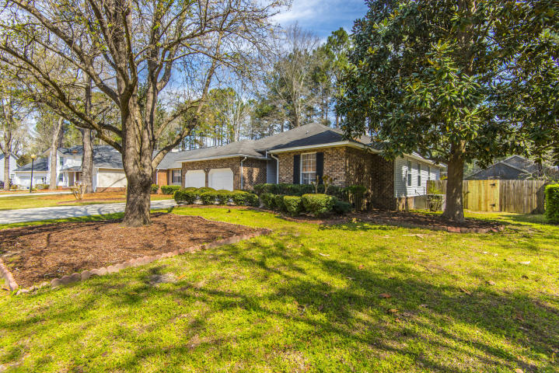
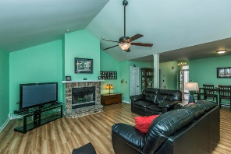
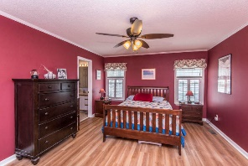
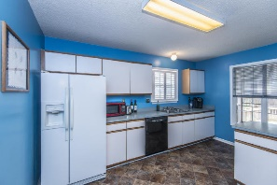
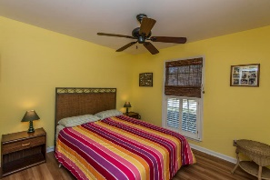
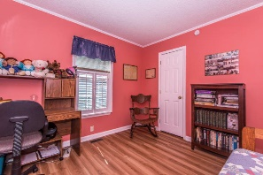
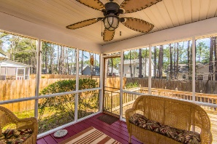
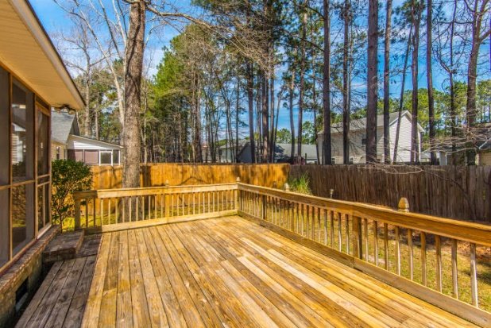
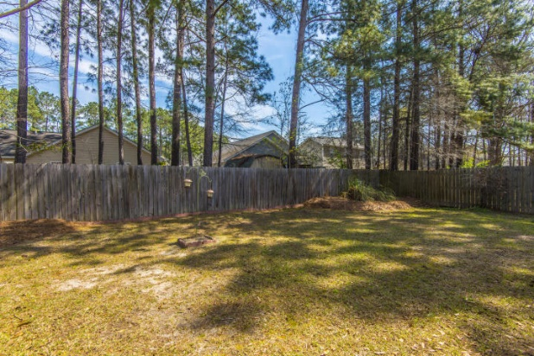


Beautiful Summerville Home, Less than 230K!
1025 Shinnecock Hill Court
Pine Forest Country Club ~ Summerville, SC 29483
MLS# 18007359 ~ $229,900
Your beautiful home awaits in Pine Forest Country Club! This charming, one story traditional home offers a screened porch, large deck and fenced yard in a quiet, established neighborhood. A wood burning fireplace adorns the spacious living and dining area. Gorgeous Allure Flooring in this well-maintained home throughout the main living space and bedrooms. Large garage for storage. Kitchen appliances and washer/dryer convey with purchase. Dorchester 2 schools and Pine Wood Preparatory School nearby. $5,000 offered at closing for painting, cosmetic updating, or closing costs with acceptable offer.
Leslie Tester
(843) 901-1971
leslietester.realestate@gmail.com
Charleston First Real Estate, Inc | 1922 Capri Dr | Charleston, SC 29407

