Slide 1
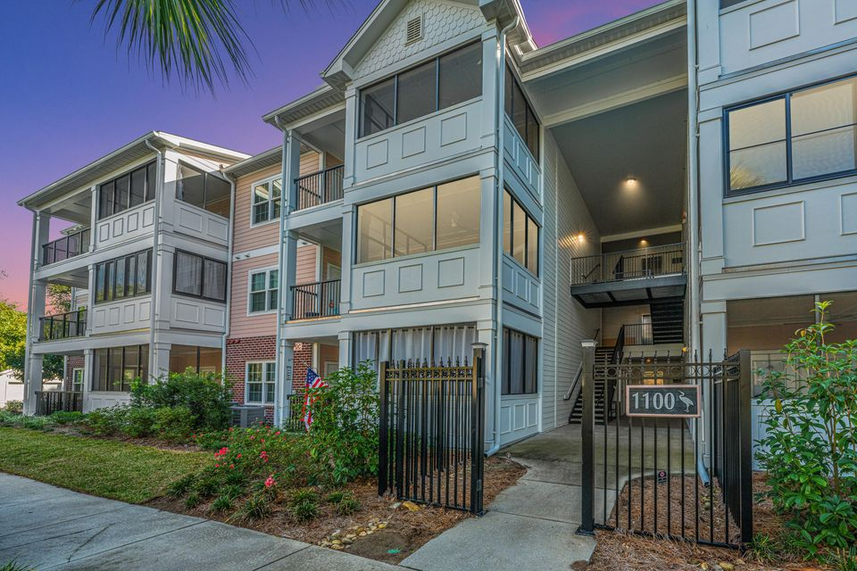
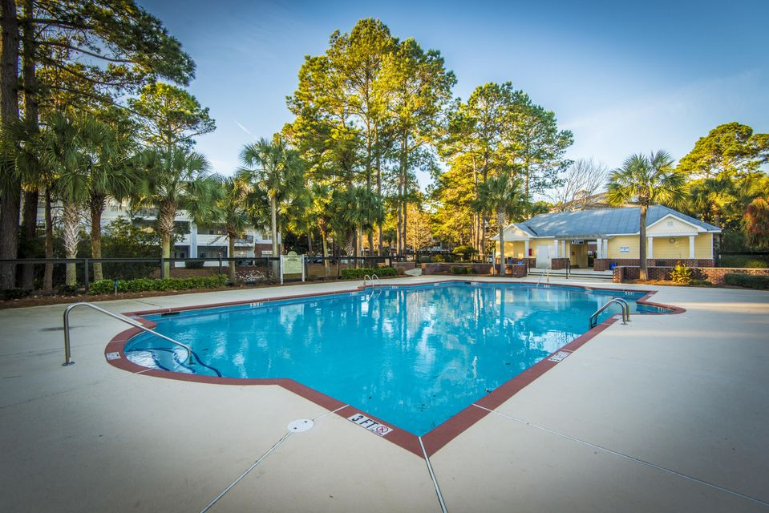
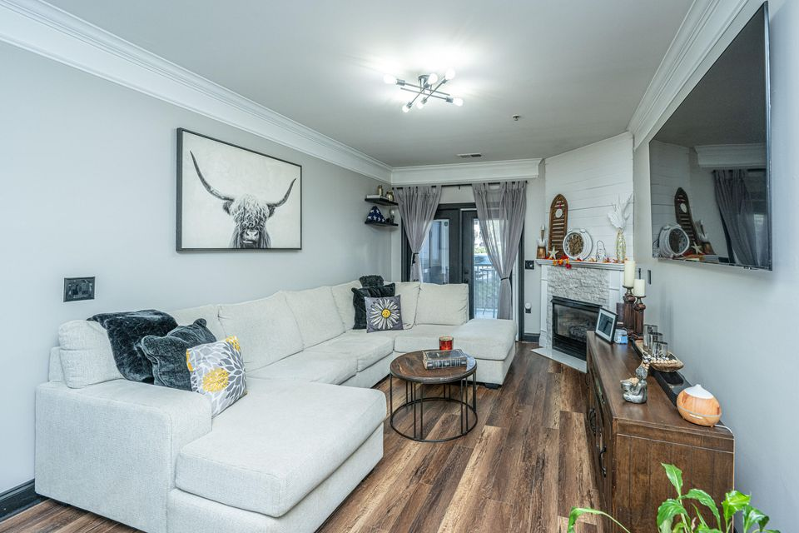
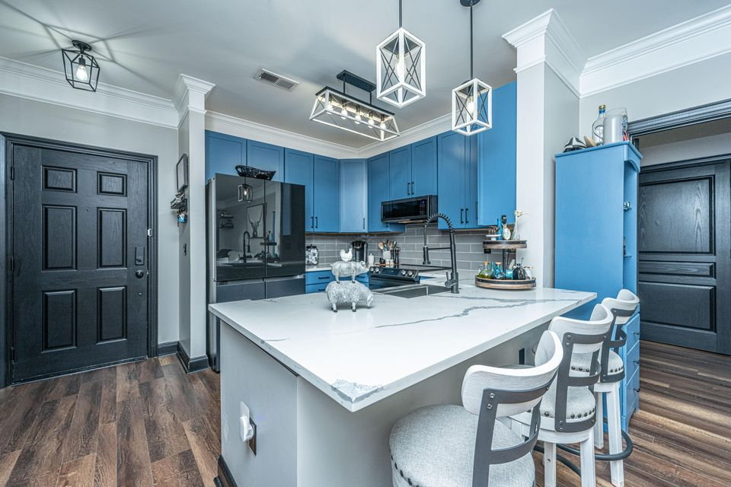
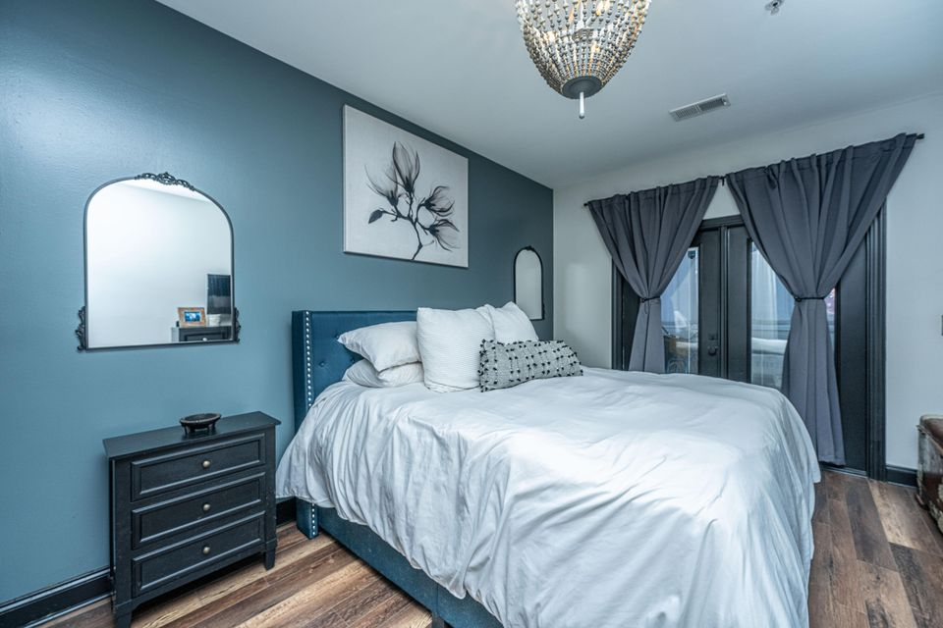
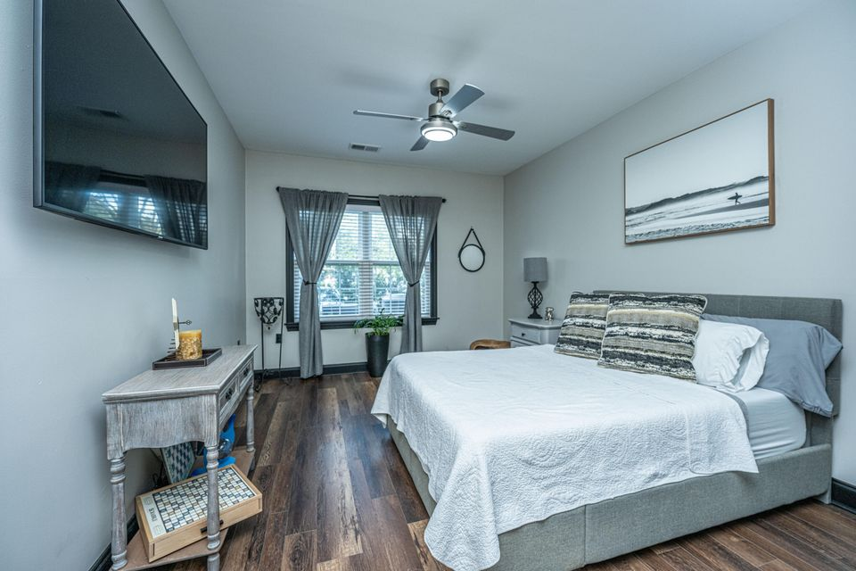

IMMACULATE CONDO FOR SALE
1025 Riverland Woods Place 1108
The Retreat at Riverland | Charleston, SC 29412 | MLS# 24028689 | $415,000
Welcome to this meticulously updated condo in the quiet gated community of The Retreat. Every detail has been thoughtfully designed to create a seamless blend of elegance and modern convenience. From the brand-new wood flooring and crown molding to the freshly painted walls and doors, the quality of craftsmanship is apparent in every corner. The heart of the home is the kitchen, where form meets function. Soft-close cabinetry pairs elegantly with quartz countertops and a ceramic tile backsplash. The gunmetal stainless steel appliance suite includes a state of the art 4-Door French Door Refrigerator, a 5-burner electric oven (with air fryer & bread-making options), microwave and dishwasher. A farm-style, handsfree, extra-deep sink offers the finishing touches.
A custom built pantry adds additional storage space!
The spacious living area is enhanced by a beautifully designed fireplace, complete with new shiplap, stone facing, and a marble hearth - creating a cozy atmosphere.
The primary suite is an oasis of relaxation, featuring an oversized custom closet with built-in shelving and ample space. The luxurious en-suite bath is a retreat in itself, with a walk-in shower equipped with a rain showerhead and elegant new quartz countertops.
The guest suite offers a spacious bedroom with a large walk-in closet. The guest bath boasts a newly installed vanity with quartz countertops. Situated away from the primary suite, this area provides a private, comfortable retreat for visitors.
Relax on the double porch, featuring both a screened-in area and an open patio. Enjoy your morning coffee in the fresh air or unwind with an evening cocktail in this versatile outdoor space.
Jenny Siggelkow
843-901-3494
jcsiggelkow@gmail.com
ERA Wilder Realty | 537 Folly Road | Charleston, SC 29412

