Slide 1
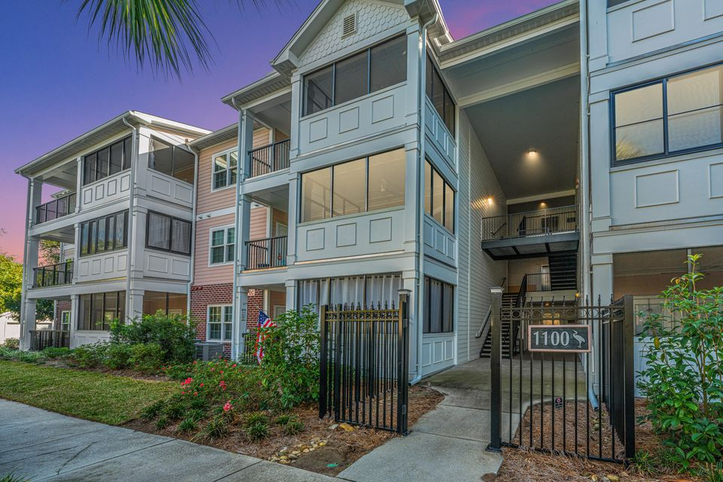
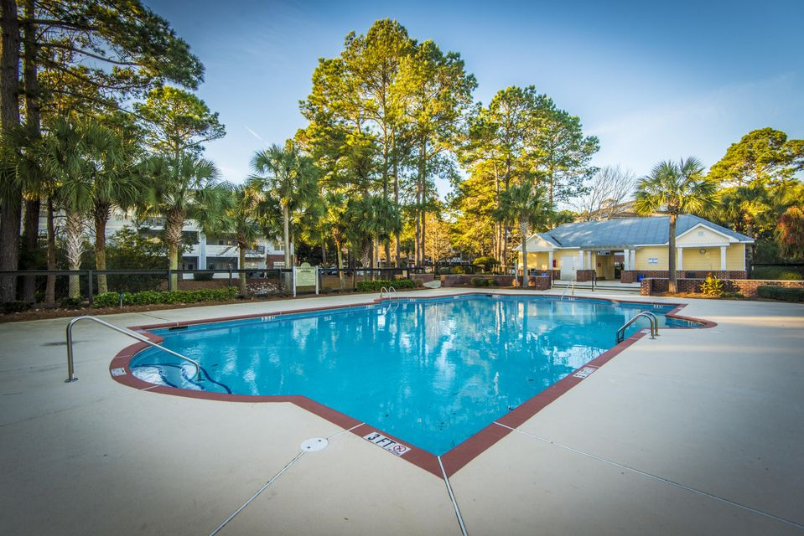
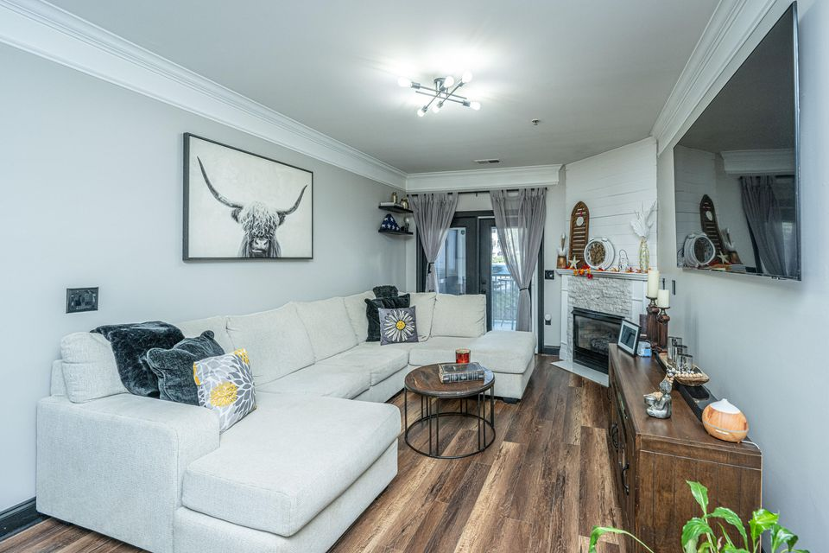
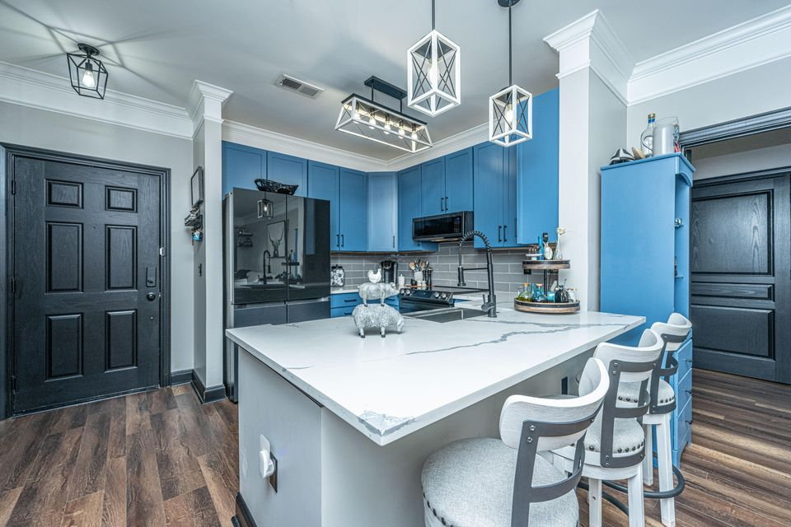
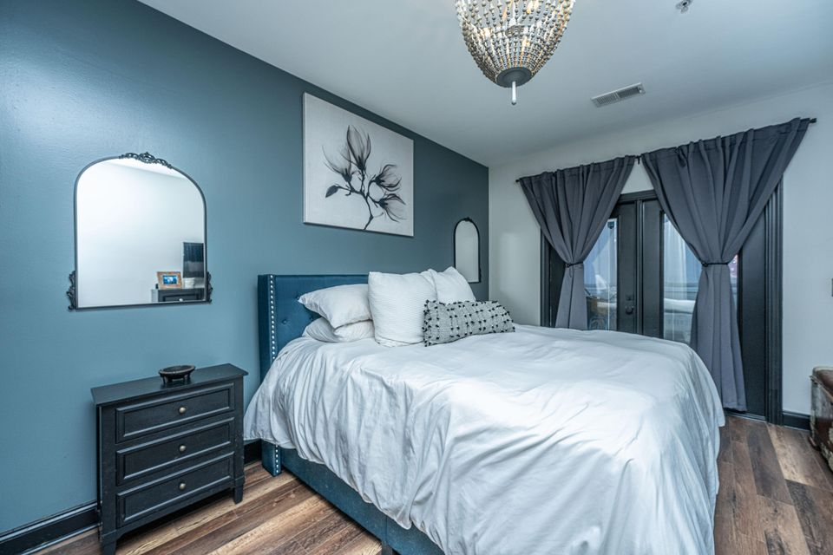
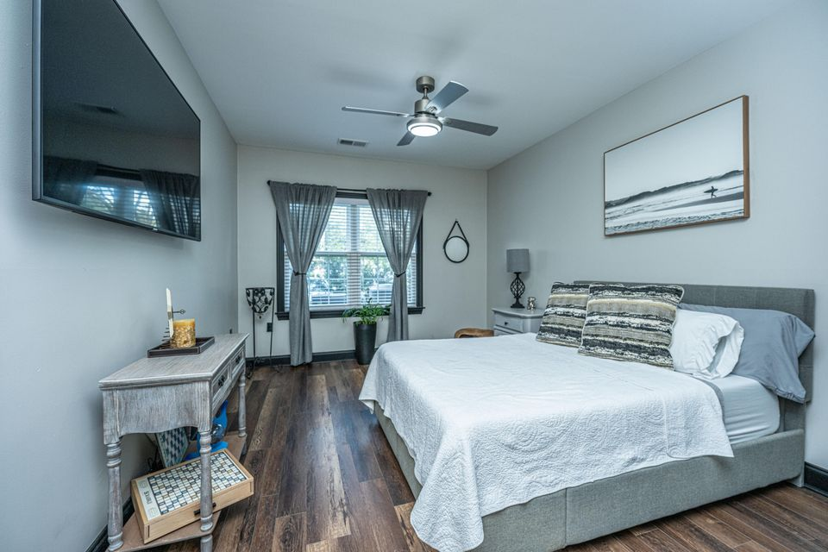

$1000 AGENT BONUS AVAILABLE
1025 Riverland Woods Place 1108
The Retreat at Riverland | Charleston, SC 29412 | MLS# 24028689 | $415,000
$1000 AGENT BONUS WITH RATIFIED CONTRACT BY 3/10!
Elegant Coastal Retreat - Immaculate & Move-In Ready! Nestled within The Retreat, one of the area's most sought-after gated communities, this stunning condo offers the perfect blend of luxury, comfort, and modern convenience. Every detail has been thoughtfully designed. Step inside to find brand-new wood flooring, crown molding, and freshly painted walls and doors, showcasing impeccable craftsmanship. The chef's kitchen is a dream, featuring soft-close cabinetry, quartz countertops, and a ceramic tile backsplash. A gunmetal stainless steel appliance suite—including a state-of-the-art 4-door refrigerator, 5-burner electric oven with air fryer & bread-making options, microwave, and dishwasher—adds both style and function. An extra-deep farm-style sink and a custom-built pantry provide the perfect finishing touches.
The spacious living area is highlighted by a beautifully designed fireplace, complete with new shiplap, stone facing, and a marble hearth, creating a warm and inviting ambiance.
The primary suite is a true retreat, boasting an oversized custom closet with built-in shelving and a spa-like en-suite bath with a walk-in rain shower and quartz countertops. The guest suite offers a spacious bedroom, large walk-in closet, and a newly upgraded bath with a quartz vanity - ensuring privacy and comfort for visitors.
Enjoy year-round coastal living on the expansive double porch, featuring both a screened-in area and an open patio - perfect for savoring your morning coffee or unwinding with an evening cocktail.
This move-in ready gem is an absolute must-see! Schedule your showing today!
Jenny Siggelkow
843-901-3494
jcsiggelkow@gmail.com
ERA Wilder Realty | 537 Folly Road | Charleston, SC 29412

