Slide 1
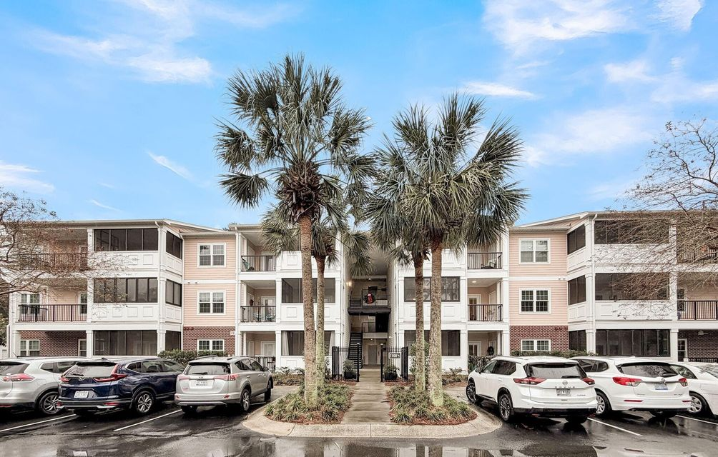
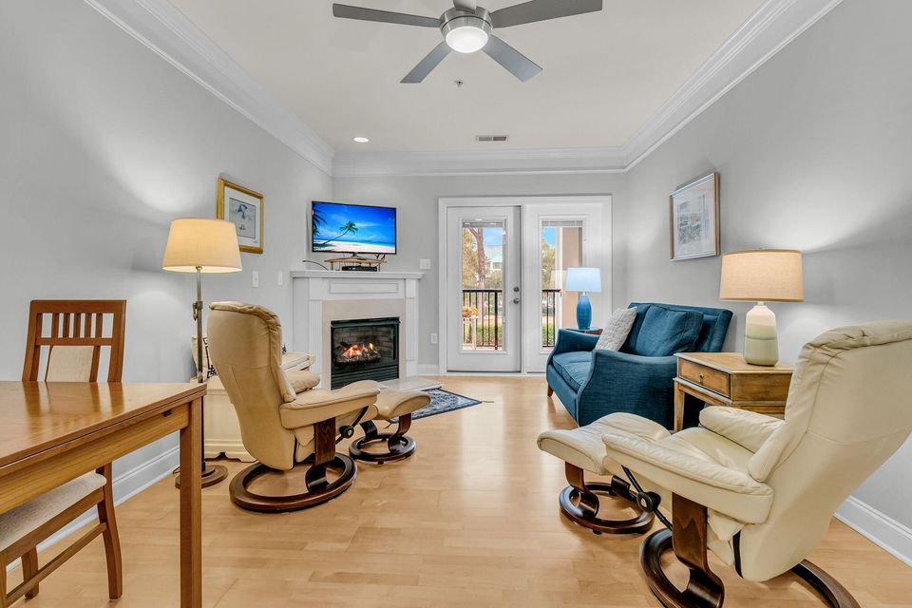
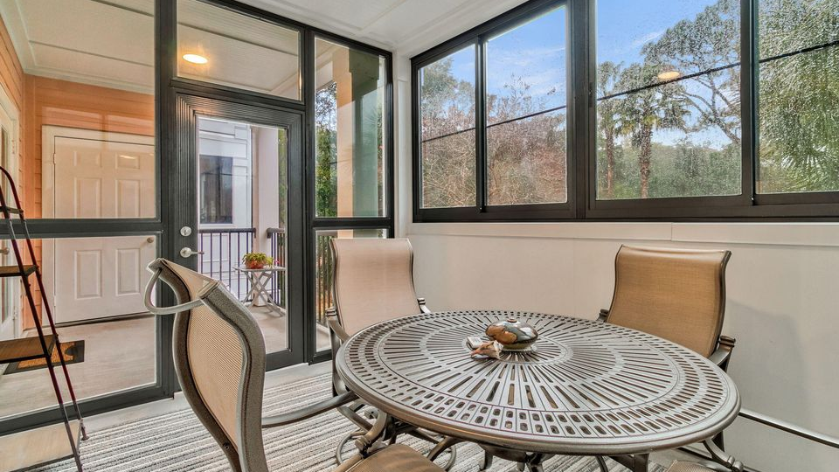
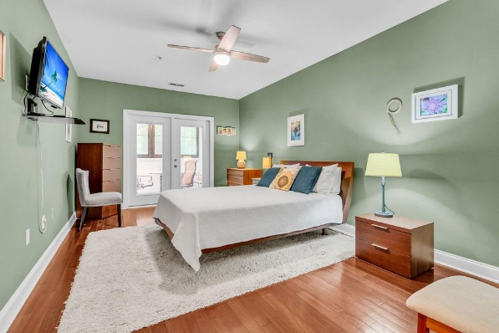



Open House
Sunday, January 4th from 12-2
4.2 Acres
1025 Riverland Woods Place #1109
The Retreat at Riverland
Charleston, SC 29412
MLS# 25031701 | $387,000
2 Bedrooms | 2 Bathrooms | 1,058 SF
Stephanie Howard
REALTOR® ABR, RENE, SRS, PSA
843-224-5912
stephanie@stephanie-howard.com
http://www.stephanie-howard.com
AgentOwned Realty Charleston Group
902 Savannah Hwy | Charleston, SC 29407-7802

