Slide 1
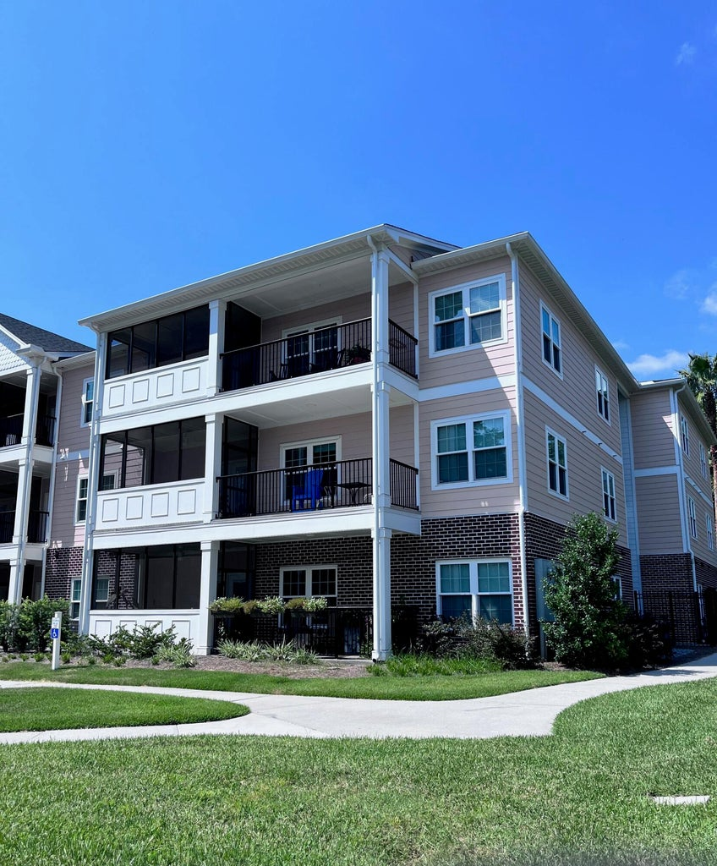
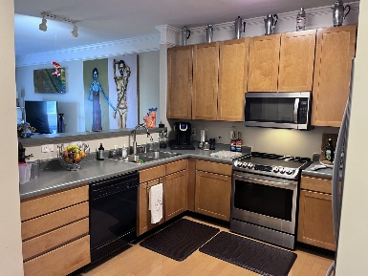
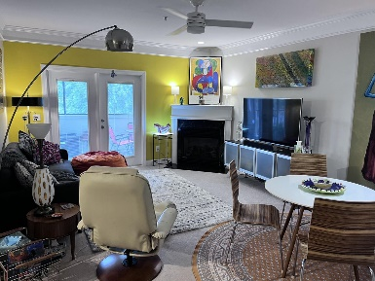
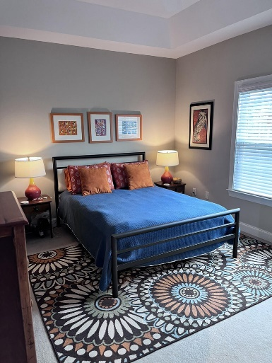
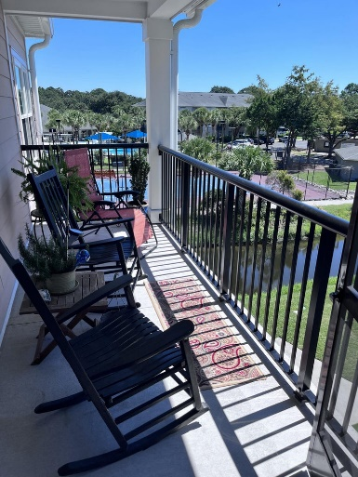
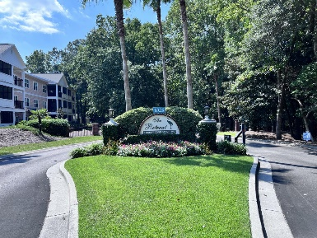
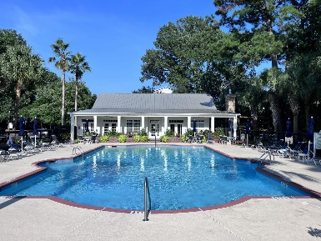


New Price - Beautiful Location
1025 Riverland Woods Place #218
The Retreat at Riverland | Charleston | MLS# 23020577 | $429,000
Take another look! Fresh paint! Beautiful grounds! Resort like amenities! Reasonable HOA fees! Impressive square footage! Corner unit on top floor! Available elevator! Planned community social functions! Inside you'll love the large kitchen with 42'' cabinets that is open to the living room and dining area. The laundry room and guest bath are off of the hallway. Both guest bedrooms can accommodate a queen size bed and have generous closets.
The primary bedroom features a tray ceiling and has its own full bath and large walk-in closet. In 2021, The Retreat at Riverland completed an extensive renovation that included new Energy Star, impact resistant Pella windows, balconies, siding, roofs and landscaping. This truly is a community with several social events planned throughout the year. Great location too, approx. 15 minutes to historic downtown Charleston and 10 minutes to Folly Beach. Owner/seller is a SC licensed Realtor.
Gary Raymond (843) 729-3688 | gary.raymond@agentownedrealty.com
AgentOwned Preferred Group | 1400-G Palm Blvd. | Isle Of Palms, SC 29451

