Slide 1
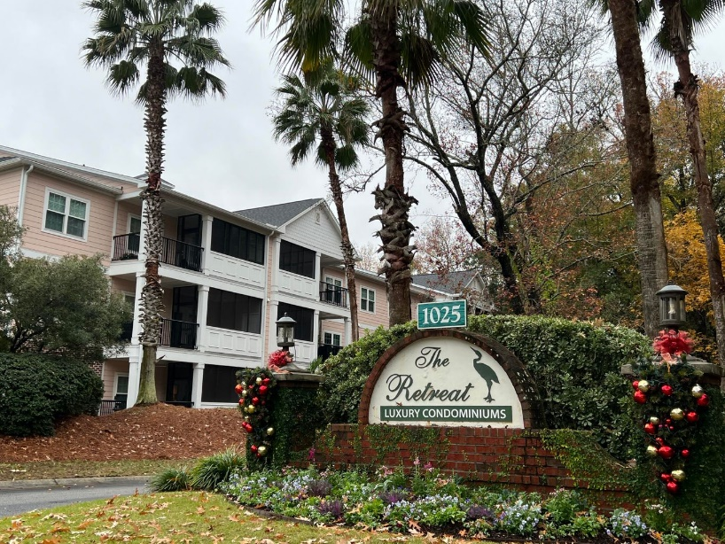
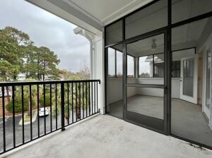
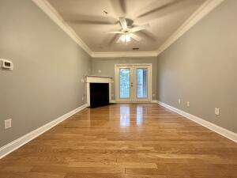
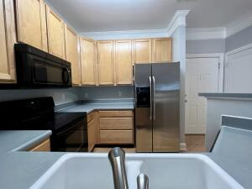
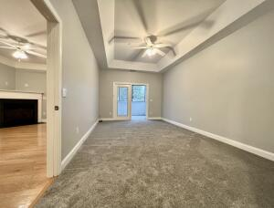
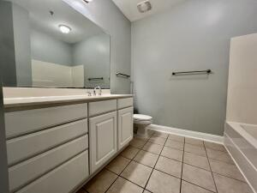
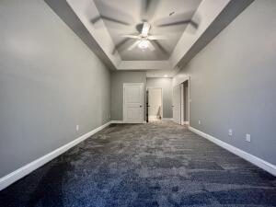
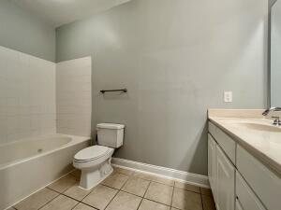
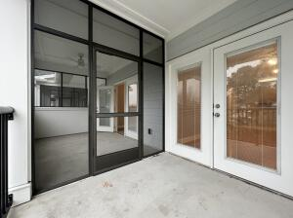
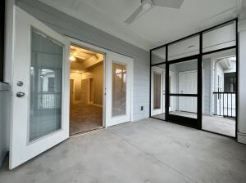


1025 Riverland Woods Place 317 The Retreat at Riverland ~ Charleston, SC 29412 MLS# 21031232 ~ $302,000
Beautiful James Island Condo
Welcome home to this beautiful condo that is in a great location off of Folly Rd! Not far from Folly beach or Downtown! Gated Community with amenities. Easy walk to the beautiful pool, clubhouse, mail boxes and trash drop off **Move in Ready** Fresh paint throughout! New carpet in the two bedrooms! The master bedroom has tray ceilings, a jacuzzi tub and its own brand new porch! All recessed lighting has been replaced throughout. In the living room you have a gas fire place, off the living room is also a brand new balcony. Enjoy being on the 3rd floor with no one above above you and easy access to the elevator. There is also a laundry room where the washer and dryer convey.
Kelly Rozier
(843) 209-3129
kellywrozier@gmail.com
Brand Name Real Estate
4 Carriage Lane Suite 106
Charleston, SC 29407

