Slide 1
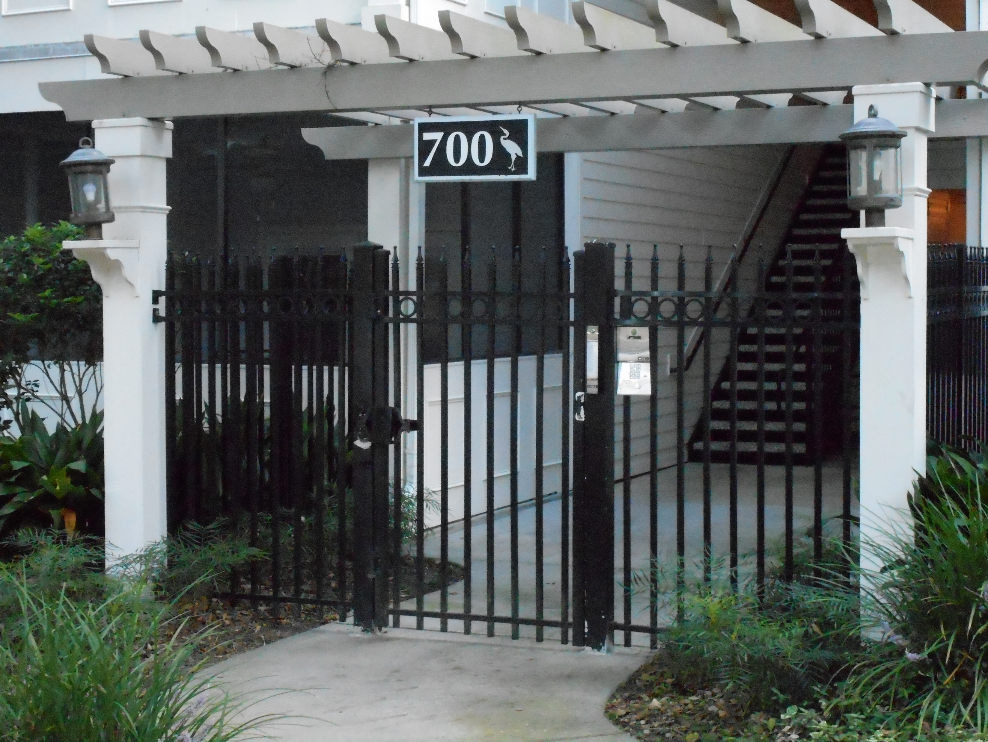
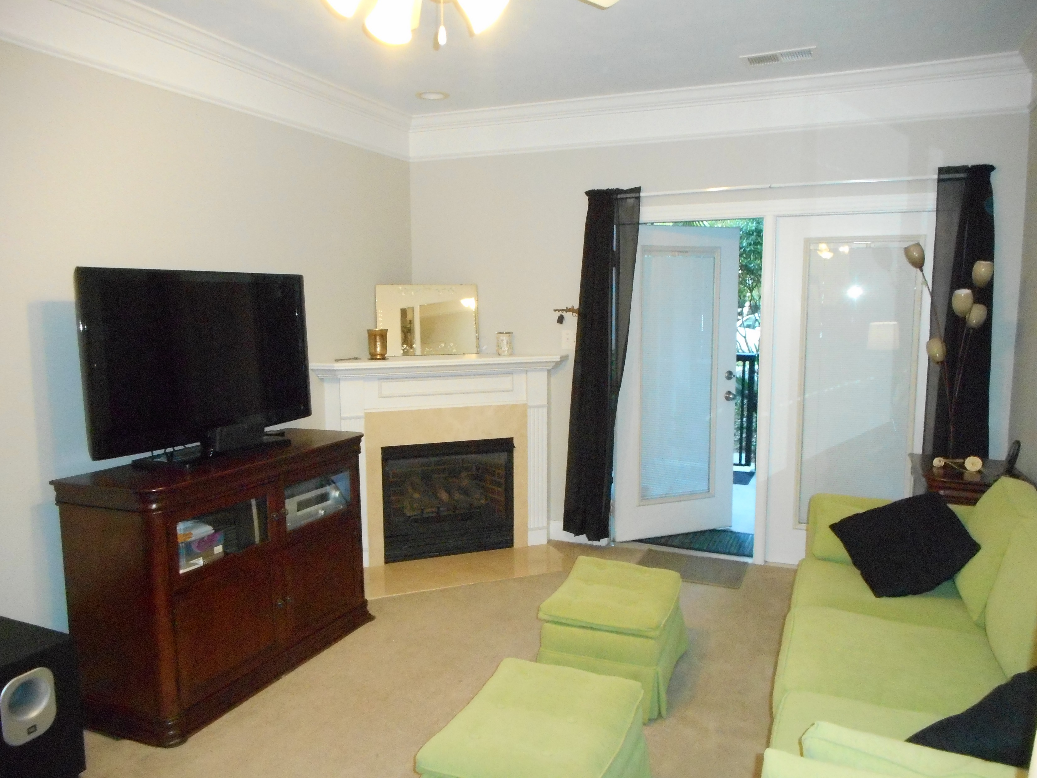
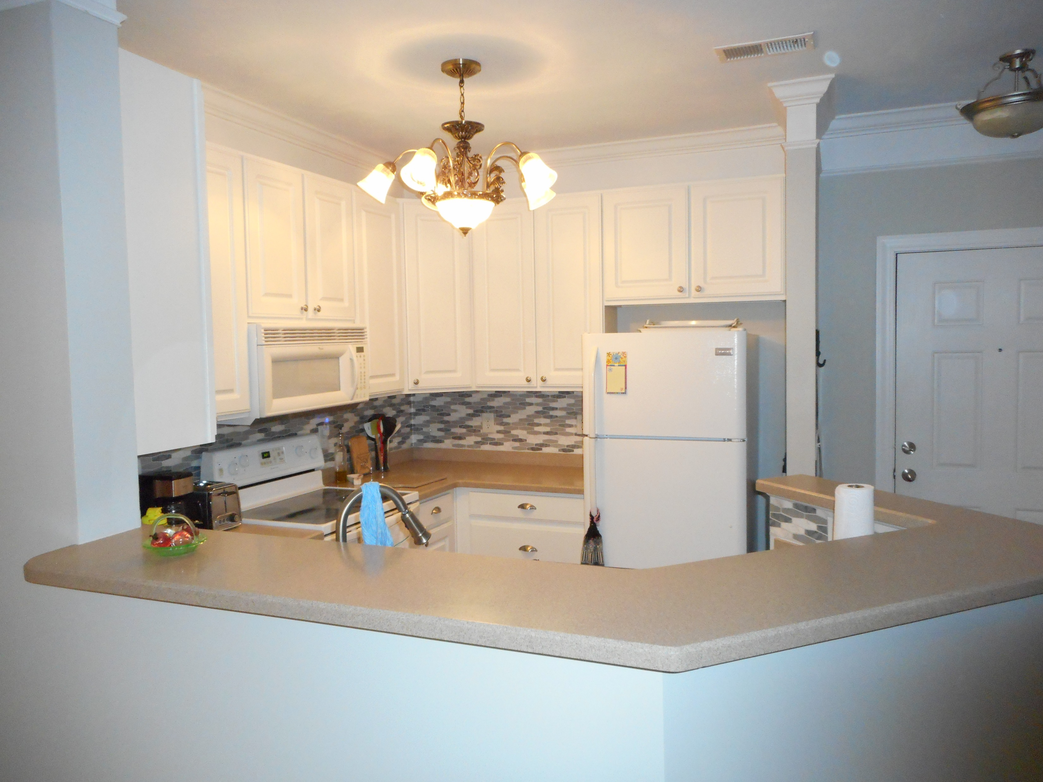
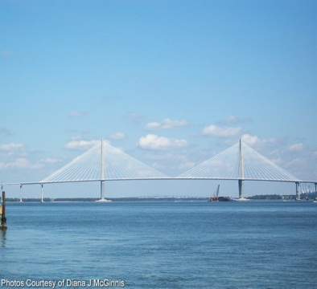
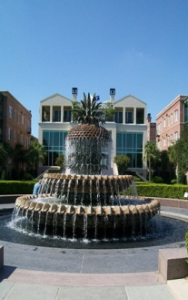
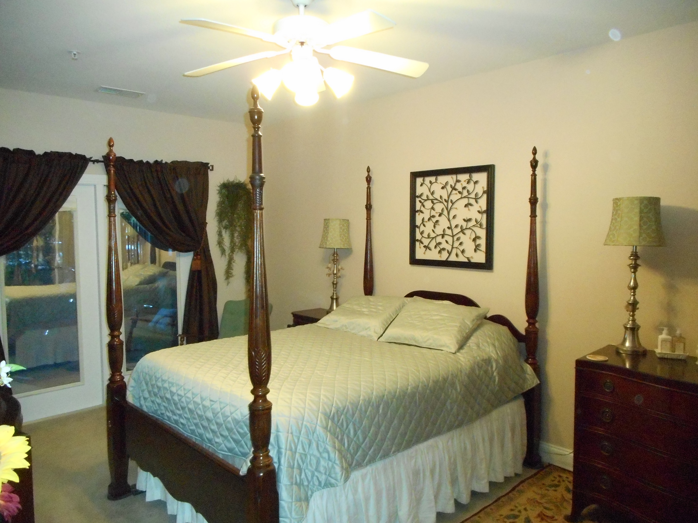
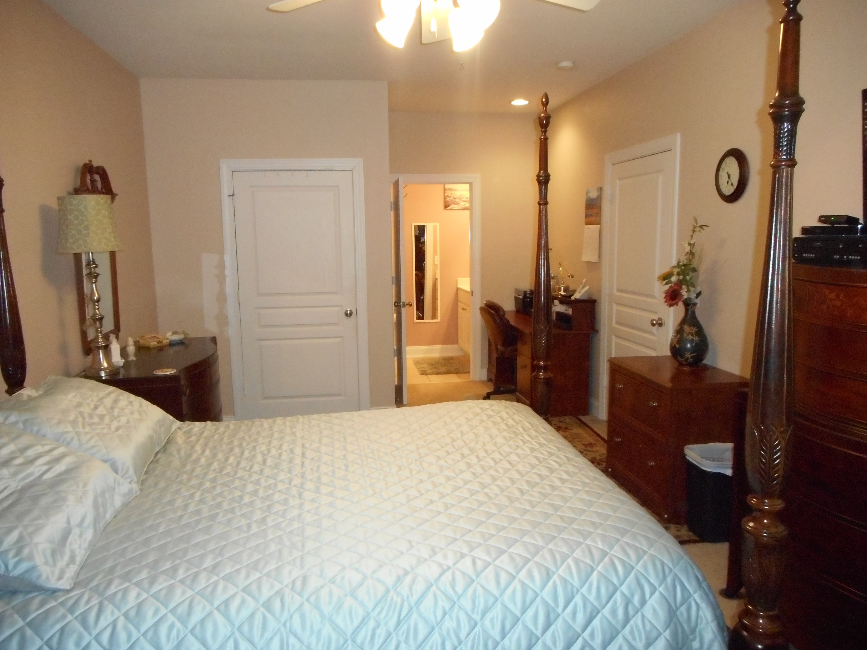
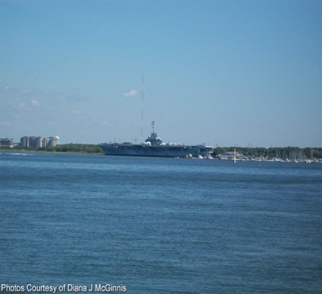
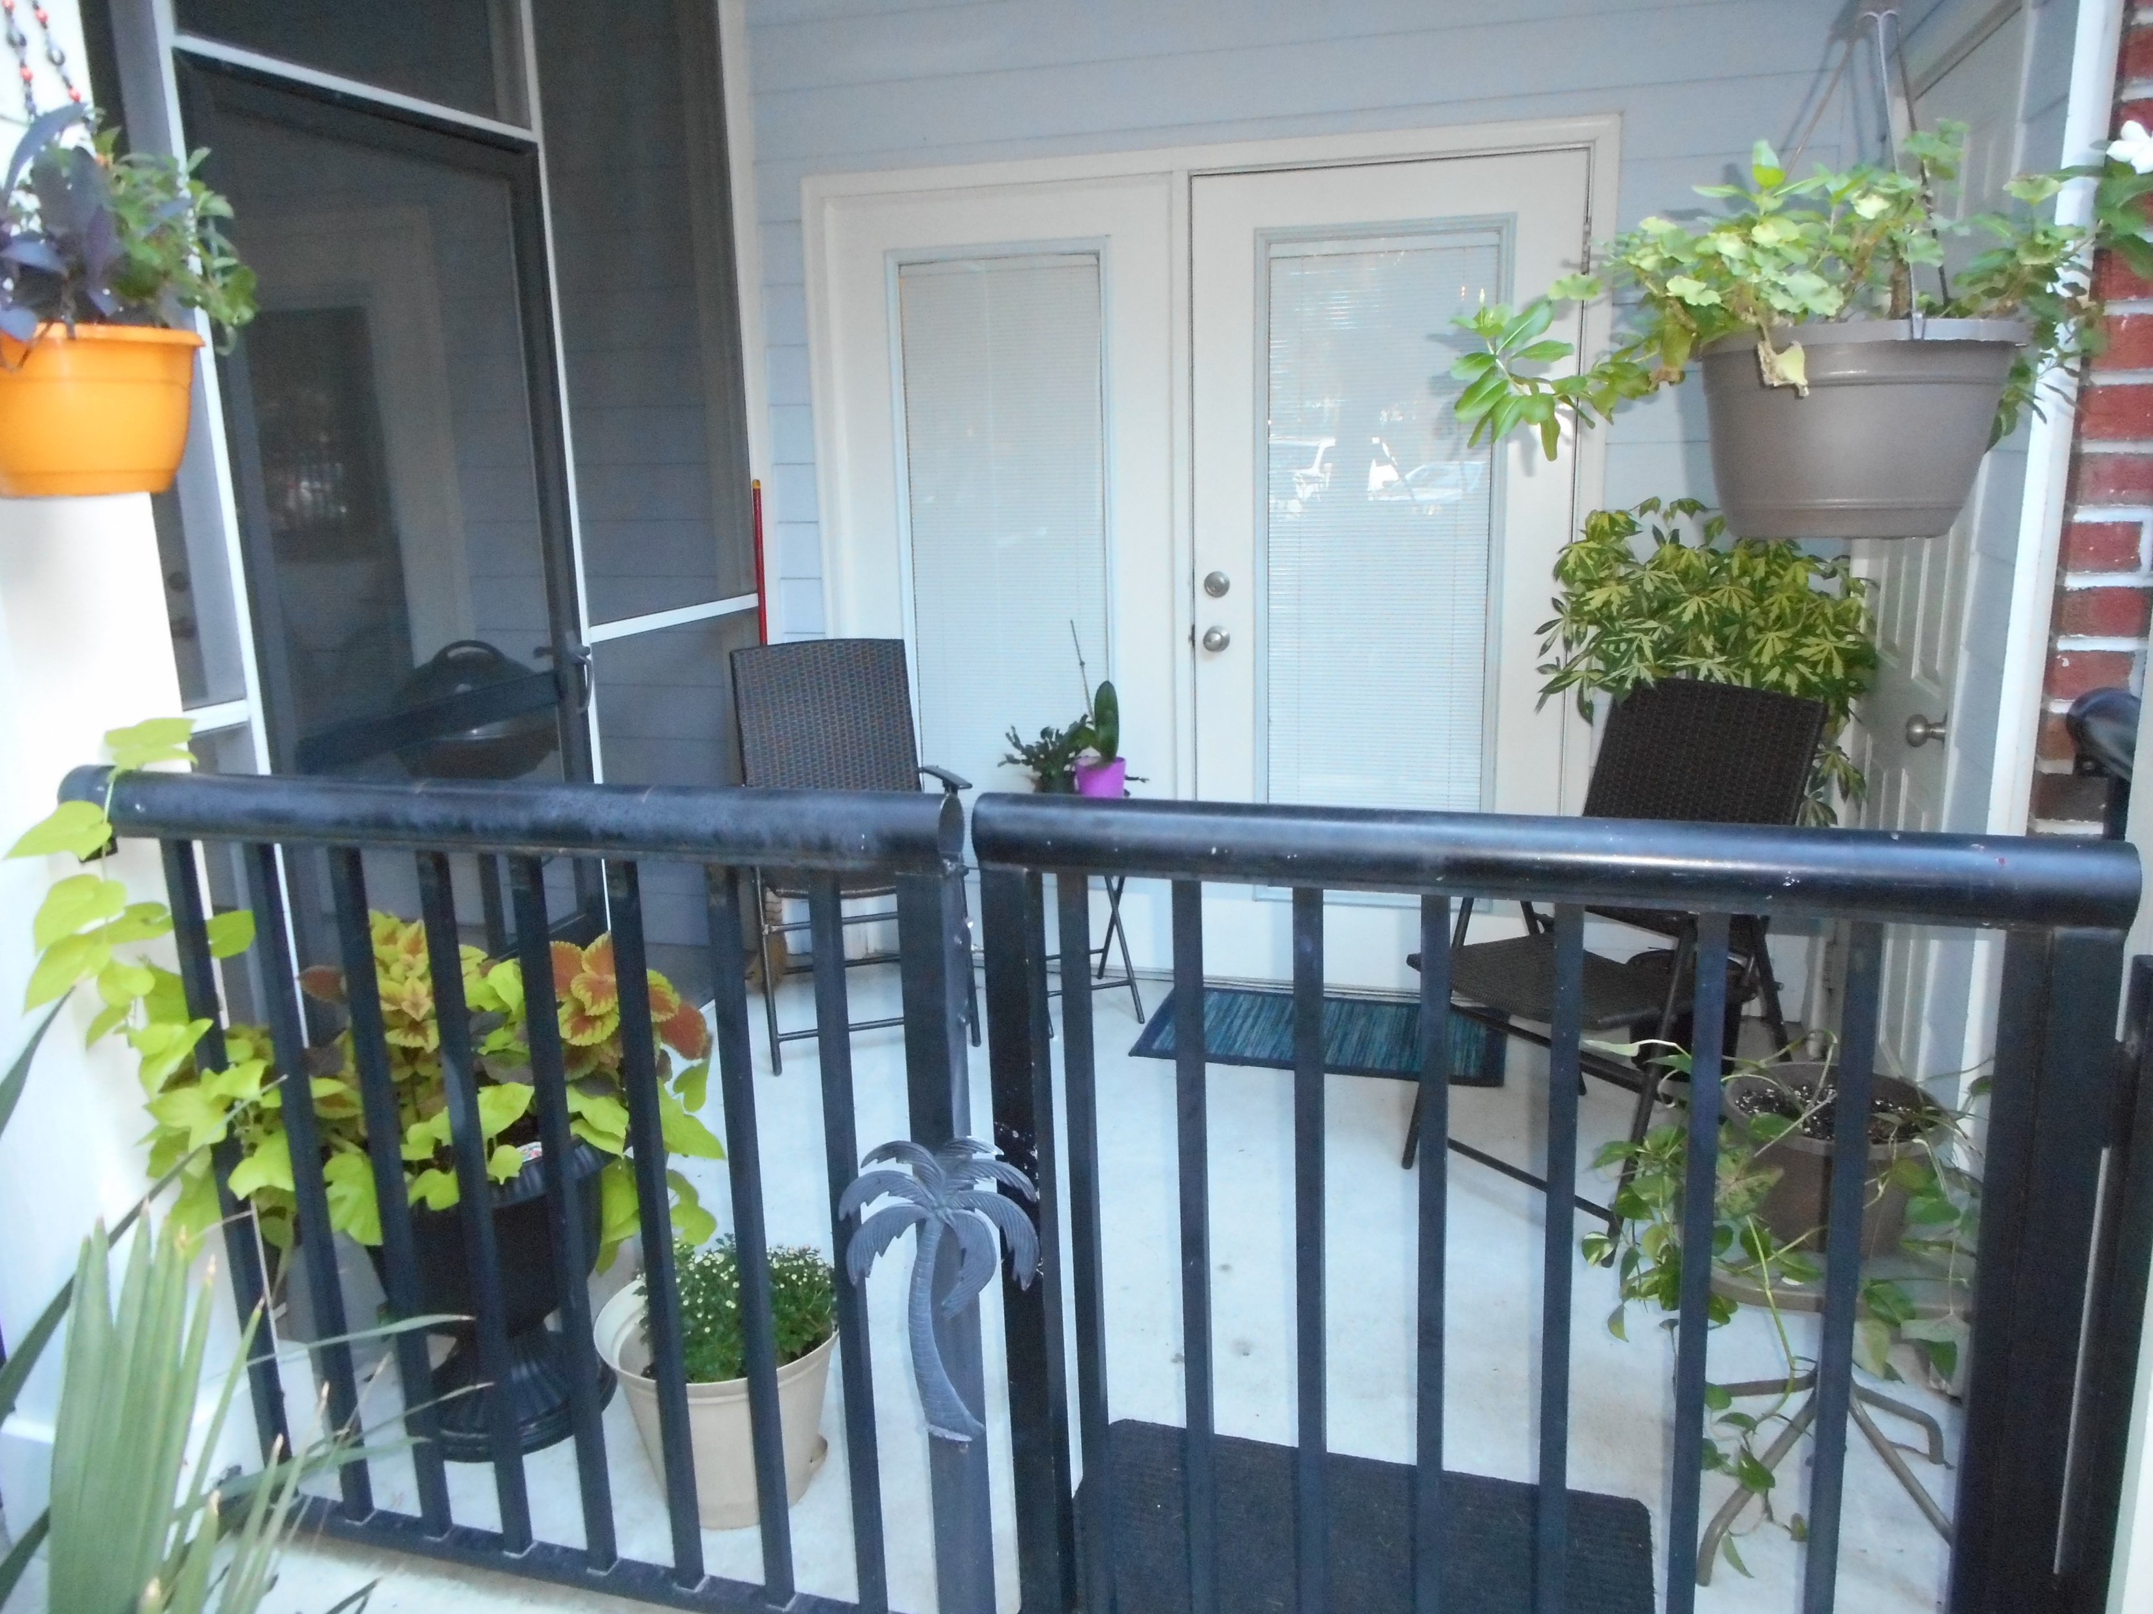


OPEN HOUSE
Sunday February 19th
1:00 - 4:00
$450,000
$450,000
1025 Riverland Woods Place #701
The Retreat at Riverland · Charleston · MLS# 16025699 · $196,900
Rodney Hancock
(843) 437-1347
rodneyhancock08@gmail.com
mortgageprofessionalsonline.com
This 1st floor St. Martin floor plan is placed perfectly in The Retreat.. Enter through your own private entrance open to the front porch. Beautiful kitchen with white cabinets, corian counter tops and new refrigerator. Crown molding throughout main living area. Separate laundry room with new washing machine. This unit offers a very spacious Master Bedroom and larger Guest Bedroom making this a split floor plan providing plenty of privacy. French doors leading to the porch overlooking beautiful landscaping. Pride in ownership shows in this unit, very well maintained. The Retreat is a gated community less than 8 minutes to Folly Beach and approx. 10 minutes to Downtown, with the resort style amenities and state palmetto trees throughout the property makes for an inviting welcome home.
AgentOwned Charleston Group
902 Savannah Hwy
Charleston, SC 29407
Real Estate ● Mortgage
Insurance ● Business Brokerage

