Slide 1
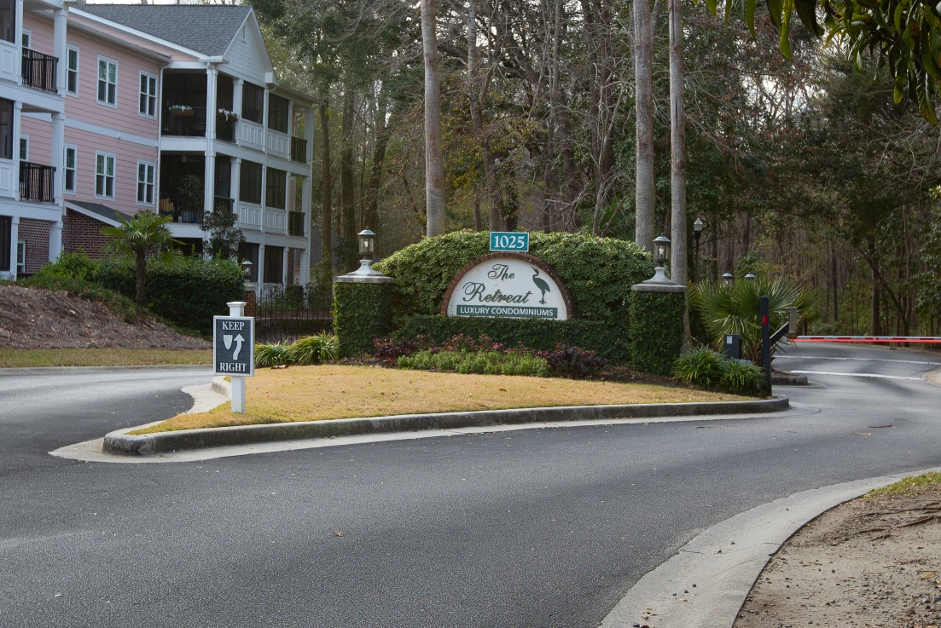
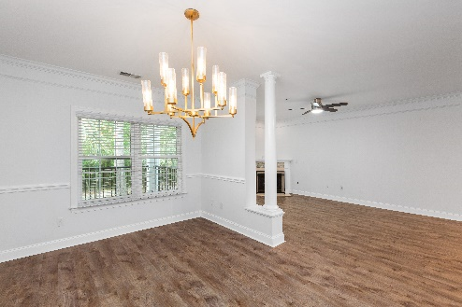
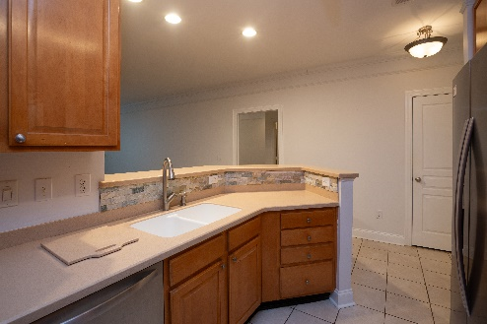
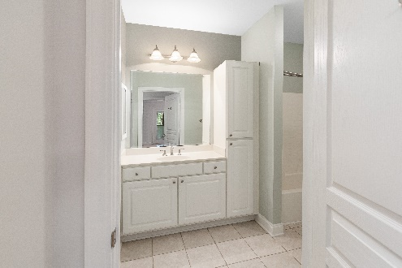
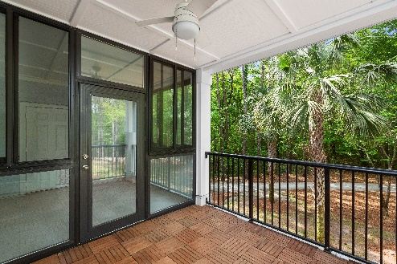


Move-In Ready ~ Open Floorplan
NEW PRICE
1025 Riverland Woods Place 713
Charleston, SC 29412 · MLS# 24004212 · $439,000
Michael Dew
O 843-769-5100
M 843-870-7000
michaeledew@gmail.com
www.michaeldewrealestate.com
Beautiful 2 bed 2 bath condo in The Retreat at Riverland. Property has security gate to enter community. Located on the third floor of the building and very close to the elevator. Larger floor plan. New LVP flooring throughout main living areas. Kitchen boasts stainless steel appliances, including a new stove, and tiled backsplash over sink. Two large bedrooms each w/walk-in closets. Second bedroom has direct access to screened porch. Master bathroom has glass shower. Hall bath includes soaking tub. Separate laundry room w/built-in cabinets and stackable washer/dryer. Spacious family room w/gas fireplace that connects to formal dining room. Sun room and screened porch that overlook quiet wooded preserve. New water heater. Community includes pool, fitness center, and walking/jogging trails! MINUTES to Folly Beach and downtown CHS. Boat/RV storage available.
AgentOwned Charleston Group
902 Savannah Hwy
Charleston, SC 29407
Real Estate ● Mortgage
Insurance ● Business Brokerage

