Slide 1
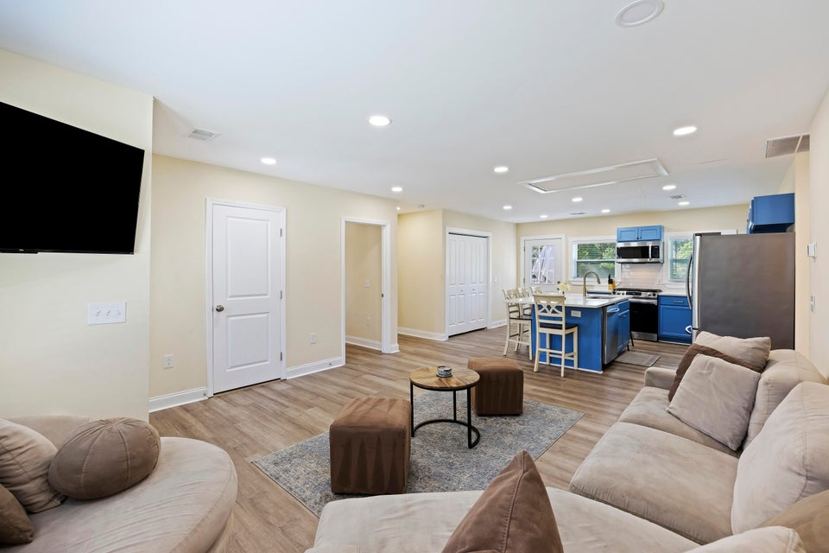
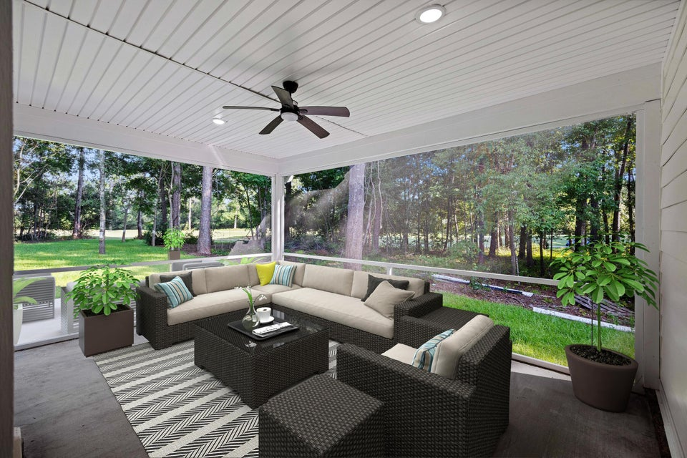
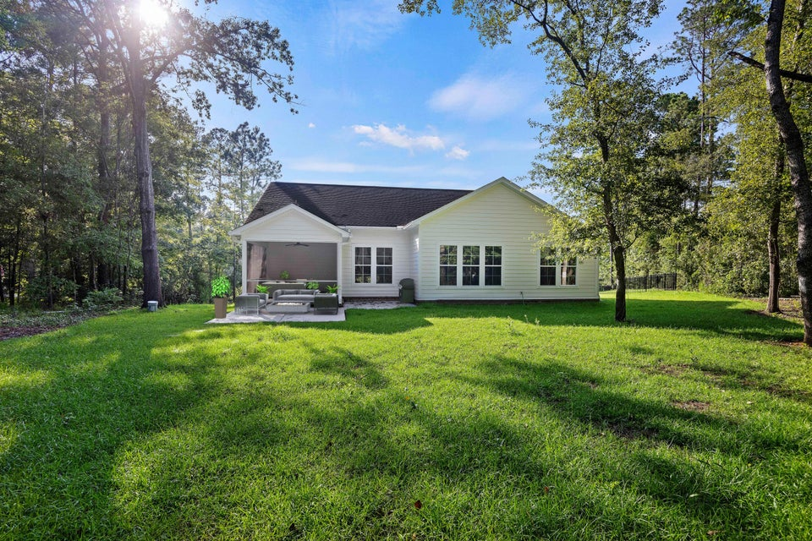
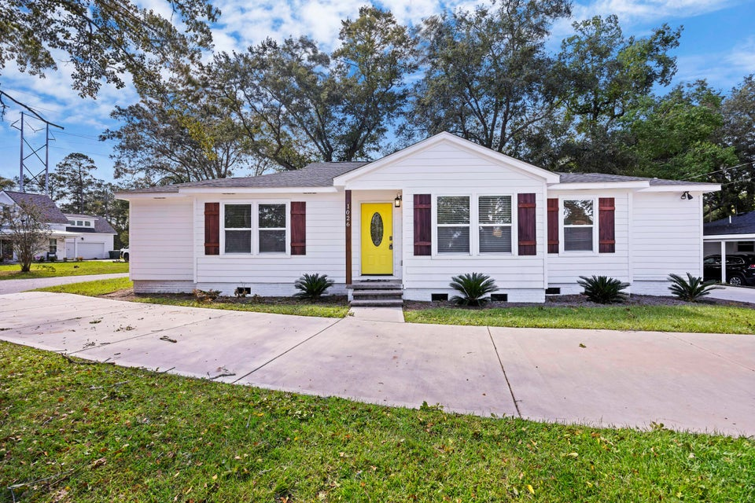
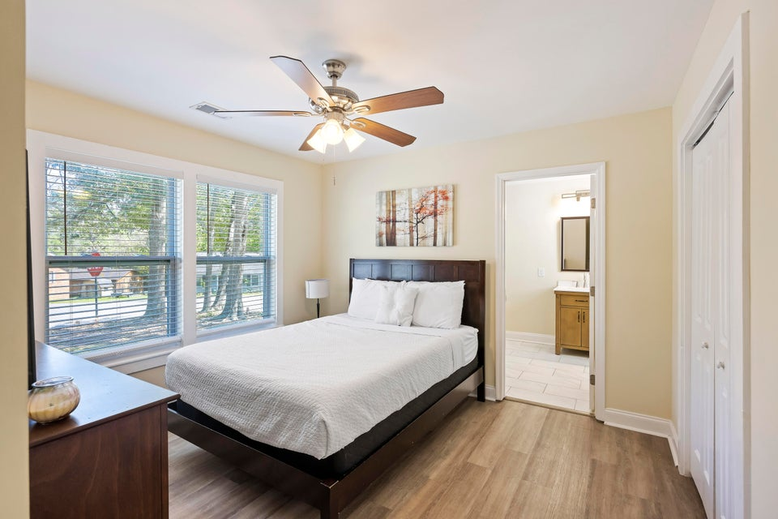
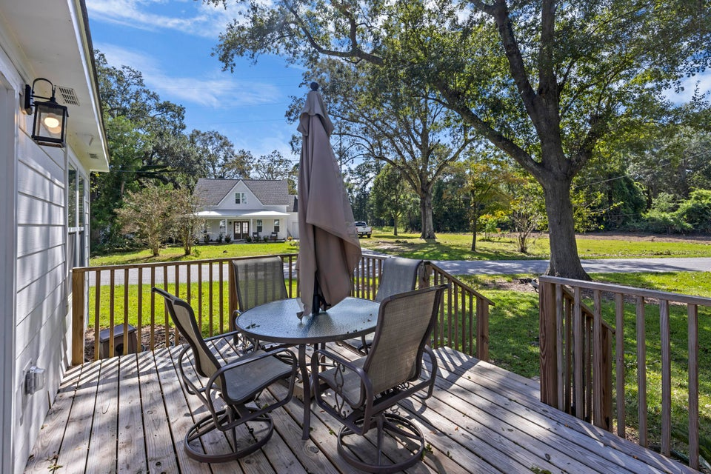


Turn-key Airbnb Property For Sale
1026 Holcombe Road
Berkley Hills | Hanahan, SC 29410 | MLS# 24026373 | $449,900
Completely Remodeled In 2023 (New Everything!)
No HOA
$33,556 Annual income (after all management expenses)
2 more Airbnb properties available with cap rates close to 8%
*inquire for more details!
Atlas Fathalla
The Home At Last Team
843-779-5613
atlas.home.expert@gmail.com

