Slide 1
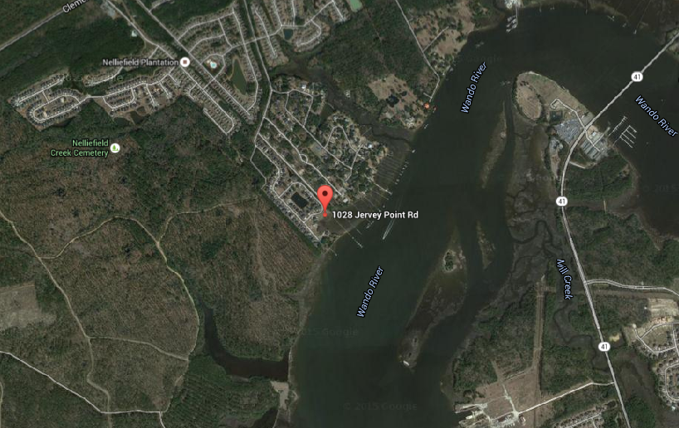
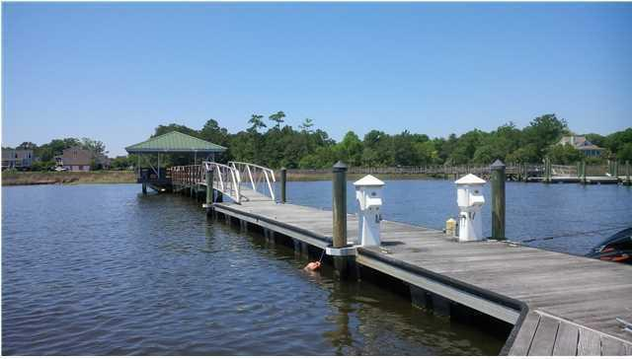
Deep Water Lot
7ft at low tide ~ includes deeded boat slip
1028 Jervey Point Road
River Reach Pointe · Wando · MLS# 16003369 · $425,000
Deep water lot: 7ft of water at low tide and includes a deeded boat slip at the end of the community dock. You pay $750/yr fee for the boat slip and the rest of the community pays for the maintenance or replacement of the dock that accesses the boat slips!!!
2 other deep water lots are for sale in the same community and priced $200,000 higher plus they have to build their own dock!
This lot is at the rear of the subdivision and can accommodate up to a 5,000 sq ft, 2 story home with spectacular views of the Wando River.
New schools scheduled to open later this year. Elementary through High School.
MLS #15010203 - 30.41 acres - $1,500,000
MLS #15010204 - 20.06 acres - $1,100,000 | MLS #15010206 - 10 acres - $580,000
MLS #15010208 - 5 acres - $299,000 | MLS #15010210 - 3 acres - $199,000
Rick Willis
843-327-3017 · Rick@RickWillis.com · The Group, LLC

