Slide 1
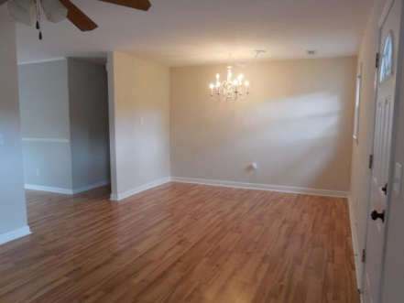
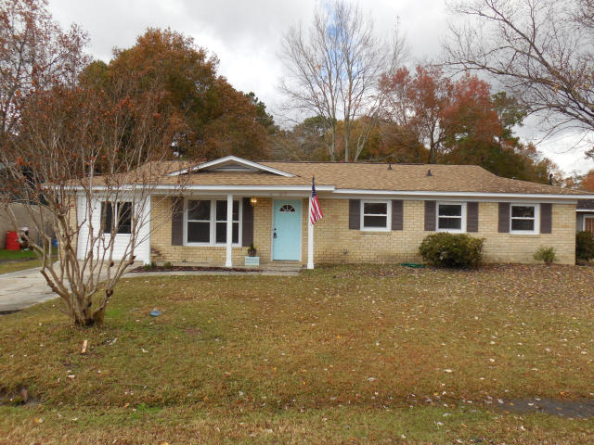
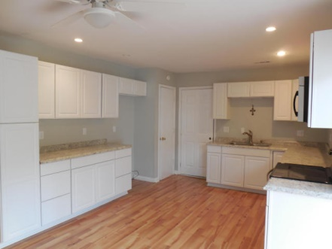
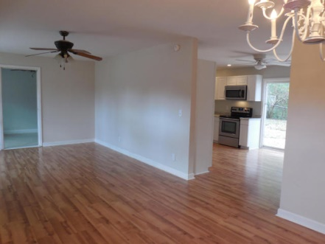
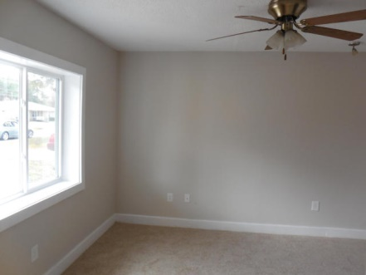
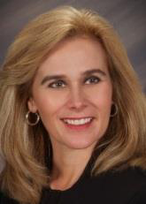

4 Bedrooms in Dorchester District 2 For $125,000!
Beautiful 4 bedroom remodeled home on a corner lot in Dorchester II school district. The home offers a new kitchen, new flooring, paint and tiled bathrooms. On the lot is a large 958 sq. ft. workshop! Come see this wonderful home.
1028 Margaret Dr
Fairlawn
Ladson, SC 29456
MLS# 14030372
Sherri Seymour
843-303-3495
Seymour.Sherri@gmail.com
CCBG Real Estate Group PO Box 1440
Mount Pleasant, SC 29465

