Slide 1

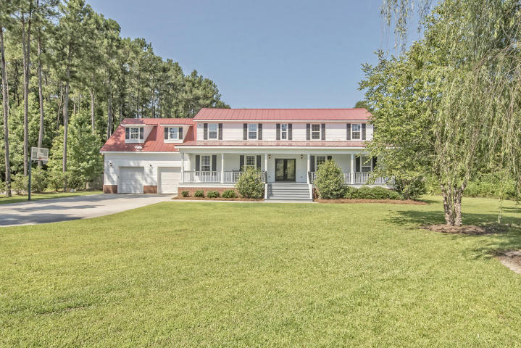
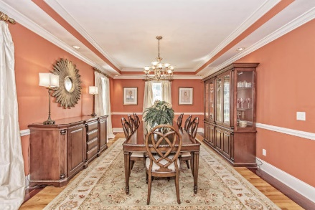
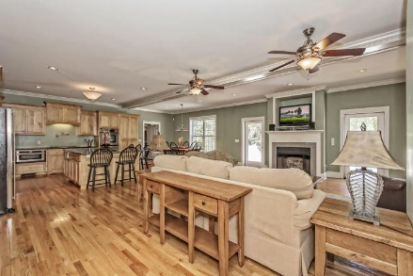
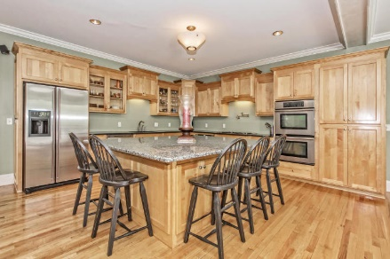
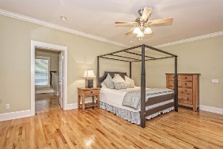
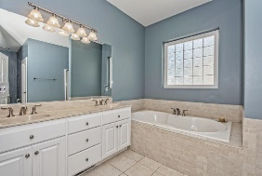
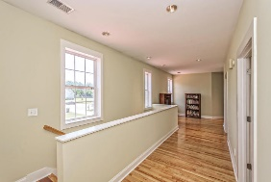
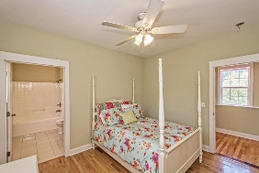
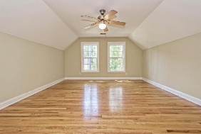
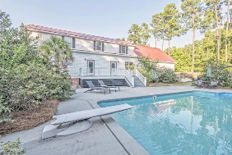

Priced $22,000 Below
Appraised Value!
Pam Bass
Realtor
M 843-259-4926 | O 843-871-2121
www.pambassproperties.com
pbass@century21properties.com
1028 Mount Whitney Dr | The Summit | Summerville | MLS# 16016963 | $545,000
Beautiful custom built home on large private lot with in-ground swimming pool. This is a great family home featuring 5 bedrooms plus a bonus room that could be a 6th bedroom. The master bedroom is location the first floor. As you enter the home you will notice the beautiful hardwood floors which run through out the home. There is an office on the right and a formal dining room on the left. The open floor plan has spacious family room with a gas fireplace and built in bookshelves. The kitchen has an abundance of cabinets and counter top space , double ovens, center island, a pot filler, granite counter tops and stainless appliances. There is a huge mud room off of the kitchen. The master suite has an enormous walk in closet, master bath with double sinks, garden tub & separate shower. There are an additional 4 bedrooms plus a large bonus room that could be a 6th bedroom and 2 large storage closets. There are 2 full bathrooms upstairs and all hardwood floors throughout the home with ceramic tile in the bathrooms. There is also a central vacuum system. Enjoy taking a dip in the pool on those warm summer days and grilling out on the large deck. The home it situated at the dead end of the cul-de-sac and has a 6 foot privacy fence. This home was built by a contractor and has a concrete slab foundation under the crawlspace and a irrigation system. Located in desirable Dorchester 2 school district, close to shopping, restaurants and only 5 minutes from Downtown Summerville and 30 minutes from Downtown Charleston.

