Slide 1
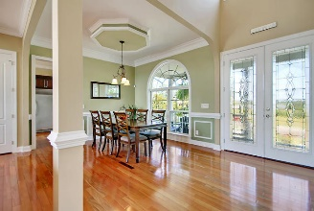
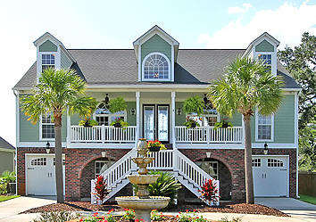
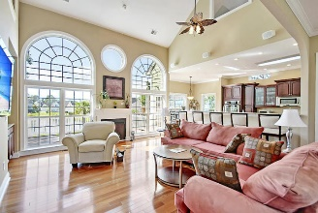
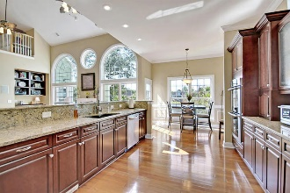

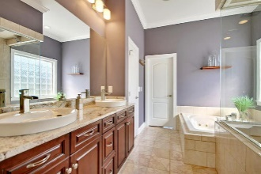
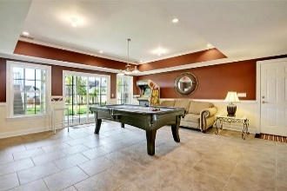
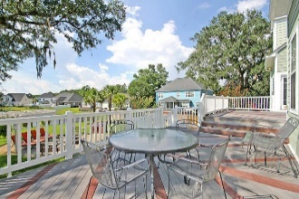
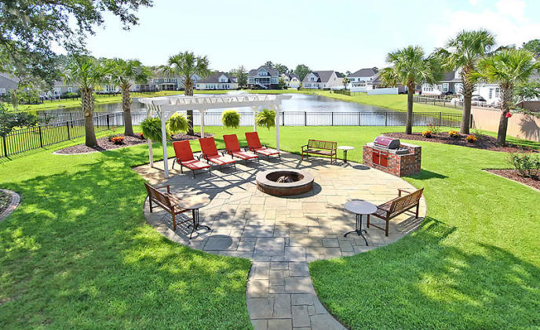
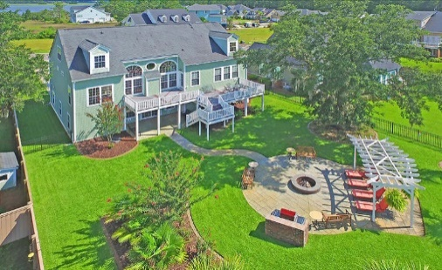
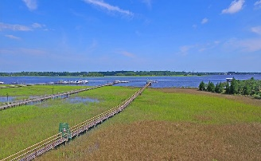

1029 Jervey Point Road Charleston, SC 29492 | MLS# 17020894 | $700,000
The Only Deep Water home on Daniel Island
Just Listed in River Reach Pointe
IMMACULATE custom-built home with beautiful views and cool breezes sits on a large lot across from the Wando River. Perfect for relaxing on your front porch. Gorgeous fenced backyard is excellent for entertaining. A spacious open floorplan with an abundance of natural light greets you upon entering the foyer, while stunning windows look out to the backyard. The great room and foyer offer 28 foot ceilings. The gourmet kitchen offers granite countertops, ss appliances, gas cooktop, double ovens, plenty of cabinet and pantry space and is a chef's paradise. An oversized master bedroom suite on main floor has separate sitting area, access to deck overlooking beautiful views of pond and custom LUXURIOUS spa-like bath with double granite vanities, jetted soaking tub, an amazing shower with 6 heads and digitally controlled-a must see to appreciate! High ceilings and trim throughout. Hardwood floors on 2nd and 3rd levels. The first floor could be a mother-in-law/teen suite with separate bedroom, entertaining area, and bath. Lots of storage and 4 car garage with workshop and utility sink. River Reach Pointe is a wonderful neighborhood with a large community deep water dock on the Wando River with overnight boat slip privileges. The neighborhood is close to local shopping and grocery stores and is a short drive to downtown Charleston with 5-star restaurants, world class shopping and iconic history as well as a short drive to the beaches, the airport, Boeing and Daniel Island. Come take a look because you will not find another home that offers as much as this one: a chef's delight and entertainer's dream!
Stan Huff
843-670-2835 stan.huff@agentowned.com
Jill Marcacci
843-297-5590 jill@agentowned.com
www.agentownedrealty.com
AgentOwned Realty Co. Preferred Group, Inc. | 824 Johnnie Dodds Blvd | Mt Pleasant, SC 29464

