Slide 1
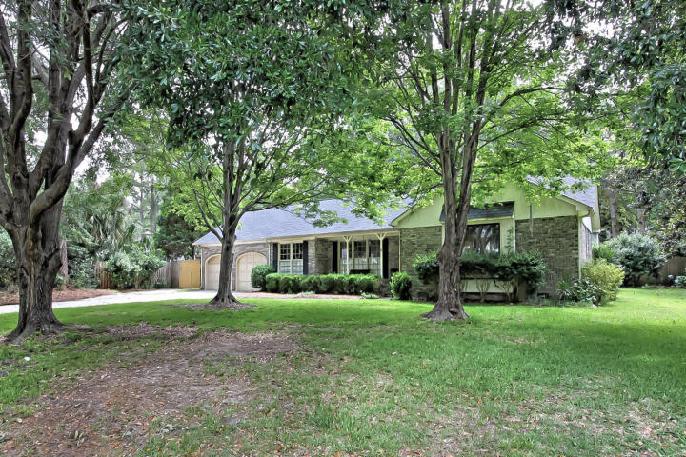
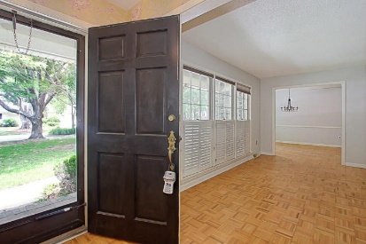
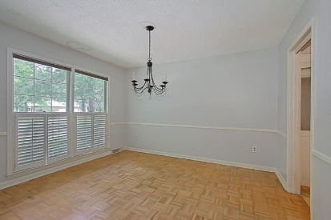
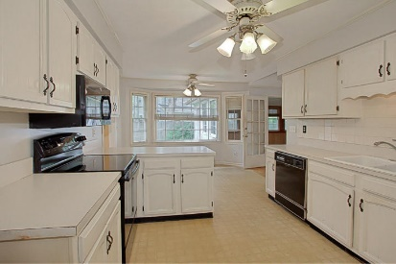
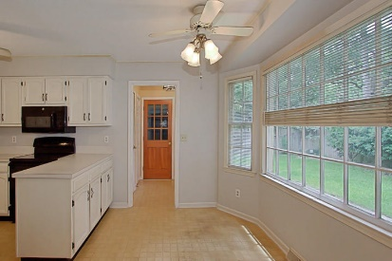
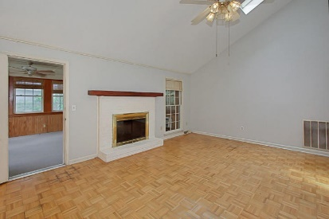
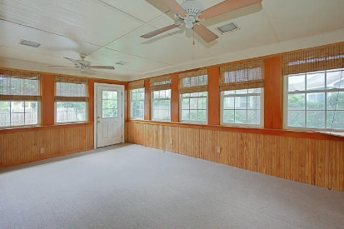
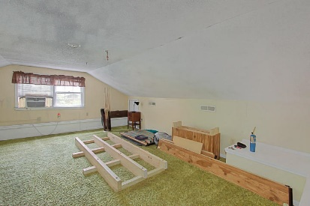
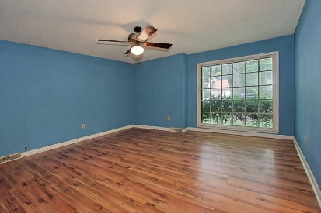
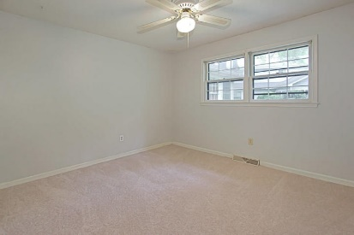
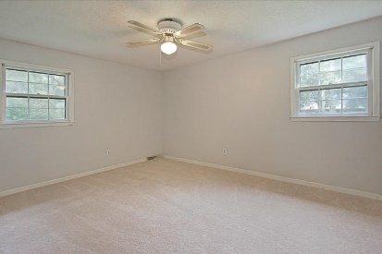


1029 Loyalist Court
Snee Farm ~ Mount Pleasant, SC 29464 ~ MLS# 17014563 ~ $449,000
Lowest Priced Single Family Home In Snee Farm
This charming brick ranch 3 bedroom, 2 bath with FROG is situated on a quiet cul-de-sac in Snee Farm.
Seller has recently replaced the roof, HVAC, repainted, and added new carpet in the spare bedrooms.
Plenty of room for buyer to add their own personal touches as they see fit.
Mary Beth Bennett
(843) 367-1774
marybeth.bennett@agentownedrealty.com
www.chsarealiving.com
AgentOwned Preferred Group | 824 Johnnie Dodds Blvd | Mt Pleasant, SC 29464

