Slide 1
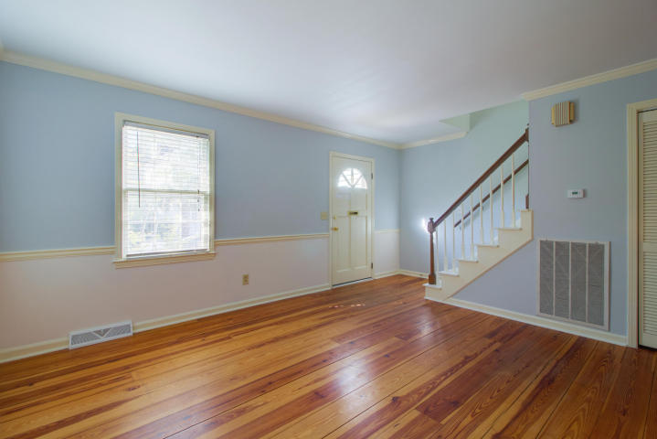
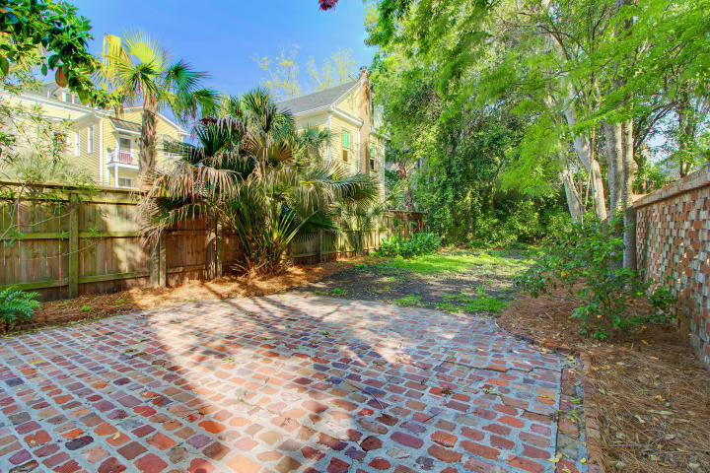
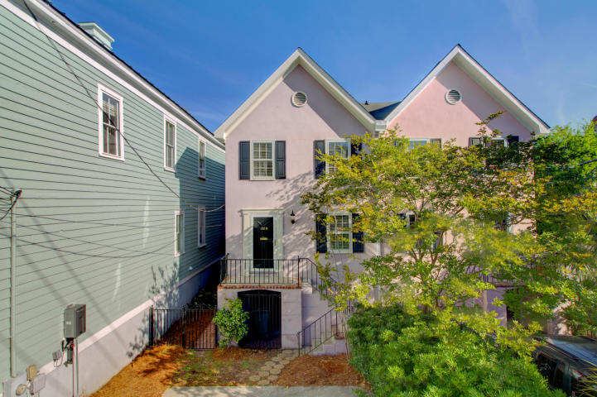
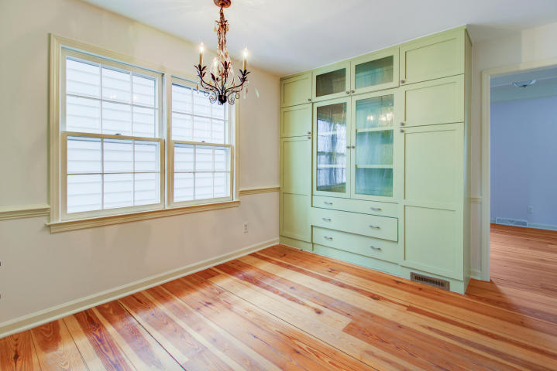
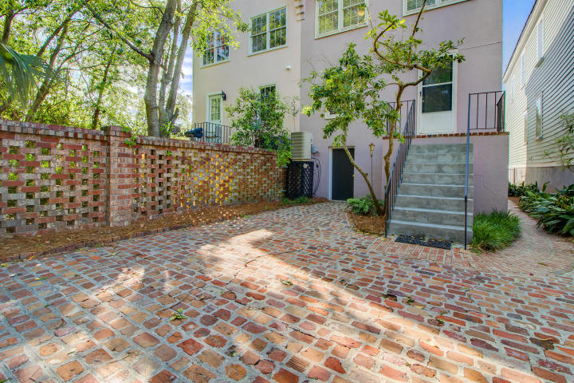
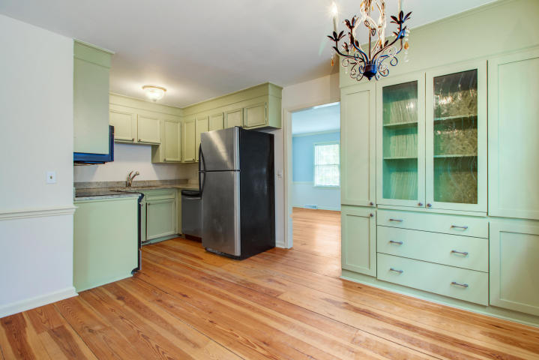
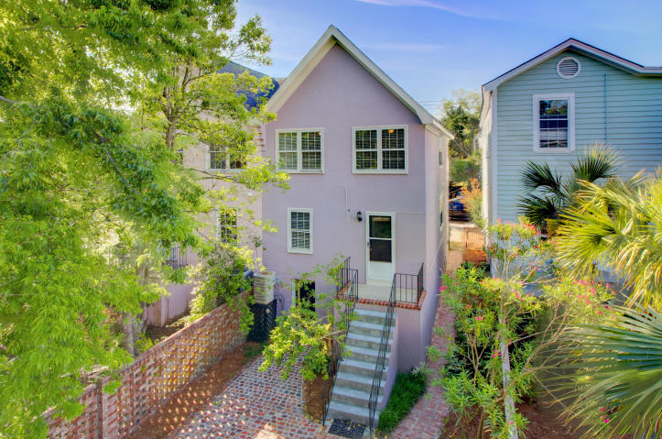
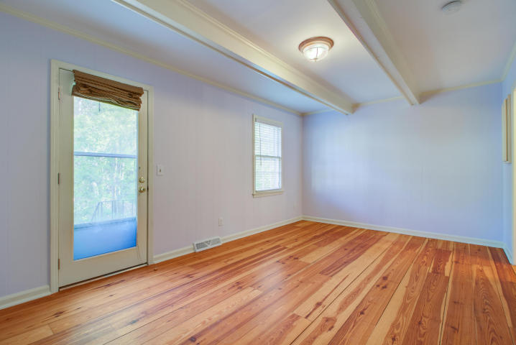
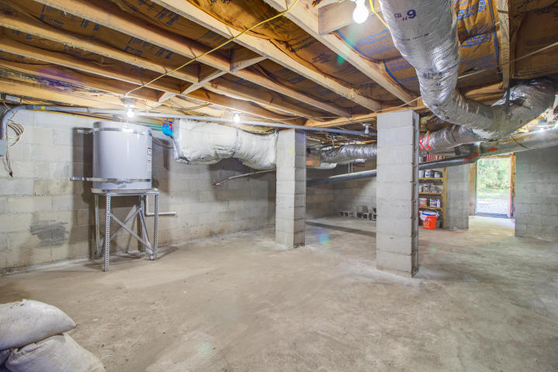


Charming 3 bedroom Townhome in historic downtown Charleston
102 Beaufain Street
Harleston Village
Charleston, SC 29401
MLS# 18012025 ~ $619,900
This is the Charleston town home you do not want to miss! This three bedroom beauty is located in the heart of it all- a mere 500 feet from beautiful Colonial Lake and walking distance to restaurants and shops along King Street and Market Street. Another amazing feature is the surprisingly large yard! Fully enclosed for extreme privacy, this large back yard with expansive brick patio could be transformed into a gorgeous Charleston Garden! Step inside and notice the beautiful heart pine floors not only on the main level but upstairs as well! The formal living room on the front of the home is large and leads to the eat in kitchen. Custom built cabinetry has been added to the eating area of this lovely kitchen to enhance the appearance and to provide additional storage. Granite counters and stainless steel appliances grace this kitchen and all appliances convey. Proceeding through the kitchen you will arrive in the family room which overlooks the beautiful back yard and has a powder room. This space could be converted into a fourth bedroom with ease. Upstairs you will appreciate the layout of this town home where all three bedrooms and the laundry are located. The master bedroom has two closets and its own half bath. The two additional guest bedrooms are on the rear of the home and the full bath is easily accessed by all bedrooms. The convenience of the laundry on the same level as all bedrooms is sure to be appreciated and the washer and dryer (both purchased within the past two years) convey with this sale. A pull down attic access with attached ladder is located in the upstairs hallway. Abundant storage is available in this large attic in addition to the built in shelving located in the lower level under the home. There are many desirable features that set this town home apart from the rest: Parking for two vehicles in your own driveway, abundant storage in the home, a very large private back yard, and numerous updates. These updates include a brand new roof (March 2018) with 50 year architectural shingles, a new water heater (April 2018), new light fixtures and ceiling fans, and a freshly painted interior to name a few. If you have been looking for a lovely downtown residence, whether full time or for vacation, you could not ask for a better location. This home is truly move in ready so don't delay in visiting this Charleston Charmer!
3D Walk thru tour on MLS or go to
http://southcarolina3drentals.com/index.php/3d-model/102b-beaufain/fullscreen
Ellen O'Neil
Broker/Owner, ABR, e-PRO, CNE
Charleston Realtor of Distinction
(843) 300-8530
www.EllenONeilProperties.com

