Slide 1
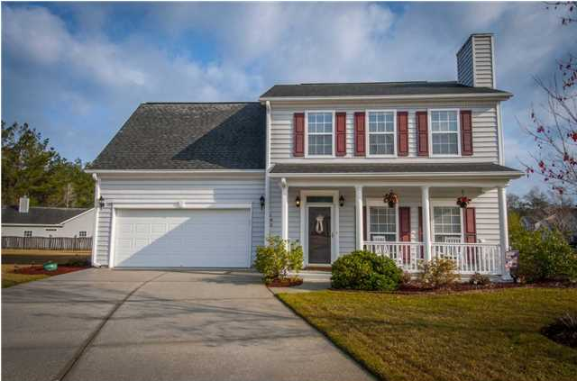
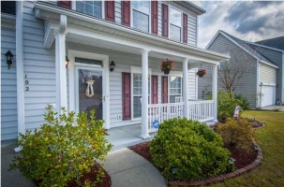
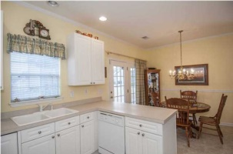
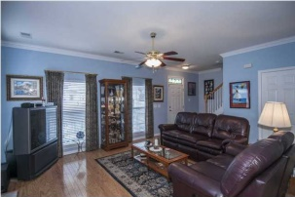
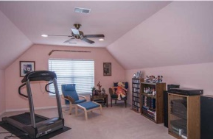
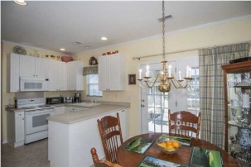


102 Brandy Ct Legend Oaks Plantation Summerville, SC MLS# 1407135 $182,500 3 Bedrooms | 2½ Baths | 1,750 Sq Ft
Open House June 19th from 12-3
BEAUTIFUL Home in desirable Legend Oaks Plantation, subsection of Willow Pointe. This is the PERFECT HOME COME TO SEE IT! IMMACULATE two story, 3 Bedroom, 2.5 Bath, home built by Beazer, on a private cul-de-sac area. BEAUTIFULLY LANDSCAPED LOT with a charming full porch in front with shutters, and cozy screen porch in back. Downtown Summerville, shopping and restaurants is only a short drive away.
LOCATION LOCATION LOCATION DORCHESTER DISTRICT II SCHOOLS Beech Hill Elementary is within walking distance from home. Enter to a lovely floor plan with a warm Great room with Wood burning Fireplace and hardwood floors by Bruce. The kitchen has white cabinets with efficient roll out shelves. The range is electric, the dishwasher and built-in microwave are all in immaculate condition. The pantry has plenty of storage. The expertly installed crown moldings add a nice touch to the 9' ceilings! The master bedroom on the second floor has a bathroom with a Garden Tub and separate shower includes dual-vanity sinks. There is ample closet and storage space throughout. The two additional bedrooms on the second floor are a nice size.
A sprinkler system has been added along with gutters as part of the many upgrades included in this home. This is a MUST SEE and will not last. Please schedule your appointment through Showing Time to see it now!
Catherine Marshall
843-991-1898 M
843-873-0722 O
cathymarshall@carolinaoneplus.com
Carolina One Real Estate
900 N Main St.
Summerville, SC 29483

