Slide 1
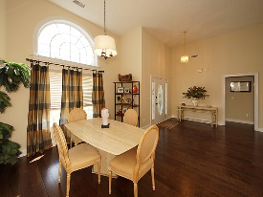
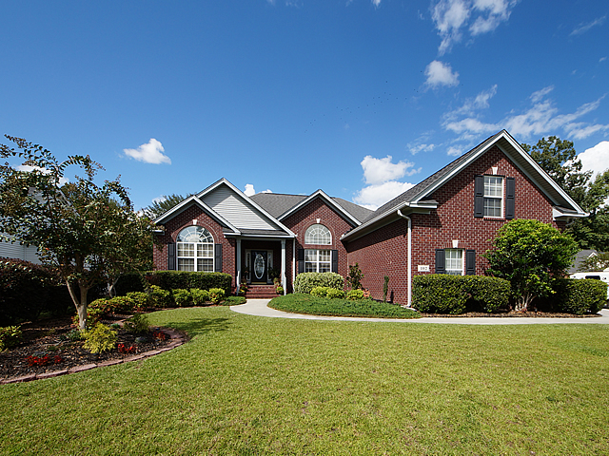
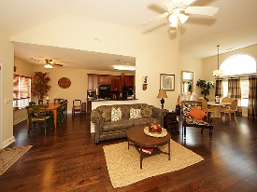
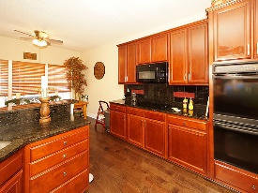
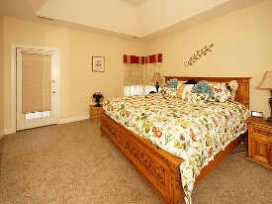
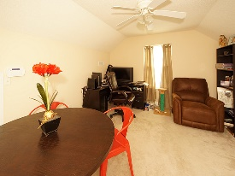
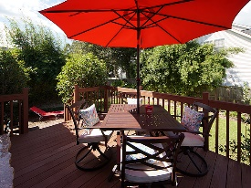
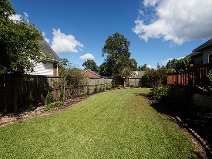

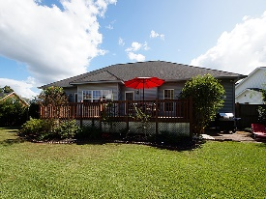

Stunning One Story Brick Home In The Hamlets
102 Chedburg Drive
Crowfield Plantation
Goose Creek, SC 29445
Open House Canceled!
Under Contract In 3 Days!
MLS# 17027119
$300,000
4 Bed / 3 Bath
Stunning one story brick home in The Hamlets, a prestige beautiful golf club neighborhood without the mandatory membership fee. This 4 bedroom 3 full bath home boasts gorgeous hardwood floors, open concept, professional paint and decor! Granite counter tops, under mount stainless sink, appliances including double wall ovens and built in microwave make this kitchen a chef and entertaining delight. Seller has created a landscaping paradise in the back yard to include tropical plants and extended deck. We are ready for you to view and call 102 Chedburg Drive your new move in ready home!
Connie White, Broker
843-532-3356 · conniesyouragent@gmail.com
Charleston Homes · 597 Old Mt. Holly Road · Suite 301 · Goose Creek, SC 29445

