Slide 1
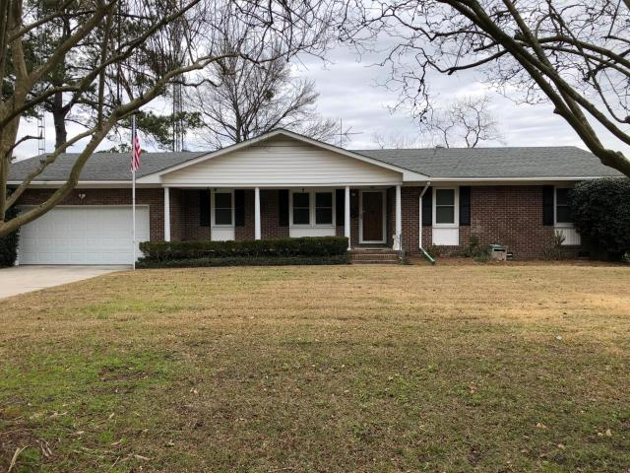
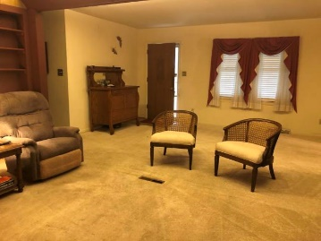
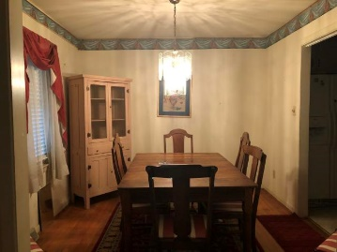
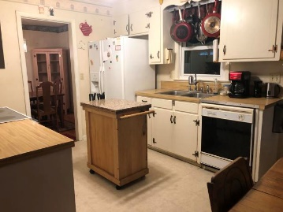
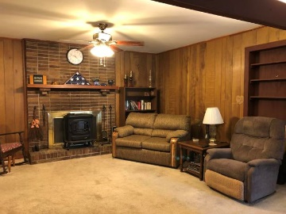
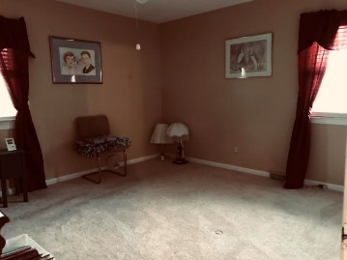
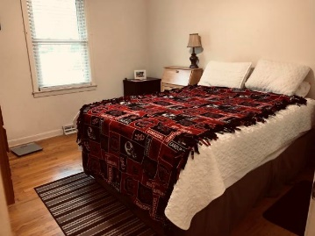
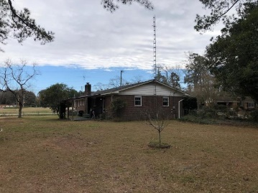


102 Edisto Drive
Salisbury Acres | Summerville, SC 29485 | MLS# 20003793 | $229,900
Open House Sunday
March 15th ~ 1-4
Great Location, Great Price and Great Opportunity for this well cared for one-owner, brick ranch home. Many updates to include new garage door(2019), newer carpet(2016), Master bathroom floor tile, shower pan, subfloor and toilet(2018), Porch Roof(2018), Ductwork(2014), Double-hung Windows(2010), GasPac(2010), Roof(2010). Tongue and Groove hardwood in DR/LR/Hallway and Bedrooms. Workshop space in 2-car garage. Huge lot(.67) with covered back patio and fenced backyard offers so much space and options. Shallow water pump is used for irrigation. No HOA! Home is ready for the next owner to love it as much as the original owner has since 1967. So close to Historic downtown Summerville as well as award winning DD2 schools, shopping, restaurants and interstate.
Beth Mandell
M 803-463-7734 | O 843-871-2121
bmandell@century21properties.com
www.bestcarolinahomedeals.com
Century 21 Properties Plus of Summerville | 118 W Richardson Ave | Summerville, SC 29483

