Slide 1
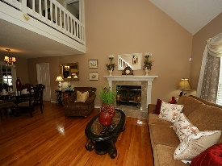
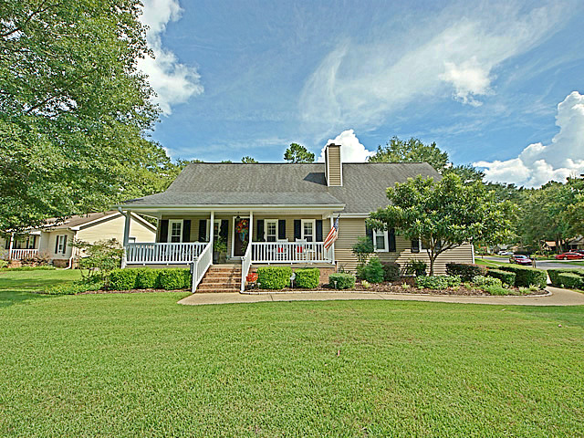
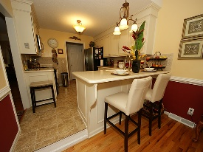
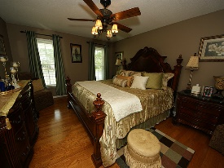
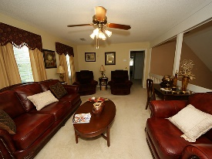
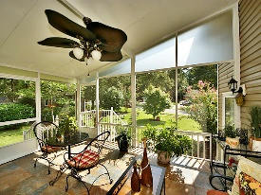
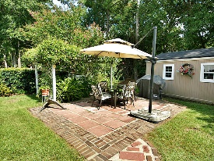
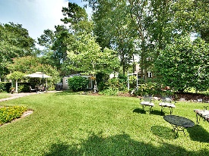


Prettiest home in Hunters Woods!
102 Fox Chase Drive
Crowfield Plantation
Goose Creek, SC 29445
Open House Canceled!
Under Contract In 3 Days!
MLS# 16022555 | $243,000
4 Bed / 2½ Bath
Sellers have added space and improved this home to make it one of the most well maintained homes in Hunters Woods. Hardwood floors, remodeled kitchen, spectacular master bath, new study, screened porch and back yard that exudes peace and tranquility. This home was originally the builders model home so the garage does have heat and air(not counted in square footage). Crowfield Plantation is a desirable community with walking trails, pool and golf memberships and tennis courts.
Connie White, Broker
C: 843-532-3356
conniesyouragent@gmail.com
Charleston Homes
111 Spring Hall Dr
Goose Creek, SC 29445

