Slide 1
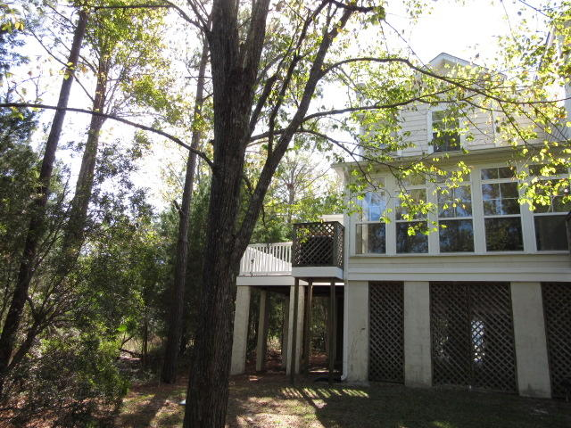
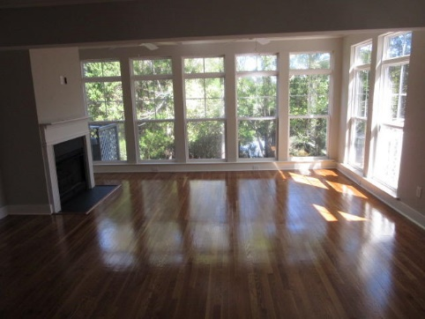
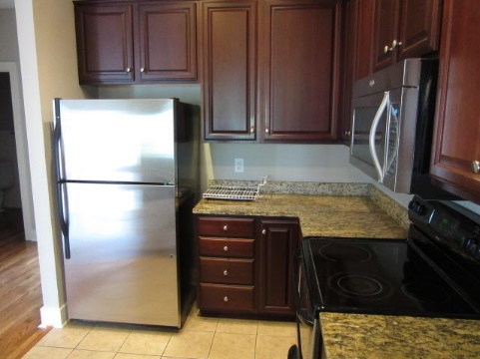
Surrounded by
Woods & Marsh
$40,000
Price Reduction!
Commercial / Fronts HWY 52
102 Garmouth Court | Charleston National
Mount Pleasant | MLS# 19030051 | $379,000 | 3 Bed | 3½ Bath
Located on a very private dead end road. It is surrounded by woods and marsh, The home has a dramatic wall of glass windows that looks over the rear yard where deer are seen almost daily. This is an end unit with an outdoor deck that's surrounded by woods and marsh. The interior has been upgraded with 100% real hardwood floors throughout except for the tile in the bathrooms and kitchen. The home is elevated with room under the home to park up to 3 vehicles plus your golf cart. The neighborhood has walking trails, golf course, pool and tennis courts. Your new home can be accessed via Highway 17 or off Riffle Range Road (so you do not need to ever get on Highway 17 to get to the beach or downtown, only 4 miles to the IOP Connector. You must see property to appreciate this properties unique setting and upgrades...Better Hurry Before Its Gone...there will always be other homes for sale in The Retreat...but not like this setting surrounded by woods and marsh. HVAC and Hot Water heater is only 2 years old.
Rick Willis
843-327-3017 Rick@RickWillis.com The Group, LLC

