Slide 1
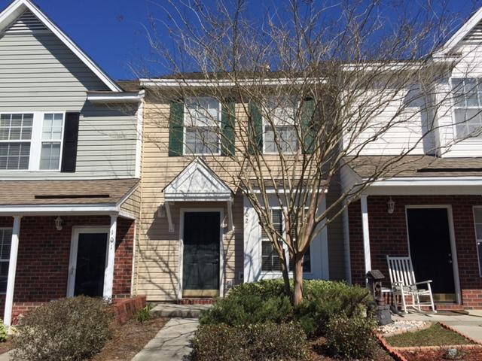
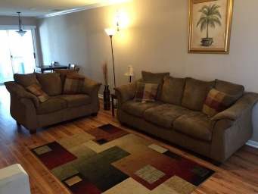
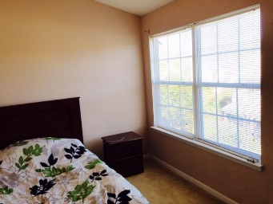
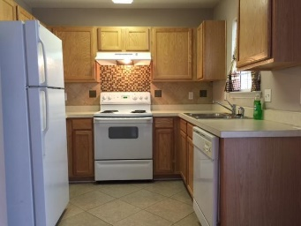
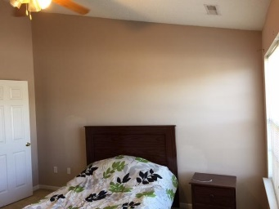
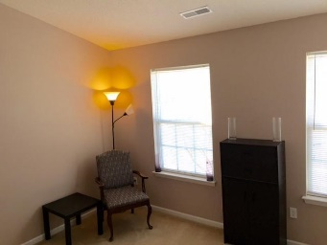
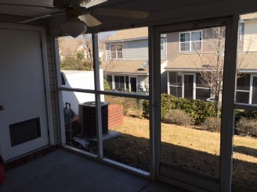
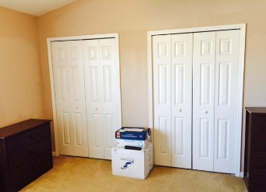
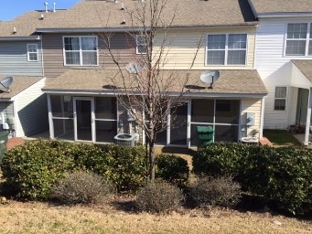


102 Hornby Circle
Persimmon Hill
Goose Creek, SC 29445
MLS# 16005358
$95,000
2 Beds | 1½ Baths
993 Square Feet
You will love Persimmon Hill!
It has such a cheerful, friendly, village feeling and a pool too. Close to shopping.
This town home has laminate flooring through out the spacious, multi function first floor.
The kitchen opens to a dining area. Enjoy summer breezes on your private screened porch. Upstairs are two bedrooms with vaulted ceilings and plenty of closet space.
Di Johnson
843-270-6448
dijohnsonsc@gmail.com
www.agentownedrealty.com
AgentOwned Premiere Group
824 Johnnie Dodds Blvd
Mt Pleasant 29464

