Slide 1
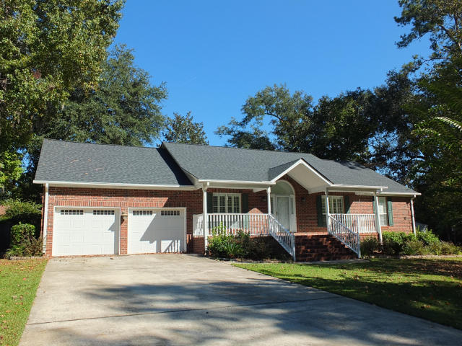
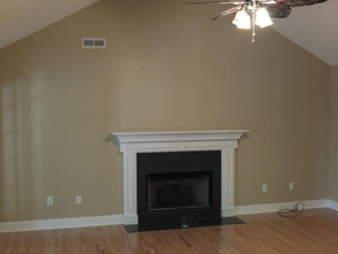
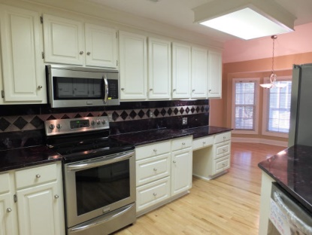

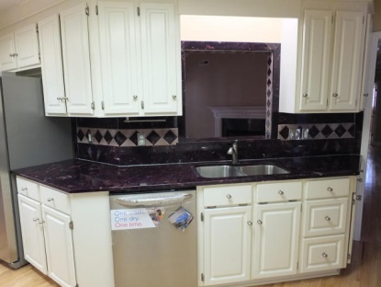

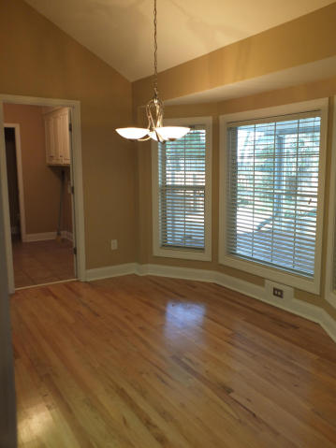
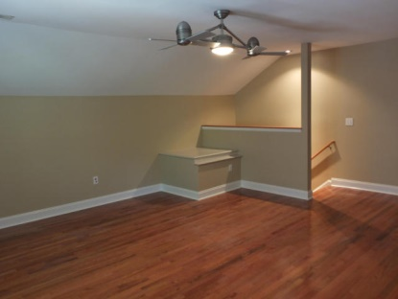
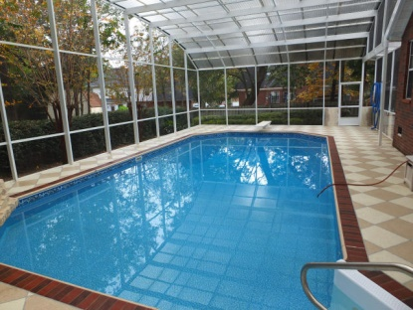
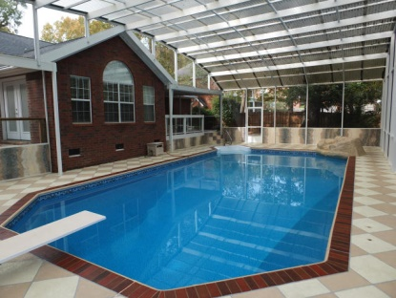
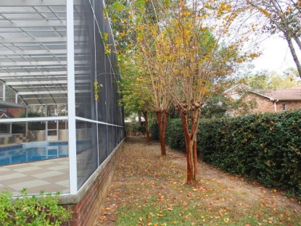
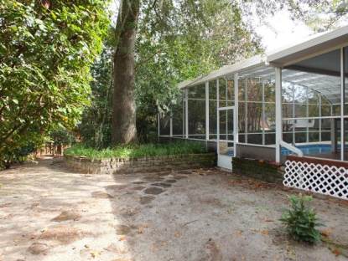



102 Hulton Ln
Summerville SC
MLS# 14029714
$319,000
2,498 square feet
4 bedroom | 2½ baths
This Newington Plantation Home Has Everything!
This is an upgraded Newington Plantation home you must see. Enter to new Oak hardwood floors. Family room vaulted ceiling has gas fireplace, French doors open to sunroom, screen enclosed in-ground pool. Formal dining with wainscoating. Eat-in kitchen has all new stainless appliances, Truestone countertops, deep storage drawers/cabinets, lots of storage space. Stamped concrete surrounds pool to enjoy your personal paradise. Gas and water outside are ready for outdoor kitchen. The current owner has done the maintenance for you. Pool liner just replaced. New 2014 Trane HVAC units, 2014 new roof. Spacious Master suite boasts French doors to deck/pool, bath with dual vanity, cultured onyx tub and shower, walk in closet. FROG with central air. Plantation shutters on front windows.
Janis Flodin
843-729-0584 M
jflodin.bcd@gmail.com
B C D Properties LLC | 123 Piccadilly Loop | Summerville, SC 29483

