Slide 1
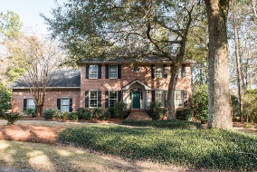
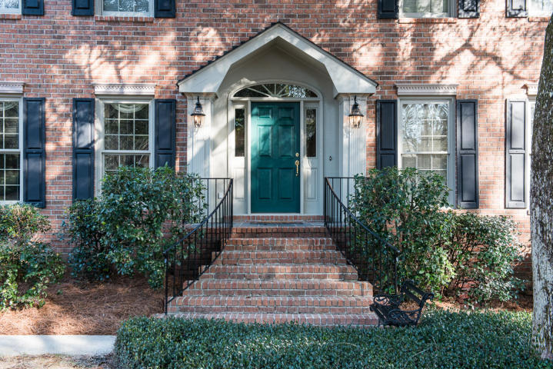
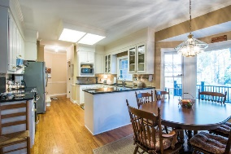
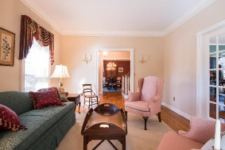
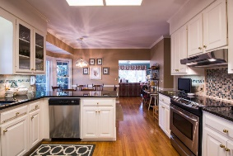
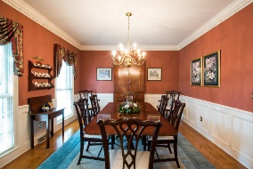
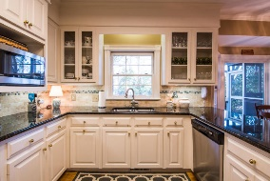
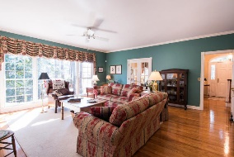
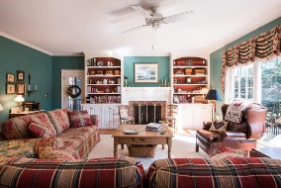
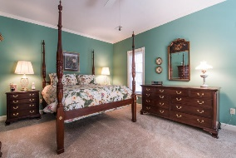
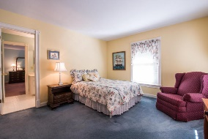
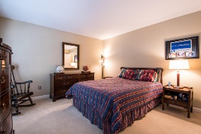
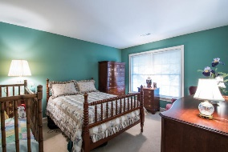
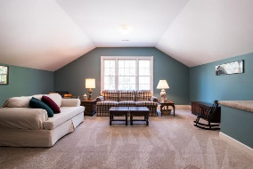
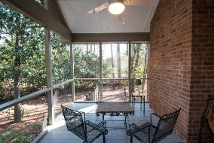
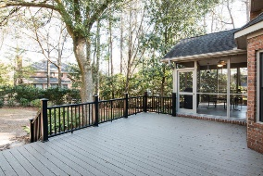
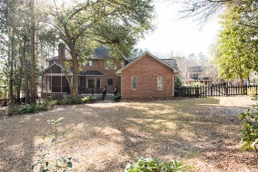

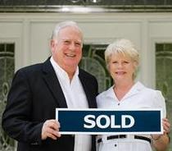
102 Hutchinson Lane
Summerville, SC 29483 · MLS# 16003845 · $595,000
Custom built home in Gadsden Estates
This meticulous 4000 square foot custom brick home features a traditional floor plan, 5 bedrooms, 3.5 baths, and is located on a 1/2 acre wooded lot on a cul-de-sac in an established neighborhood in historic Summerville. The large master suite is located on the 1st floor as is the laundry room which features an utility sink and built in desk. This spacious plan is open and airy with formal areas perfect for entertaining. The family room has a masonry fireplace with built in bookcases and ceiling fan.
The vaulted screen porch with ceiling fan opens to an oversized open deck with steps leading into the fenced rear yard. Additional features include gleaming oak flooring, crown molding, chair rail, custom trim and cabinetry, granite countertops in the kitchen with generous counter space, and stainless appliances. Enjoy walking or biking to nearby restaurants, shops, banks, schools and parks. Super value for a quality home in a desirable location with excellent schools in a small town setting.
Tommy & Lynne Lovett
Tommy - (843) 442-1276
Lynne - (843) 697-0491
tlovett@carolinaone.com
lynne.lovett@carolinaone.com
www.tommylovettrealestate.com
Carolina One Real Estate
628 Long Point Rd.
Mt Pleasant, SC 29464-3032

