Slide 1
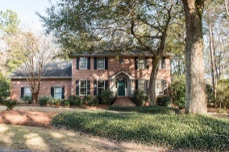
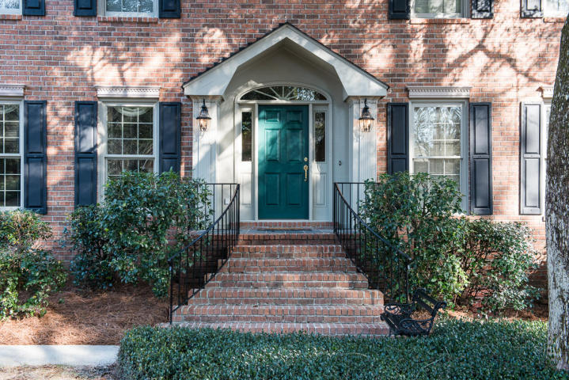
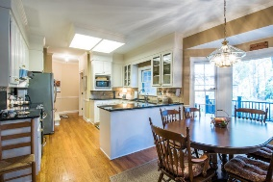
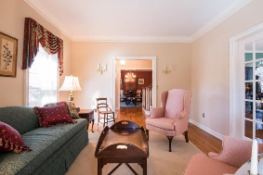
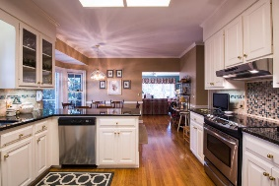
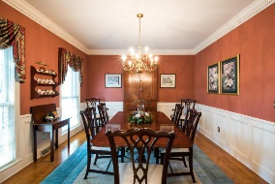
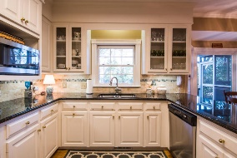
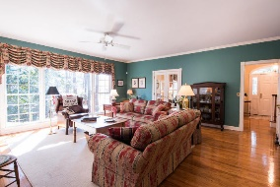
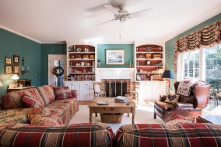
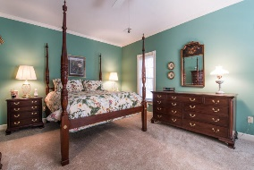
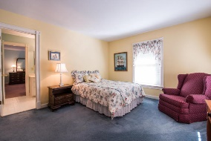
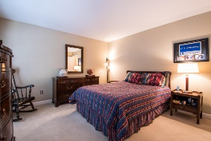
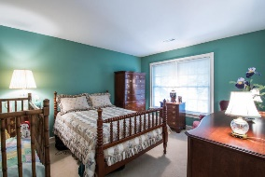
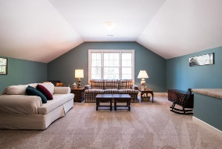
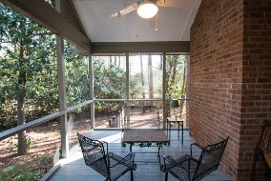
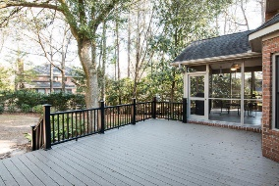
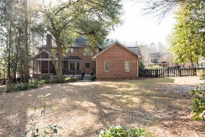

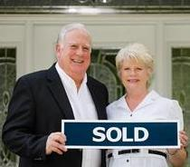
102 Hutchinson Lane Summerville, SC 29483 · Gadsden Manor · MLS# 16026745 · $574,900
Beautiful Custom Home In Summerville
On A Large Mature Lot
$529,900
Best value in Summerville for two story brick custom 4000 sqft , 5 br, 3.5 ba executive home featuring all formal areas, hardwood flooring, custom moldings and cabinets, large kitchen with granite countertops and stainless appliances, wonderful master suite on first level, formal dining room, separate living room, open breakfast room, den with fireplace and built in book cases, large screen porch and spacious open deck overlooking beautifully landscaped and maintained fenced yard.Front and rear stair cases for access to second floor. All bedrooms are spacious with large bonus/media/game room over garage. Great home for entertaining. Quality of construction, condition, lot size, location, school district and neighborhood make this a really wonderful real estate find for the right family.
Tommy Lovett Tommy - (843) 442-1276
tlovett@carolinaone.com www.tommylovettrealestate.com
Carolina One Real Estate
628 Long Point Rd.
Mt Pleasant, SC 29464-3032

