Slide 1

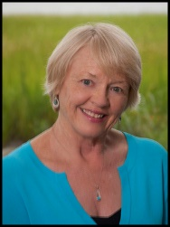
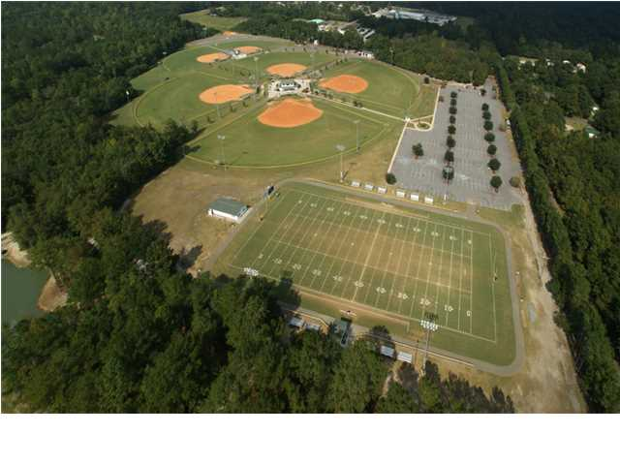
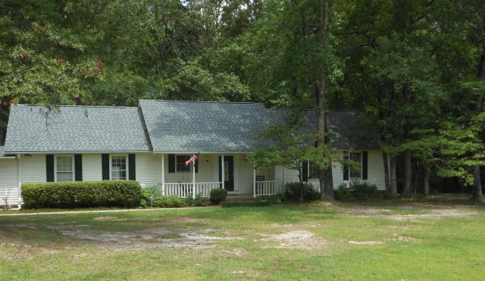
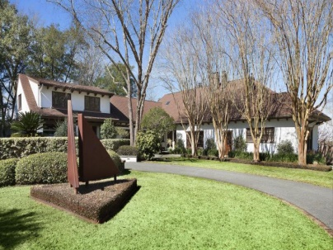
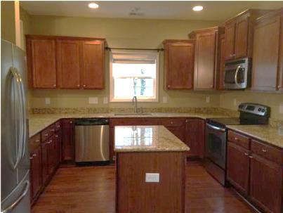
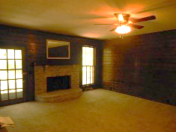
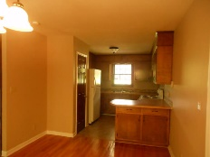
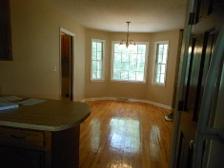
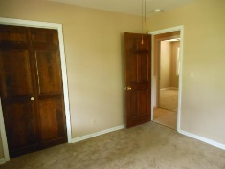
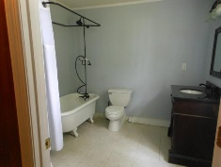
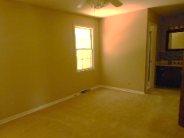
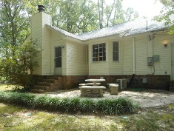
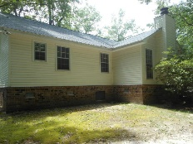
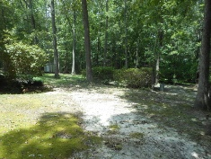
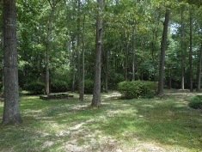
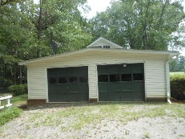

Jane Locke, Realtor
M (843) 819-3508
lockejaneb@aol.com
www.century21properties.com
Huge Price Reduction
102 Paris Ln | Caire Yelleau | Summerville | MLS# 15018599 | $319,700
Want the spaciousness and quiet of country living, but close to all amenities? This home is for you on almost 2 acres. Home has 5 bedrooms with 3 baths and lots of storage with very nice cabinetry and many closets. The roof is new - installed this year. There is a horseshoe shaped drive which allows for lots of parking. Ceiling fans throughout. Real oak paneling in the den with a lovely fireplace. Kitchen has nice cabinets with tile backsplash with bay window in dining room. Second master bath has lovely footed bath tub. There is a stream on the back of property. Huge back yard with established spring blooming azaleas and all hardwood trees. Home has a security system. This home needs a family to move in and make it their own paradise.
Century 21 Properties Plus | 3301 Salterbeck St Suite 100 | Mt. Pleasant, SC 29466

