Slide 1
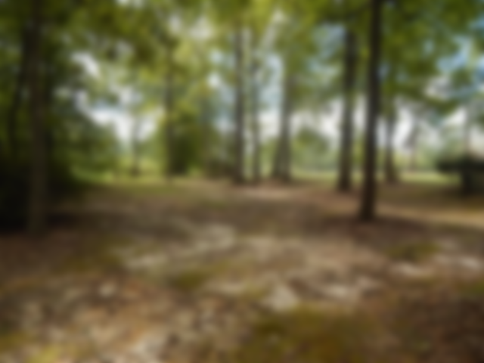
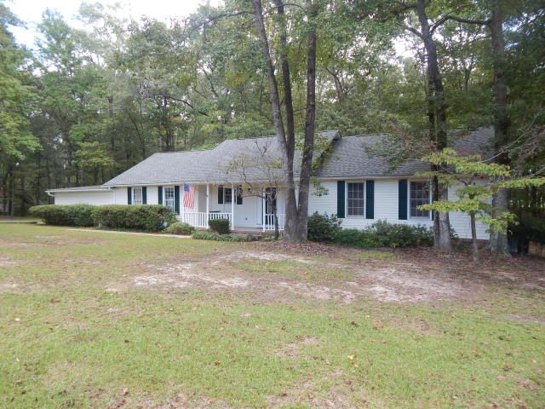
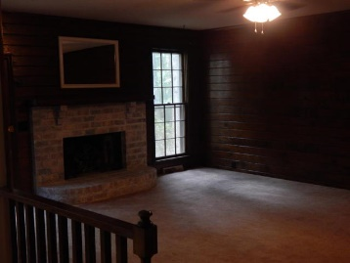
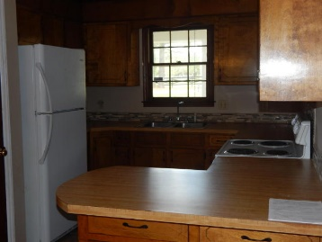
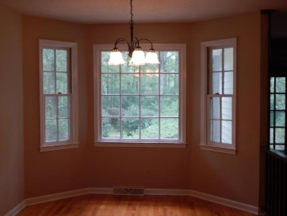
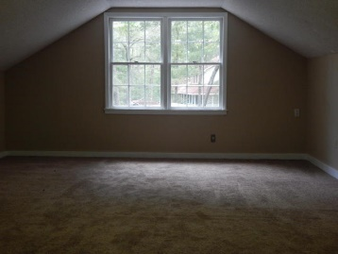
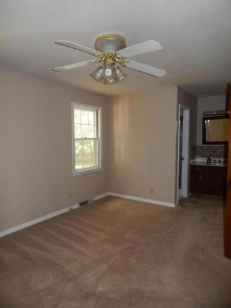
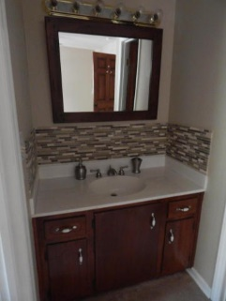
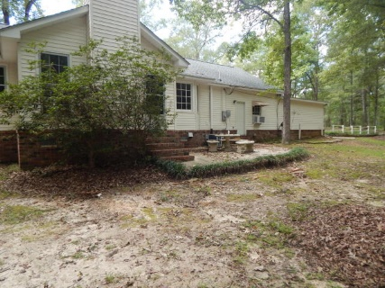
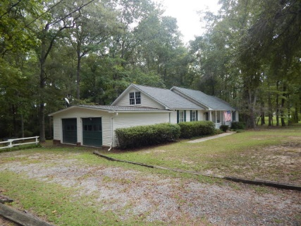

MUST SELL!!
102 Paris Lane
Caire Yelleau
Summerville, SC 29483
MLS# 16025599
$275,000
4 Bedroom | 3 Baths
PRICE SLASHED ON THIS BEAUTIFUL PIECE OF PROPERTY WITH NO MOBILE HOMES IN NEIGHBORHOOD!
Enjoy quiet, country living just minutes away from shopping and restaurants. In this pastoral setting, one can enjoy horses at pasture, wild life and beautiful birds among the expansive open areas. This beautiful home is nestled on a large, private lot that backs to a small creek and then stables and riding area. This ranch home offers 3 bedrooms plus an added on mother-in-law suite with huge closet and full bath. There is also a very large FROG, with large storage closet, that could be a 5th bedroom or wonderful flex space. Off the storage closet is access to attic. Large home needs some updating but offers a lot of space for the money. Compact kitchen with large eating area at bay window overlooks beautiful, tranquil backyard and family room. Family room offers real pine paneling and wood burning fireplace. The hall bath and master bath have recently been remodeled. The home's roof was installed within the past 3 years. This home offers lots of space and is in move-in condition, but does need some updating.
Darlene Bollettino
Miler Properties
Office: 843-821-1111
Cell: 843-209-8955
dbollo84@yahoo.com www.milerproperties.com

