Slide 1
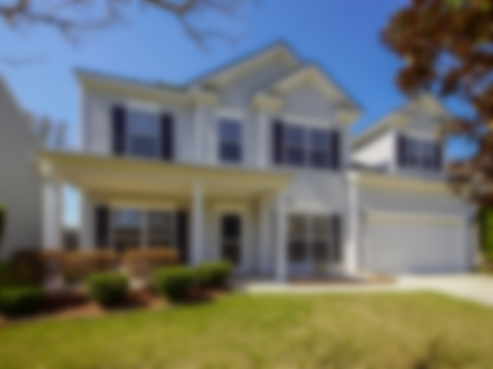




Walkthrough Beautiful Home In Summerhaven!
102 Saw Palm Drive ~ Ladson ~ MLS# 20007578 ~ $295,000
Your home search stops here! New ROOF! New HVAC! New CARPET! New HOT WATER HEATER! Residing on a quiet cul de sac and overlooking a beautiful pond, this home is just 2 doors down from the play park, renovated neighborhood pool and clubhouse! Offering an open floor plan allowing for great entertaining, the eat-in kitchen is open to the living room with gas fireplace for warm & cozy nights. Upon entry, you will appreciate the sunny office on the left & spacious dining room to the right. You will love the easy care of the hardwood floors throughout the living level. The accommodating space in this home makes room for 5 generous sized bedrooms. The master suite boasts a large soaking tub, separate shower & large walk in closet. In addition to the master suite upstairs, there are also 3 additional bedrooms & a laundry room. For extra guests, there is a guest room conveniently located downstairs off the kitchen. Step out onto the screen porch overlooking a private backyard with your morning coffee to enjoy the beginning of the day or al fresco dining in the evening. Desirable Dorchester II school district and is just minutes from I-26.
Video Walkthrough: https://youtu.be/kdrIz5IT308
Handsome Properties, Inc
53 Broad St
Charleston, SC 29401
Elizabeth Shirley
843-276-2970
lizshirleyrealestate@gmail.com
Suzanne Conway
843-814-6778
s.conway@bhhssun.com

