Slide 1
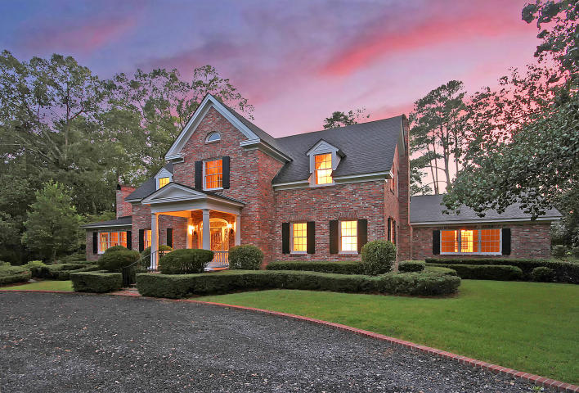

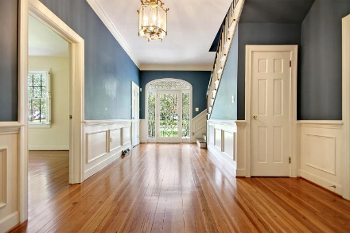
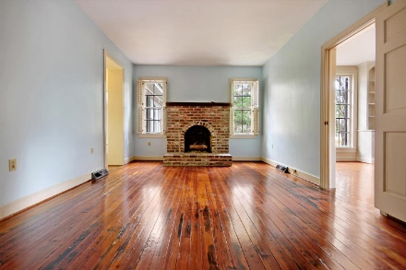
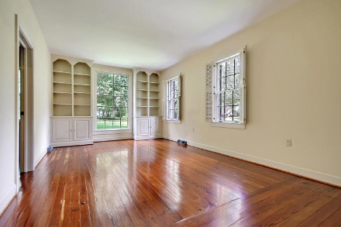
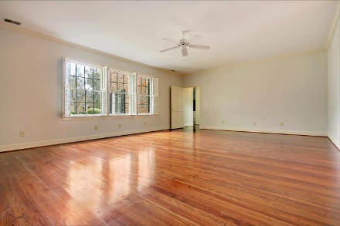
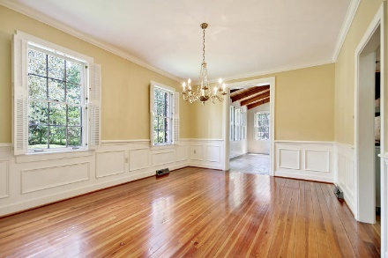
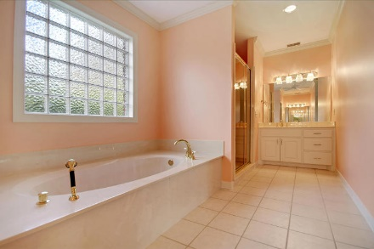
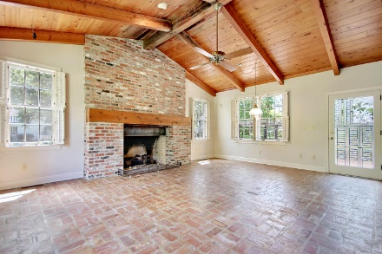
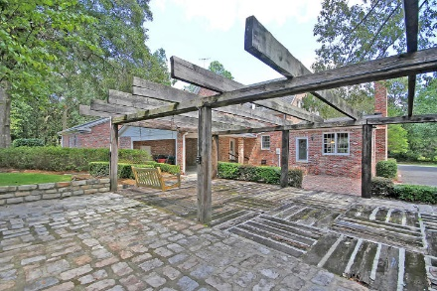
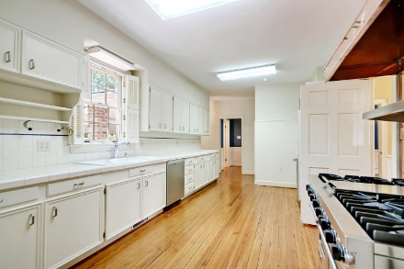
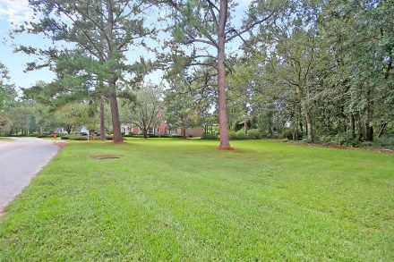

Parkshore Marshfront
Tea Farm Open House Saturday, March 17th from11-3
102 Sebring Street
Summerville, SC 29483 ~ MLS# 17025580 ~ $649,000
Nicknamed “The Birthplace of Sweet Tea,” Summerville is a vibrant community, rich in history with natural beauty at every turn. This stunning, custom brick home is located in The Tea Farm, a private community within walking distance of the Summerville Country Club which offers golf, swimming, tennis and social activities. This historic property is situated on a wooded lot with a circular drive and patio/pergola area in the backyard (made from old ballast Belgium blocks from downtown Charleston) and is the ideal setting to sip on the famous low country sweet tea. Inside you’ll find generously sized rooms,9-10 ft vaulted ceilings, first floor master suite, refinished antique heart of pine floors, custom glass doors, custom moldings and two fireplaces. The main bones of the home are actually constructed from materials of the Original Barn giving the home a solid foundation and amazing history. Come stop by today!
Additional features include:
Exterior painted August 2017
Exterior re-glazing
Some interior re-painting
Replaced one HVAC in 2017
Home constructed with Old Charleston Brick
Gorgeous Viking gas range & oven with copper hood, Sub Zero refrigerator, Bosch dishwasher, and ice maker
Great room features brick flooring, a cathedral ceiling with wood beams and beautiful fireplace
2 master bedrooms - 1 on the first floor and 1 on the second floor
All bedrooms have ceiling fans
Lots of storage
Additional 2nd laundry room outside with washer and dryer connection
Book your showing today!
Missy Reid Missy@MattOneillTeam.com (864) 934-5447

