Slide 1
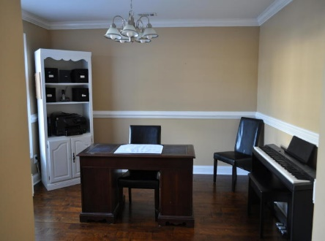
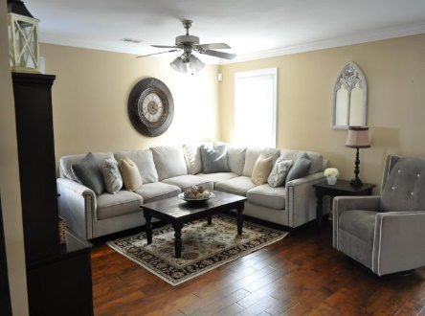
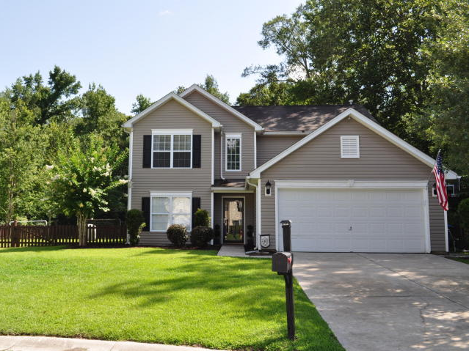
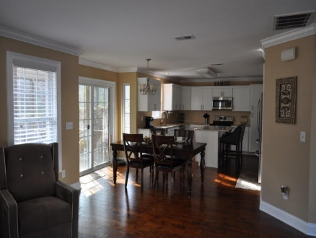
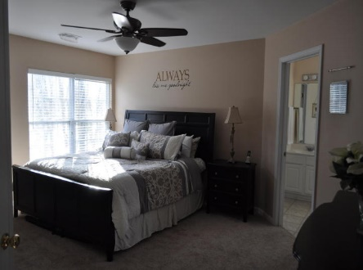
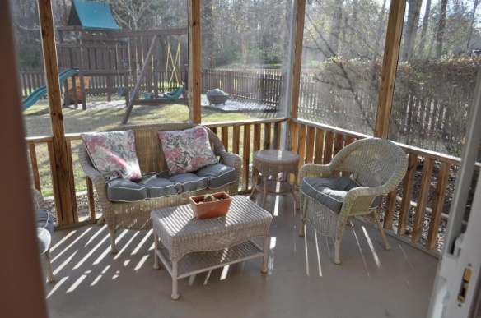
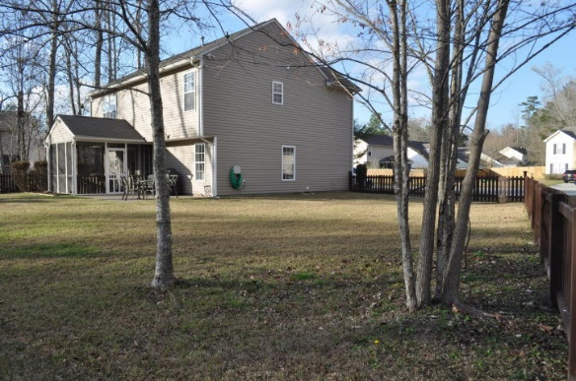
$1,000 AGENT BONUS WITH RATIFIED CONTRACT BY April 6th
102 Teakwood Court
Arbor Oaks
Summerville, SC 29485
MLS# 18004718
$229,900
3 Bedroom ~ 2½ Baths
1,793 Square Feet
This home is nestled on a quiet cul-de-sac with a beautiful landscaped yard on a large lot. Enter the front door, notice a two story foyer with hardwood floors which is throughout the downstairs. A home office/formal dining room is to the left. Forward is a large family room, dining area that adjoins a newly renovated kitchen with granite counter tops and fresh white cabinets. This kitchen is fully equipped with stainless steel appliances, walk-in pantry, and a kitchen island that seats two. Enjoy the sounds of the pond fountains from the screened porch off the kitchen. Upstairs you will find 3 bedrooms including the large master suite with private ensuite & walk-in closet. Don’t miss the separate craft/workshop in the garage. Don’t miss out on the gorgeous home! It will not last long!
Terri Wood
Real Estate Agent
Miler Properties
Office: (843) 821-1111
Cell: (843) 478-7020
terri@milerproperties.com www.milerproperties.com

