Slide 1
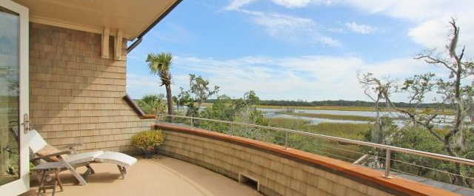
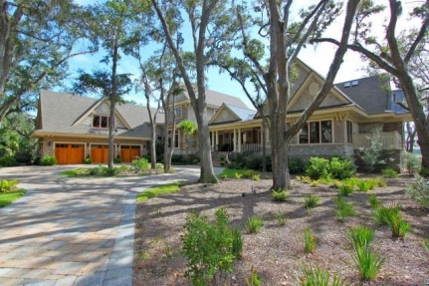
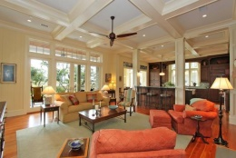
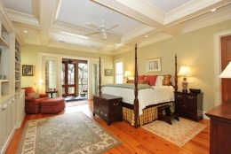
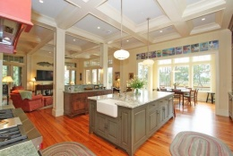
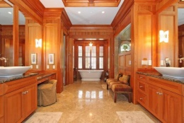
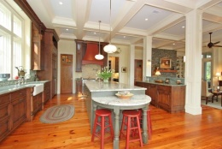
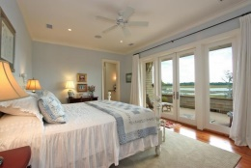
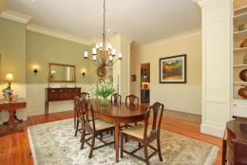
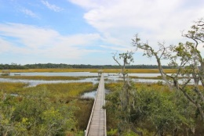
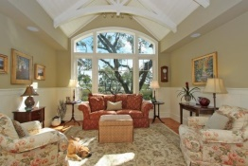
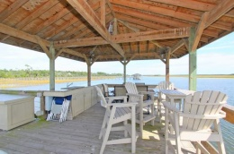
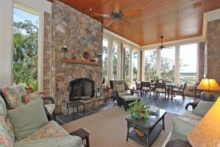
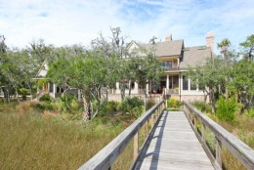


Deepwater Exquisite Coastal Estate
102 White Salt Lane
Beresford Hall - Charleston
MLS# 14030209 - $3,500,000
The most discriminating coastal living home nestled on a deep water creek- custom designed & featured in multiple Charleston design magazines! The private, 1.66 acre setting of this beautiful home has inspiring architectural elements and understated elegant interiors all designed around the pristine eco system. Discerning features of the home include a whole house generator, hurricane rated glass throughout the home, interior sprinkler system, Rinnai hot water heaters and industrial coating upgrading on exterior paint. The fabulous kitchen is a chef's dream as it is completely open to the family room and ALL SEASON PORCH with handsome fireplace and views galore of the beautiful water vista. Please click to read more about the exquisite details of this beautiful home...The high end stainless appliances, abundant storage, natural stone counters, butler's pantry, service area & the dry stack stone fireplace in family room that was completely done by hand makes for the heart beat of the home. Ceilings that soar to nearly 12 feet high, heavy trim package, vertical board ship lapping, heart of pine flooring throughout and over sized doors of solid cherry are just some of the discriminating architectural details. On the main floor of the house is the exceptional master bedroom suite complete with owner's screened porch, private office and laundry area. The master bath is lavishly adorned with timeless marble and granite, heated floors, over sized shower, soaking tub, multiple sinks and wonderful storage. The study is handsomely designed with gorgeous mahogany treated walls and built-ins. Upstairs are three additional bedrooms all complete with private bathrooms and abundant storage. Views of the marsh and creek are breathtaking from the guest rooms and private second porch areas too! The attached garage is over sized for 3 vehicles and has built-in storage as well as a gardening sink. The room above the garage is perfect as it is entered from the back stairway from the family room. It is complete with a game room, kitchenette area and private 5th bedroom and full bath. Additionally on the property is a most charming artist studio that catches all the right light. Truly, this property is completely magical and a beloved waterfront estate.
Sheila Romanosky
(843) 224-0242
sromanosky@carolinaone.com

