Slide 1
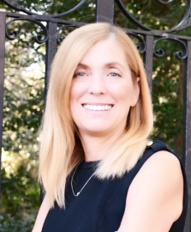
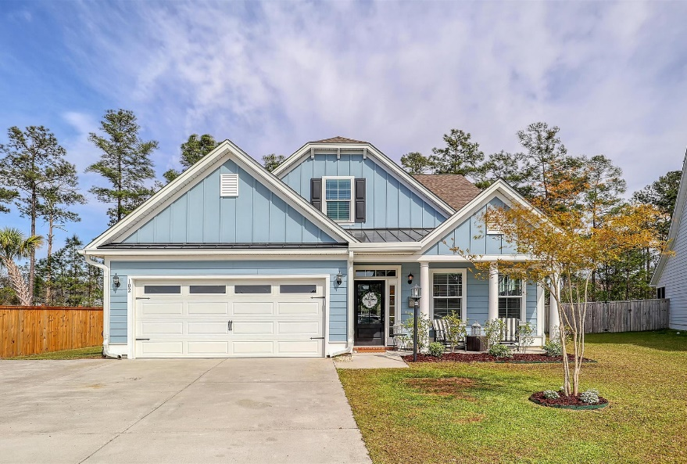
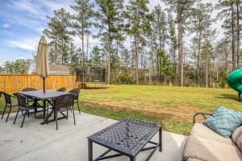
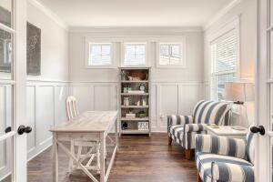
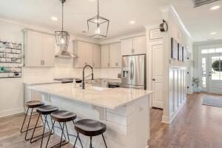
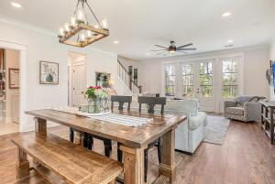
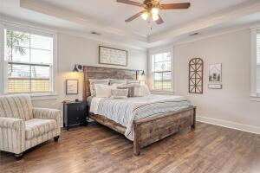
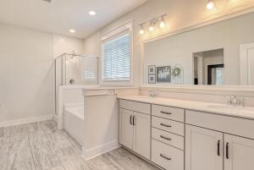

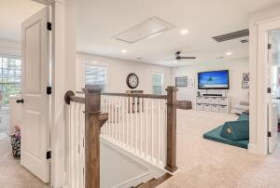
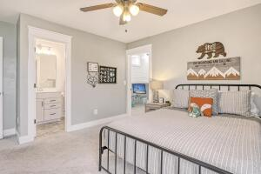
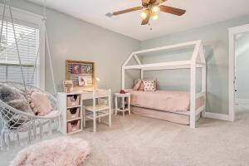
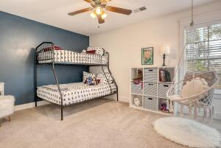
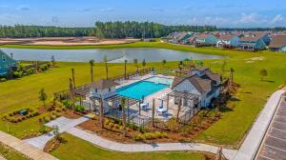
Open House
Sunday, March 26th from 1-3
Debbie Cromer
ABR, RSPS, REALTOR, CRS
(843) 437-6342
debbie@debbiecromer.com
www.debbiecromer.com/
102 Flip Flop Court
Cane Bay Plantation | Summerville, SC 29486 | MLS# 23006038 | $525,000
Luxury home located on a peaceful cul-de-sac w/ stunning wood floors, an open concept living space & wooded backyard. The first floor features engineered hardwood floors that flow throughout while board & batten wall accents add character. Natural light floods the living spaces through custom 8 ft glass doors. In the dream kitchen, you'll find quartz countertops, tile backsplash, farm sink, SS appliances including gas stove w/ vented hood & cabinet microwave. The master suite is tucked away in the back of the house & boasts a luxurious bath & large walk-in closet. Upstairs are 3 add'l bedrooms, 2 add'l bathrooms & loft along w/ an amazing playroom guaranteed to inspire creativity! Step outside onto your private oasis, which backs up to community space. Path to YMCA & trails nearby!
Video Tour: https://vimeo.com/809888637
Century 21 Properties Plus | 1090 Park West Blvd; Ste 103 | Mount Pleasant, SC 29466

