Slide 1
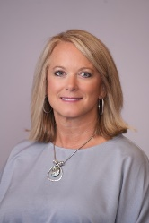
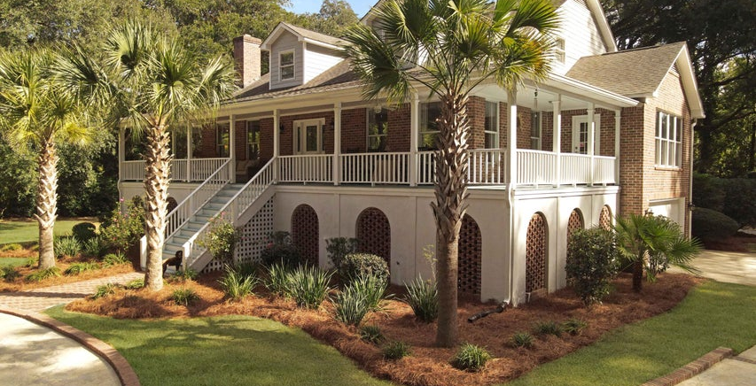
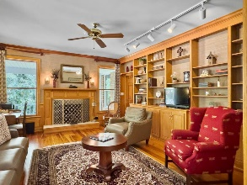
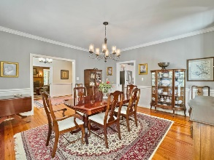
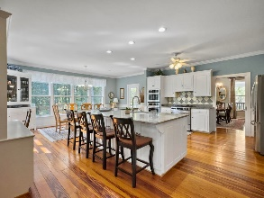
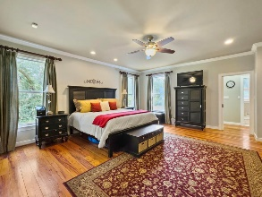
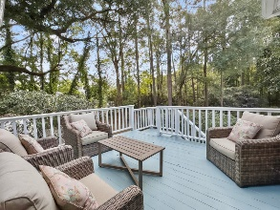
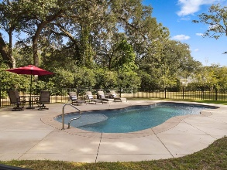

Pam Bass
Realtor
843-259-4926
pam@pambassproperties.com
www.pamsellscharleston.com
Agent Luncheon & Broker Open House
Thursday 11-1
102 Flud Street | Historic District | Summerville | MLS# 24027780 | $1,995,000
Please join us for an Agent Open House this Thursday December 12 from 11-1. Light Lunch will be served.
Chance to win $$$ just in time for Christmas! Bring your buyers.
Welcome to your dream home in the heart of Summerville! This beautifully custom residence boasts 5218 square feet on a sprawling 2.3-acre lot. With 4 bedrooms and 4.5 bathrooms, it offers an incredible layout, including a full downstairs apartment featuring a bedroom, bathroom, full kitchen, den, breakfast area, and laundry room—perfect for guests or as an in-law suite. As you step through the grand foyer, you'll find a dedicated study to the left, complete with built-in bookshelves and a cozy wood burning fireplace. To the right, the formal dining room flows seamlessly into a massive kitchen, equipped with abundant countertop space, a central island, double ovens, a gas range, and a sunlit breakfast nook with large windows. The spacious family room, also featuring built-in book shelves and a gas fireplace, provides a warm and inviting gathering space. The main floor master suite is a true retreat, showcasing a walk-in closet and a luxurious ensuite with dual sinks, a brand new soaking tub, and a separate shower. Upstairs, you'll discover two generously sized guest rooms, each with its own full bath, ensuring comfort and privacy for family or visitors. Step outside to enjoy your private oasis, complete with a charming gazebo and a sparkling saltwater pool: ideal for entertaining or simply relaxing in the serene surroundings.
This exceptional property offers ultimate privacy while being just a short golf cart ride from downtown Summerville, where you'll find an array of restaurants, shops, and pubs. Plus, it falls within the desirable Dorchester 2 school district. Don't miss your chance to own this exquisite home in a prime location! Schedule your showing today!
VIRTUAL TOUR
EXP Realty LLC | 170 Meeting Street Ste 304 | Charleston, SC 29401

