Slide 1
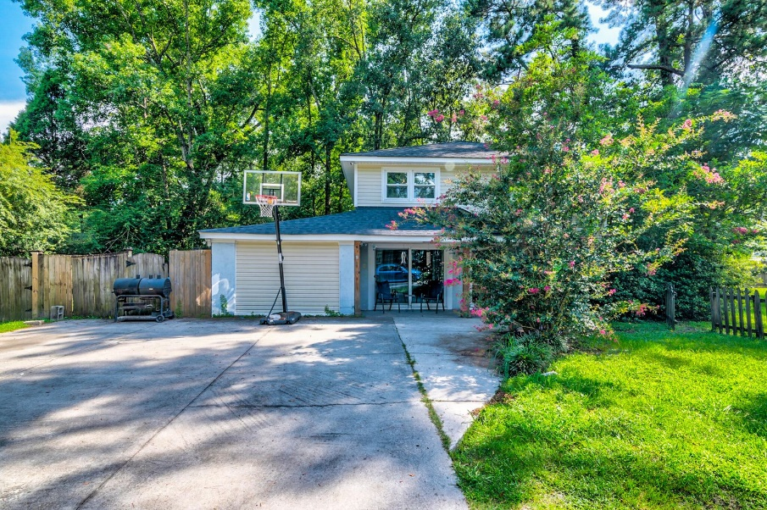
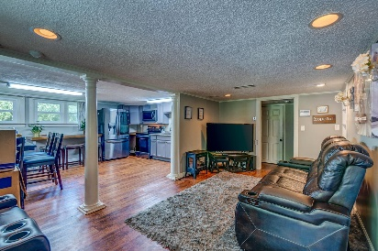
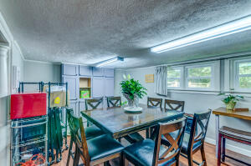
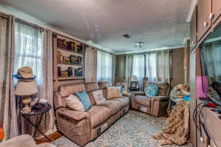
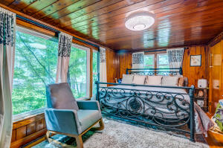
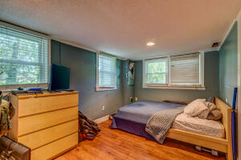
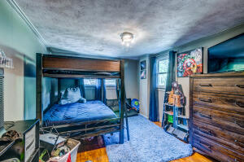
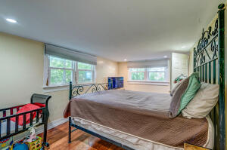
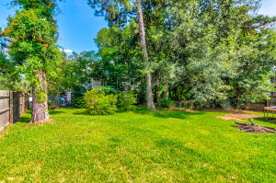



SPACIOUS HOME WITH UPDATES CLOSE TO EVERYTHING!
102 Newington Road Riley
Summerville, SC 29485
MLS# 22018287
$300,000
5 Bed | 2 Bath | 2,001 sf
Welcome home! Very spacious 5 bedroom and 2 full bathroom home in the quiet neighborhood of Riley! This highly desirable location makes this home perfect for any buyer. Upon walking in, you're greeted by open floor plan for the living room and kitchen. The recently renovated kitchen boasts newer cabinets, sink, all new stainless steel appliances, new granite countertops, separate dining area and breakfast nook area within the kitchen with additional cabinet for storage of all of your cookware! Both of the bathrooms were renovated with tiled showers, new flooring, new vanities and hardware/fixtures. The roof was also just redone in 2020! Outside you'll notice the ENORMOUS fenced yard with PLENTY of room for hosting and entertaining any outdoor events/activities. Septic tank was cleaned in 2017. Great location - close to schools, Summerville Hospital, medical facilities, shopping, restaurants, Boeing, Bosch, churches, I-26 and just a quick drive to West Ashley, Magnolia Plantation, Charleston Woodlands, etc by taking Ashley River Road. Come see this today!
Nick Mazzilli (843) 640-5575
nick@nickmcharleston.com www.mavenrealtysc.com
Maven Realty
2180 McMillan Ave
#71672
Charleston, SC 29405

